Slide 1
System Admin

Slide 2
Agenda
1
Networking
2
Operating System (OS)

Slide 3

Course Objectives (1 of 2)
At the completion of the course,
you will be able to:
Describe the basics of a network
Explain the benefits of networking
Describe the hardware requirement of the network devices
Differentiate the kinds network cables
Describe network and application protocols

Slide 4
Course Objectives (2 of 2)
Define an IP address
Define the DHCP and DNS
Describe the windows server administration
Describe the Active Directory

Slide 5
Welcome to the Day 1 Session
Topics to be covered:
Basics of Networking
Benefits of Networking
Networking Classification
Network Topologies

Slide 6
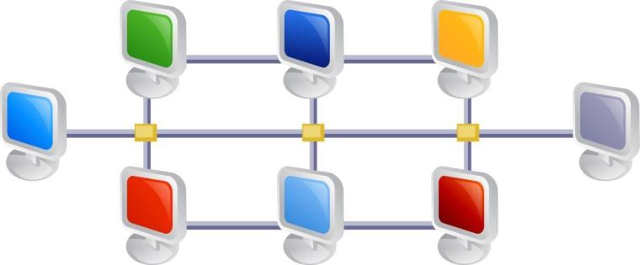
Networking (1 of 3)
Networking means linking of computers in various places using communication devices to share resources and information.

Slide 7
Networking (2 of 3)
The networking process can be a peer-to-peer or client-server.
The purpose of a network is to share resources:
Network can be used to share files and folders.
Network can be used share the resources like printer and scanner.
Network can be used for communication with others via email, text chat, voice chat, Video chat
Network can have the backup of data at a remote system.
Network can use a networked printer or scanner to complete the work.

Slide 8
Networking (3 of 3)
The kind of network is decided based on the topology of the network.
Two major branches of networking concepts are:
Protocol: It is a defined format to transmit data between two devices.
Devices: Circuit switching & Packet switching

Slide 9
Networking Methods (1 of 2)
Circuit switching is a methodology of implementing a telecommunications network in which two network nodes establish a dedicated communications channel (circuit) through the network before the nodes may communicate.

Slide 10
Networking Methods (2 of 2)
Packet switching is a digital networking communication that groups all data transmitted - regardless what is the content, type, or structure - into the suitable sized blocks, called as Packets.

Slide 11
Benefits of Networking

Slide 12

Benefits of Networking (1 of 4)
Flexibility
Sharing of files by networking computers give flexibility than using storage devices.
Documents, movies, photos and music can be shared with others.
Hardware Sharing
All the network users can share printers and scanners.
This reduces the investment cost on printers and scanners.

Slide 13

Benefits of Networking (2 of 4)
Data Sharing
Networking is to allow the sharing of data. It is used to transfer the data.
Internet Access
Internet is an enormous network, so when accessing internet a network is used.

Slide 14
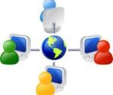

Benefits of Networking (3 of 4)
Internet Access Sharing
Computer networking allows multiple users to share single internet connection.
Data Security and Management
Networking provides the increased data security by encrypting all the data transferred through the network.

Slide 15


Benefits of Networking (4 of 4)
Performance Enhancement and Balancing
Performances of some applications are enhanced by distributing the tasks of the application among various devices on the network.
Entertainment
Network facilitates games and entertainment as the computers are connected on network and will be able to communicate to each other.

Slide 16
Networking Classification

Slide 17
Different Kinds of Network (1 of 3)
Peer-to-Peer
A peer-to-peer network is composed of two or more self-sufficient computers.
Each computer handles the entire functions, logging in, storage, providing a user interface and so on.
The computers on a peer-to-peer network can communicate, but does not depend on the resources or services available from the other computers on the network.

Slide 18
Different Kinds of Network (2 of 3)
Client-Server
The client-server network utilizes client and server computers assigned with specific purposes.
This model is used on the Internet and local area networks.
Web browsers and Web servers are example for client-server available on Internet.

Slide 19
Different Kinds of Network (3 of 3)
Server computer stores information and applications. It contains large storage space and high powered processors.
The server provides a service that the client computer needs.
Clients connect to the server across the network in order to access the service.

Slide 20

Types of Network
The types of network are:
Local Area Network (LAN)
Metropolitan Area Network (MAN)
Wide Area Network (WAN)

Slide 21

Local Area Network (LAN) (1of 2)
Local Area Network (LAN)
Local Area Network refers to geographically small networks within a room or office for file sharing, printer sharing and files transfer.
It uses Ethernet cables, network adapters and hubs to transfer data.

Slide 22
Local Area Network (LAN) (2 of 2)
Benefits of LAN
Files can be easily stored on a central computer and can be retrieved quickly.
Expensive devices like scanners or laser printers can be shared.
Cost reductions through sharing of information, network services, databases, and resources.

Slide 23
Metropolitan Area Network (MAN) (1 of 3)
Metropolitan Area Network (MAN)
Metropolitan Area Network is a computer network within a campus or a city connecting few local area networks.
It acts as an efficient gateway to a Wide Area Network (WAN).

Slide 24
Metropolitan Area Network (MAN) (2 of 3)
Features of MAN
The size of the network is between LAN and WAN. In general, it covers a city.
No single owner.
Uses OSI model layer 2 protocols.
It is a high speed network to share regional resources.

Slide 25
Metropolitan Area Network (MAN) (3 of 3)
Benefits of MAN
The size of the network is between LAN and WAN. In general, it covers a city. Metropolitan Area Network (MAN) is a computer network within a campus or a city connecting few local area networks.
It acts as an efficient gateway to a Wide Area Network (WAN).

Slide 26
Wide Area Network (WAN)
Wide Area Network (WAN)
WAN, as its name indicates, covers a broad geographical area.
Big business organizations and government agencies use WAN to transfer data to various geographical locations.
It connects many small networks like LANs or MANs.

Slide 27
WAN Connectivity Technologies (1 of 2)
PPP (Point to Point Protocol)
PPP is designed for point-to-point connection between two devices in the network.
It is a complete link layer protocol suite for devices using TCP/IP.
Leased Line
It connects two locations for private voice and data telecommunication service.
It is a reserved circuit between two points.
It maintains a single open circuit at all times.

Slide 28
WAN Connectivity Technologies (2 of 2)
Dialup
Dial-up connection is a circuit-switching technology.
It provides cost effective methods for connecting across WANs.
Integrated Services Digital Network (ISDN)
Integrates speech and data on the same lines.
It provides voice, video and text transmission between individual desktop at a time.

Slide 29
Network Topology

Slide 30

Network Topology
Network topology means the physical and logical shape and structure of a network.
Network topology is determined by the configuration of connections between the nodes.

Slide 31
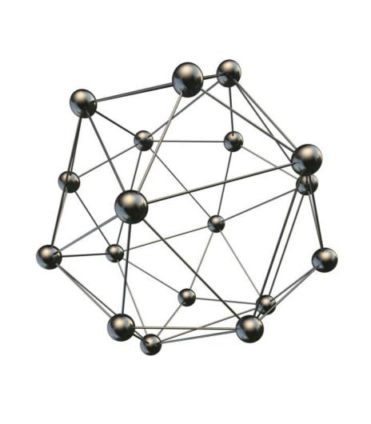
Types of Network Topology
Types of Network topology
Bus topology
Star topology
Ring topology
Mesh topology

Slide 32
Bus Topology
Bus Topology
Bus topology connects each computer to a main communication line. This main communication line is called a bus.
The signal travels from one end of the bus to the other end.
It is a passive topology as all the computers listen to a signal.

Slide 33
Bus Topology - Advantages and Disadvantages
Advantages
It is easy to implement and expand.
It is good for temporary networks.
Disadvantages
Addition of more computers brings the performance down.
The entire network will not work if there is a cable brake.

Slide 34
Star Topology
Star topology
In star topology all computer nodes are connected to a central device.
The central device can be a switch, hub or computer which acts as a router to transmit messages.

Slide 35
Star Topology - Advantages
Advantages
Star Topology is easy to implement and extend, even in the larger networks.
The failure of any nodes will not have major impact on the functionality of the network.
As each station has its own cable to the central device or hub there is no problem with Collisions of Data.
As the devices are connected using Central Device it’s easy to implement security.

Slide 36
Star Topology - Disadvantages
Disadvantages
There is no direct communication among nodes though they are located nearby.
As the devices are centrally connected, failure of the central node will become a problem as the entire network will get hampered.
Limited cable length and number of stations.
Maintenance cost may be higher in the long run.

Slide 37
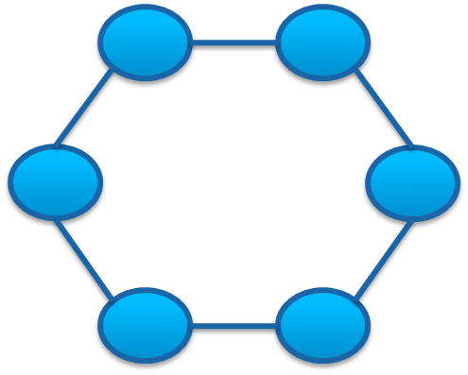
Ring Topology
Ring topology
A ring structured topology connects all the nodes (computer) so as to form a ring.
A message goes from one computer to another computer till it reaches the destination.
If a computer receives a message meant for another computer, its repeater passes this message to the next computer.

Slide 38
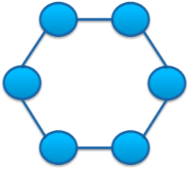
Ring Topology - Advantages
Advantages
It is easy to implement and configure.
It is easy to add new computer nodes.
Packets travel in one direction, the transmission of data is easy and simple.

Slide 39
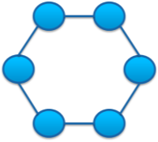
Ring Topology - Disadvantages
Disadvantages
Data packets will travel through every device between the sender and recipient.
Data traffic will fail if there is a break down in the device connecting each other fail.
The entire network will not work if there is a problem in one place.

Slide 40
Mesh Topology
Mesh topology
It is a way of routing data, voice and instructions between nodes.
It allows continuous connectivity and reconfiguration around paths which are broken or blocked.

Slide 41
Mesh Topology - Advantages
Advantages
Mesh networks are self-healing and are reliable.
The network can still operate even when one node breaks down or when a connection is not available.
This topology is decentralised and relatively inexpensive.
It can handle high volume of traffic.
Modification and expansion is very easy.

Slide 42
Mesh Topology - Disadvantages
Disadvantages
It is very expensive as there are many redundant connections.
It is used in wireless networks.
Maintenance becomes very difficult.

Slide 43

Knowledge Check
What is Networking?
Notes:
What is Networking?
Networking means linking of computers in various places using communication devices to share resources and information.

Slide 44
Knowledge Check
List the benefits of Networking.
Notes:
List the benefits of Networking.
Flexibility
Hardware sharing
Data sharing
Internet access
Internet access sharing
Data security and management
Performance enhancement and balancing
Entertainment

Slide 45
Knowledge Check
Expand LAN.
Notes:
Expand LAN.
Local Area Network (LAN)

Slide 46
Knowledge Check
List WAN connectivity technologies.
Notes:
List WAN connectivity technologies.
PPP (Point to Point Protocol)
Leased Line
Dialup
Integrated Services Digital Network (ISDN)

Slide 47
Knowledge Check
What is network topology?
Notes:
What is network topology?
Network topology means the physical and logical shape and structure of a network.

Slide 48
Knowledge Check
Mention any two network topology.
Notes:
Mention any two network topology.
Bus topology
Star topology
Ring topology
Mesh topology

Slide 49
Knowledge Check
List any two advantages of star topology.
Notes:
List the advantages of star topology.
Easy to implement and extend, even in large networks.
The failure of a non-central node will not have major effects on the functionality of the network.
No problems with collisions of data since each station has its own cable to the central device/hub.
Security can be implemented in the central device (hub/switch).

Slide 50
Knowledge Check
List any two disadvantages of ring topology.
Notes:
List any two disadvantages of ring topology.
Data packets must pass through every computer between the sender and recipient.
If any of the nodes fail then the ring is broken and data cannot be transmitted successfully.
The entire network will not work if there is a problem in one place.

Slide 51
End of Day 1 Session
Let’s meet tomorrow for the next session

Slide 52
Hardware Requirement for Network

Slide 53
Welcome to the Day 2 Session
Topics to be covered:
Hardware Requirement for Networks
Medias of Network & Types of Network Cables

Slide 54
Hardware Requirement for Network (1 of 12)
Network Cables
Network cable connects a network device to another or it connects more computers to share resources like printer and scanner.
There are different types of network cables used depending on the topology, protocol and size of the network.
Examples of network cables are Coaxial cable, Optical fiber cable and Twisted Pair cables.

Slide 55
Hardware Requirement for Network (2 of 12)
LAN Cards
It is the hardware available inside a computer to link with network.
This enables the connection of the computers in a network.
Repeater
Repeater receives signals and retransmits at a higher speed to enable the signal to travel longer distance.
It preserves signal integrity and extends the travelling distance.

Slide 56
Hardware Requirement for Network (3 of 12)
Multiplexer
Multiplexer is a device which combines two or more signals into an aggregate signal for transmission.
Multiplexer device chooses an input signal from many analog or digital signals and forwards the input signal into a line.
Several signals can share one device or resource if you use multiplexer.

Slide 57
Hardware Requirement for Network (4 of 12)
HUB
Hub receives message and sends the message to all the networked computers though the message is meant for only one computer.
It is not an intelligent device to understand the data transmitted by it.
It does not know who sends the message and who should get the message. It receives from someone and forwards to all.

Slide 58
Hardware Requirement for Network (5 of 12)
Switch
A switch connects Ethernet cables from a number of devices together.
It allows devices to talk (interact) to other devices.
Switches decide who can access various parts of a network.
Switches can be used to eliminate the possibility of data collisions in the network.

Slide 59
Hardware Requirement for Network (6 of 12)
Router
A router interconnects two or more computer networks and interchanges data packets between them.
It connects logical subnets having a different network address.

Slide 60
Hardware Requirement for Network (7 of 12)
Bridge
Bridge connects two local area networks that are using the same protocol.
It sends the received message to all computers as there is no location associated with the networked computers. Though all the computers receive the message, only the intended computer accepts the message.

Slide 61
Hardware Requirement for Network (8 of 12)
Modem
Modem stands for modulator - demodulator.
Modem enables a computer to transmit data over telephone or cable lines.
Different types of Modem
Internal modem
It is installed inside a laptop.
It communicates with other connected computers via network.

Slide 62
Hardware Requirement for Network (9 of 12)
Modem
External modem
It is a separate device which uses other interfaces to connect with a computer.
USB modem
It uses USB port only for connection.
DSL (Digital Subscriber Line) modem
It connects a computer or router to a DSL phone line.

Slide 63
Hardware Requirement for Network (10 of 12)
Wireless Access Point (WAP)
Wireless Access Point (WAP) is a device which allows
wireless devices to connect to the wired devices using
Bluetooth or Wi-Fi.

Slide 64
Hardware Requirement for Network (11 of 12)
Proxy
Proxy serves as a hub to process Internet requests.
It receives the request and processes it. Then it contacts the Internet, collects the requested information from respective web servers and returns the data.
It serves as an intermediary between you (computer) and Internet.
It is used to filter web content and to monitor downloads and uploads of data.

Slide 65
Hardware Requirement for Network (12 of 12)
Firewall
Firewall is a set of computer programs available at a network gateway server.
It protects the network resources from unauthorised users.
There are many firewall techniques. One method is to verify the authenticity of requests to make sure they come from a known domain name and Internet Protocol addresses.

Slide 66
Medias of Network & Types of Network Cables

Slide 67
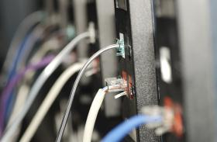

Medias of Network
The different medias of network
Wired
Wireless

Slide 68

Medias of Network - Wired (1 of 2)
Wired
In wired, all the components in the network are connected with network cables.
The transmission of information takes place through the cables.
Wired / Ethernet CSMA / CD as a one of the Media Access for the data travel. (Carrier Sense Multiple Access with Collision Detection)
CSMA/CD is used to improve the performance of CSMA by terminating transmission once collision is detected, thus reducing the time before it can try to again send the request.

Slide 69
Medias of Network - Wired (2 of 2)
Advantages
Speed - provides very fast transmission.
Security - highly secured.
Disadvantage
It is difficult to install.

Slide 70

Medias of Network - Wireless (1 of 3)
Wireless
In Wireless media, transmission of information takes place between two or more computers that are not physically connected.
It connects devices using infrared signals or radio waves as a transmission medium.
Transmission of waves takes place in the electromagnetic (EM) spectrum.

Slide 71

Medias of Network - Wireless (2 of 3)
Wireless
The three broad categories of wireless media are:
1. Radio
2. Microwave
3. Infrared

Slide 72
Medias of Network - Wireless (3 of 3)
Advantages
It is easy to install.
It gives lot of flexibility.
Disadvantages
Signal barriers.
Speed is not good as there is no physical connection.
Security: It is not highly secured. If it is not properly configured, anyone can access your network.

Slide 73
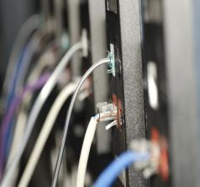
Types of Network Cables
Network Cables
Copper Wire
Co-axial cable
Twisted pair cable
Optical Fiber
Single mode
Multi-mode
Thinnet
Thicknet
UTP
STP
Refer to the notes section or the participant guide for detailed explanation
Notes:
Copper wire:
Copper wire is divided into two types:
Co-axial cable
Coaxial cable is used for cable television systems. LAN uses it to connect devices within office buildings.
This cable is made of copper or aluminium wire with an insulation layer. The insulation reduces interference and distortion.
The co-axial cable consists of two conductors that share a common axis:
The inner conductor is a straight wire, either solid or stranded.
The outer conductor is a shield or a foil.
Coaxial cable is used to carry video signals, radio signals, data signals, and measurement signals.
There are two types of Coaxial cables
Thinnet
Maximum cable length is 185mts, 0.25 inch thick.
Transmission speed is 10 Mbps.
Thicknet
Half inch rigid cable.
Maximum cable length is 500mts.
Transmission speed is 10Mbps.
2. Twisted pair cable
Twisted pair wire is used for telecommunication. This cable is made of insulated twisted copper wires.
This cable is used for voice and data transmission.
Twisted pair cable is of two types:
Unshielded Twisted Pair (UTP)
UTP is two twisted insulated wires.
It is the most commonly used form of twisted pair cable.
Shielded Twisted Pair (STP)
STP means the twisted pair of copper wires coated with an insulation coating.
It protects the transmission line from electromagnetic interference.
Different CAT cables used in UDP
Following are the quality of the cabling systems which is used to carry high frequency signals:
Cat 1
It is the cabling that meets the minimum requirements for Plain Old Telephone Service (PTOS) or analog voice.
It is also known with name Grade 1.
It is commonly called as inside wire by the Telco community.
Cat 2
It is a 100 ohm UTP system, operates Token Ring and similar networks at the speed of 1Mbps.
It is also known with name Grade 2.
The other name for Cat2 is IBM Type 3 cabling system.
Cat 3
This cable type supports applications likely till 10 Mbps and is characterized to 16 MHz
Cat 4
This cable type supports applications likely till 16 Mbps and is characterized to 20 MHz
Cat 5
Its frequency is 100 MHZ.
It is also known with the name ISO/IEC 11801 Class D cabling.
Optical Fiber
Optical fiber or Fiber optic cable is long, thin fine threads of glass, which are packed in bunches.
They are used to transmit data, voice and video over longer distance.
It transmits information using light pulses.
Fiber optic cable consists of glass threads that transmit data.
It has greater bandwidth to carry more data.
Digital data transmission is possible.
There are two types of fiber optic cable:
Single mode: Single-Mode cable is a single strand of glass fiber with a core diameter of 8 to 10 microns.
Multi-mode: Multi-mode cable is made of glass fibres, with a core diameter greater than 10 microns.
Advantages of Optical Fiber
It requires lesser maintenance.
It operates at a very high speed.
Have greater bandwidth (up to 10 Gbps) and hence carry data in bulk.
Have greater resistance to noises such as motors, radio signals or nearby wires/cables.

Slide 74

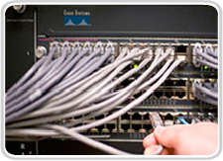

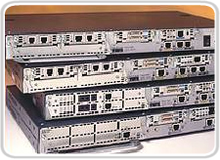

LAN Device Consideration
Cost
Ports
Speed
Expandability
Manageability

Slide 75
LAN Physical Layer Comparison
Cable length
Cost (mat. + install)
Ease of installation
Susceptibility to interference
Speed
Attenuation
Security (eavesdropping)

Slide 76
Ethernet in the Campus
10base-T
Fast Ethernet
End user
Gigabit Ethernet
Backbone

Slide 77
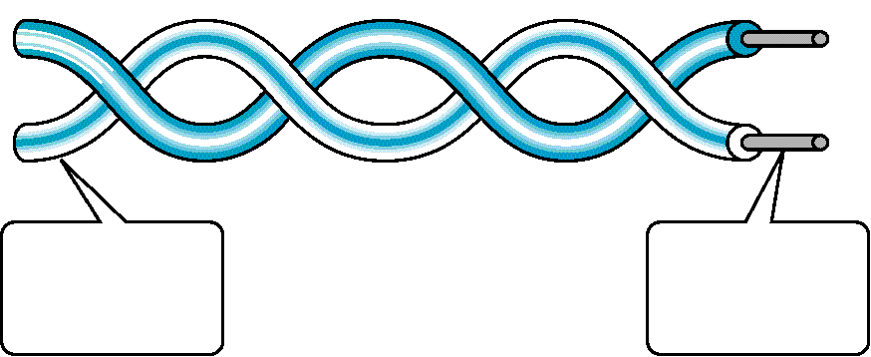
Twisted Pair Cable
100 Hz
5 MHz
Outer Insulator
(PVC)
Solid Copper
Conductors

Slide 78
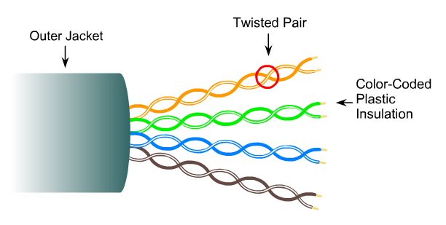
UTP (Unshielded Twisted Pair) Cables

Slide 79
UTP (Unshielded Twisted Pair) cable standard
Category | Bandwidth | Digital/Analog | Use
1 | very low | Analog | Telephone
2 | < 2 MHz | Analog/digital | LANs
3 | 16 MHz | Digital | LANs
4 | 20 MHz | Digital | LANs
5 | 100 MHz | Digital | LANs
5e | 100 MHz | Digital | LANs
6 | 250 MHz | Digital | LANs
6a | 550 MHz | Digital | LANs
7 | 600 MHz | Digital | LANs

Slide 80
UTP Cables and Ethernet
Types | UTP Cable Type | Duplex | Max Distance
10Base-T | Cat3/Cat5 | Half/Full | 100 m
100Base-T4 | Cat3 | Half/Full | 100 m
100Base-TX | Cat5 | Full | 100 m
1000Base-T | Cat5e/Cat6 | Full | 100 m
1000Base-TX | Cat6 | Full | 100 m
10GBase-T | Cat6a/Cat7 | Full | 100 m

Slide 81
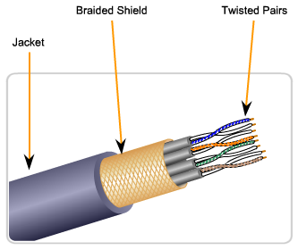
Shielded Twisted-Pair Cable

Slide 82
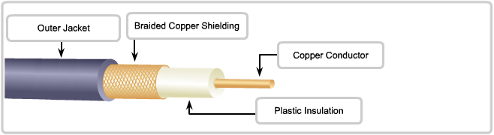
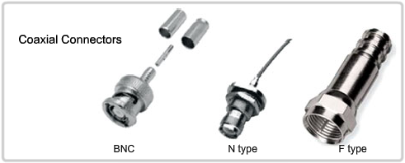
Coaxial cable
100 KHz
500 MHz

Slide 83
Coaxial cable standard
Category | Impedance | Use
RG-59 | 75 Ω | Cable TV
RG-58 | 50 Ω | Thin Ethernet
RG-11 | 50 Ω | Thick Ethernet

Slide 84
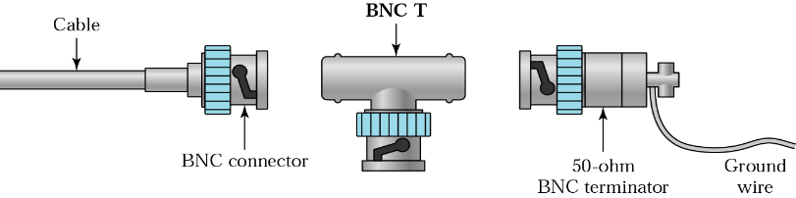
Coaxial cable connector
Barrel Connectors
Bayonet network connector (BNC)
T-connector
Terminator

Slide 85
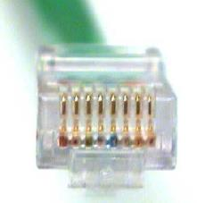
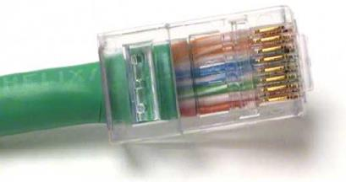
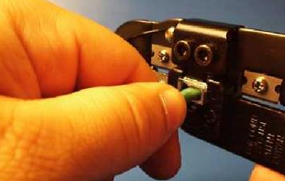
Attach the RJ-45

Slide 86
Ethernet Straight-Thru Cable
RJ-45 Connector
RJ-45 Connector
PIN #
PIN #
1
TD +
TD +
1
2
TD -
TD -
2
7
x
8
x
9
x
1
0
x
1
1
x
1
2
x
7
x
8
x
9
x
1
0
x
1
1
x
1
2
t
x
3
RD +
RD +
3
e
n
C
r
e
7
8
9
1
0
1
1
1
h
2
t
E
A
1
2
3
4
5
6
1
x
2
x
3
x
4
x
5
x
6
x
1
x
2
x
3
x
4
x
5
x
6
4
4
A
B
x
5
5
Hub
PC
6
RD -
RD -
6
7
7
8
8

Slide 87
Ethernet Crossover Cable
RJ-45 Connector
RJ-45 Connector
PIN #
PIN #
1
TD +
TD +
1
2
TD -
TD -
2
3
RD +
RD +
3
4
4
5
5
PC
6
RD -
RD -
6
PC
7
7
8
8

Slide 88
Ethernet Media and Connector
“Electronic Industries Association and the Telecommunications Industry Association” (EIA/TIA) standards
EIA/TIA-568 (SP-2840)
Commercial Building Telecommunications Wiring Standards

Slide 89
RJ-45 Color Code
1. White/Green
1. White/Orange
2. Green
2. Orange
3. White/Orange
3. White/Green
4. Blue
4. Blue
5. White/Blue
5. White/Blue
6. Orange
6. Green
7. White/Brown
7. White/Brown
8. Brown
8. Brown
EIA/TIA 568 A
EIA/TIA 568 B

Slide 90
Straight-Thru Cable
1
2
3
4
5
6
7
8
1
2
3
4
5
6
7
8
1
2
3
4
5
6
7
8
1
2
3
4
5
6
7
8
EIA/TIA 568 A
EIA/TIA 568 B

Slide 91
Crossover Cable
1
2
3
4
5
6
7
8
1
2
3
4
5
6
7
8

Slide 92
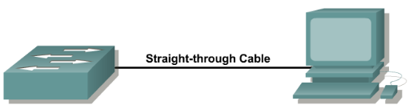
Straight-Through Cable
1
1
2
2
3
3
4
4
5
5
6
6
7
7
8
8
straight-through

Slide 93

Cross-Over Cable
1
1
2
2
3
3
4
4
5
5
6
6
7
7
8
8
cross-over

Slide 94
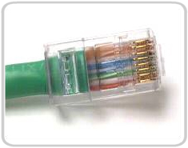
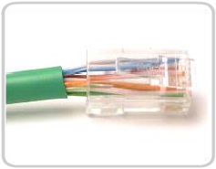
Good vs. Bad Cabling
Good
Bad
Wires are untwisted too long

Slide 95
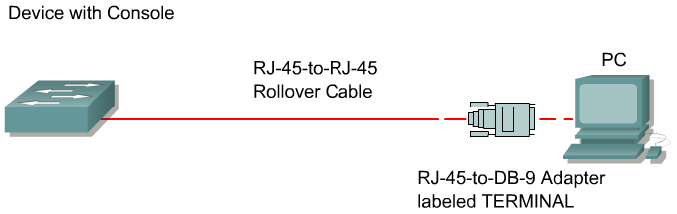
Roll-Over Cable
1
1
2
2
3
3
4
4
5
5
6
6
7
7
8
8
roll-over

Slide 96
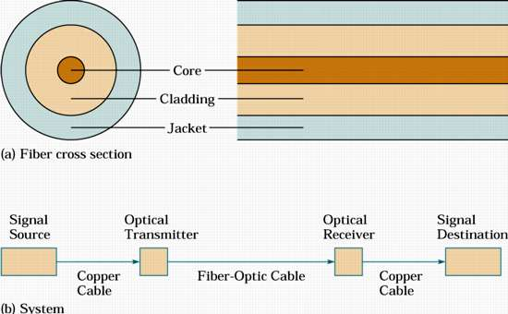
Optical Fiber & Communications System

Slide 97
Optical Fiber
Optical fiber is made from thin strands of either glass or plastic
It has little mechanical strength, so it must be enclosed in a protective jacket
Often, two or more fibers are enclosed in the same cable for increased bandwidth and redundancy in case one of the fibers breaks
It is also easier to build a full-duplex system using two fibers, one for transmission in each direction

Slide 98
Total Internal Reflection
Optical fibers work on the principle of total internal reflection
With light, the refractive index is listed
The angle of refraction at the interface between two media is governed by Snell’s law:
It is the relationship between angle of incidence and refraction.

Slide 99
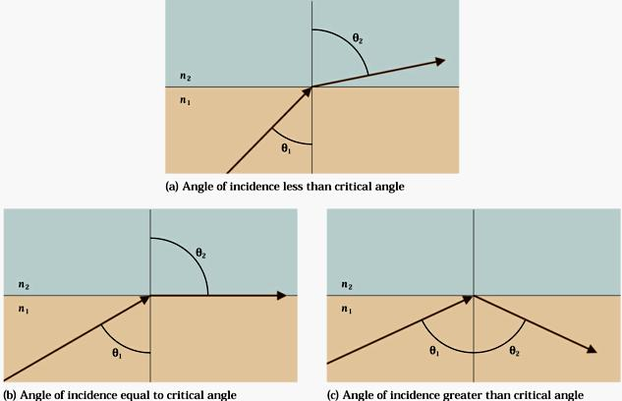
Refraction & Total Internal Reflection

Slide 100




Wireless Network (1 of 2)
PC with USB wireless adapter
Notepad with USB wireless adapter

Slide 101
Wireless Network (1 of 2)
Wireless network refers to a network that is not connected by physical cables. This method avoids the costly process of providing cable connection as a medium of communication.
Wireless network is a kind of computer network that is not connected by any type of cable.
Wireless networks use radio waves for connection.

Slide 102
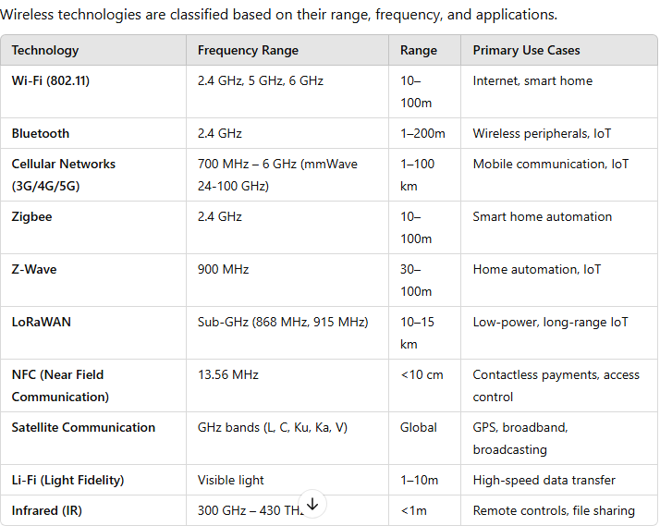
Types of Wireless Technologies

Slide 103
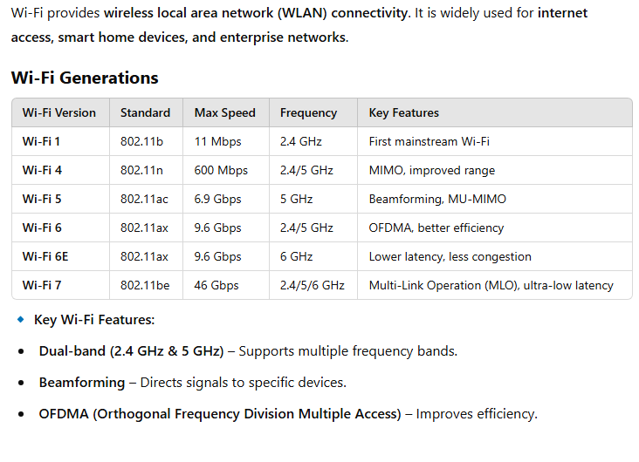
Wi-Fi Technology (IEEE 802.11)

Slide 104
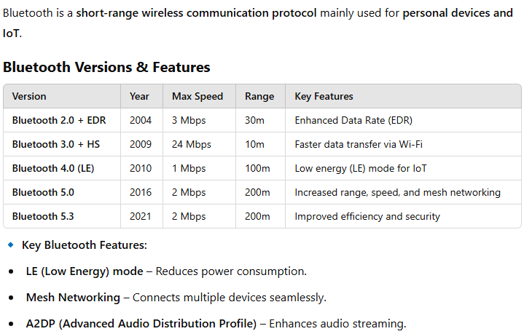
Bluetooth Technology (IEEE 802.15.1)

Slide 105
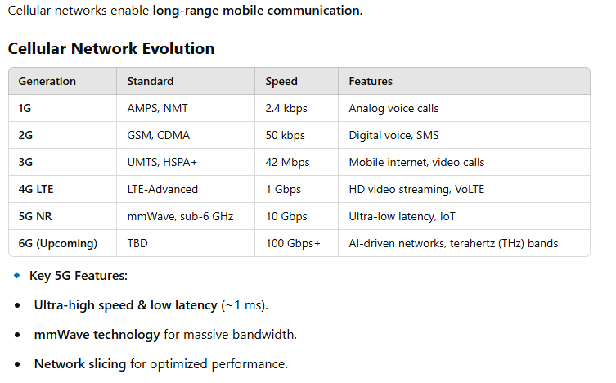
Cellular Networks (3G, 4G, 5G, 6G)

Slide 106
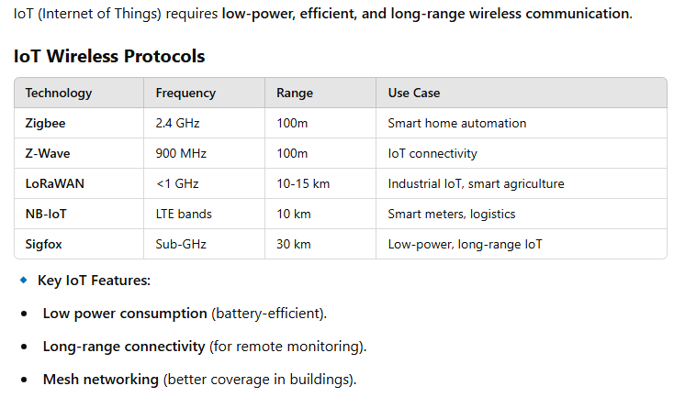
IoT Wireless Technologies

Slide 107
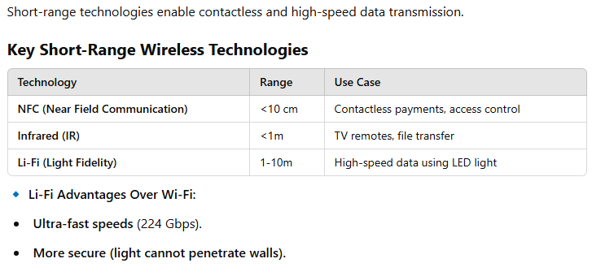
Near-Field & Short-Range Wireless

Slide 108
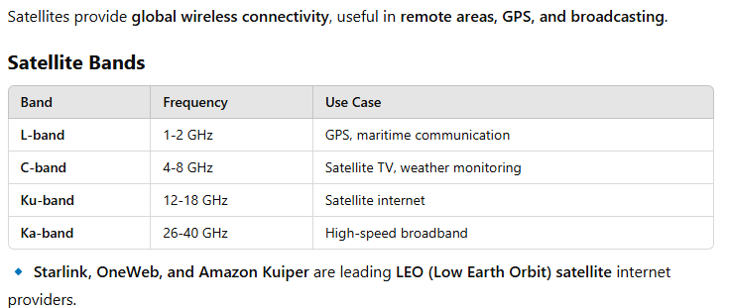
Satellite Communication

Slide 109
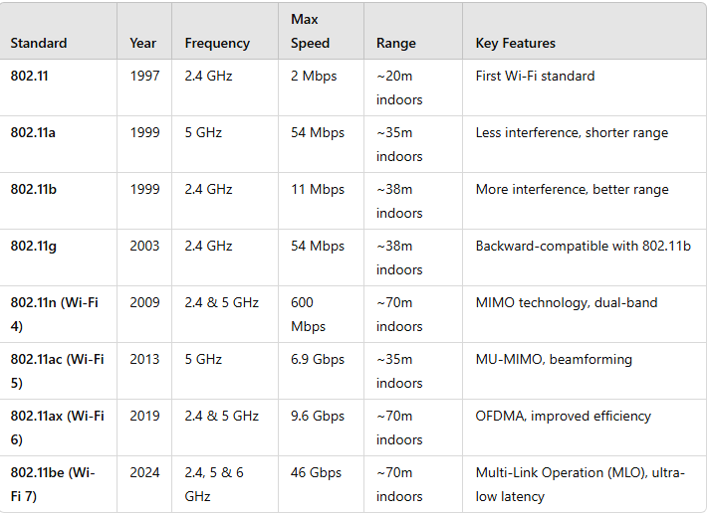
Wi-Fi Standards (IEEE 802.11)

Slide 110
Key Features in Wi-Fi Standards
MIMO (Multiple Input Multiple Output) – Allows multiple antennas to transmit and receive data simultaneously.
Beamforming – Directs signals toward the device instead of broadcasting in all directions.
OFDMA (Orthogonal Frequency Division Multiple Access) – Efficiently shares bandwidth among multiple devices.
Wi-Fi 6E – Expands Wi-Fi 6 to the 6 GHz spectrum, reducing congestion.

Slide 111
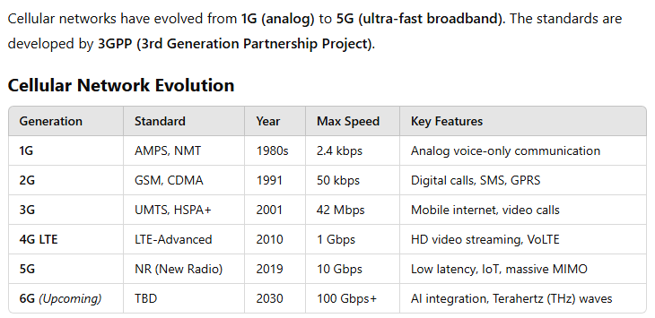
Cellular Network Standards

Slide 112
Key Technologies in Cellular Networks
GSM (Global System for Mobile Communications) – Dominant 2G technology.
CDMA (Code Division Multiple Access) – Alternative 2G/3G technology.
LTE (Long-Term Evolution) – 4G standard for high-speed mobile data.
5G NR (New Radio) – Uses millimeter waves (mmWave) and sub-6 GHz for ultra-fast data speeds.

Slide 113
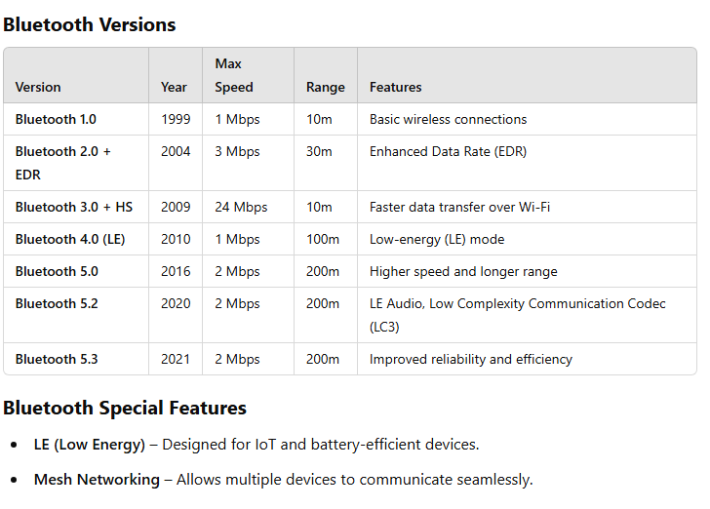
Bluetooth Standards (IEEE 802.15.1)

Slide 114
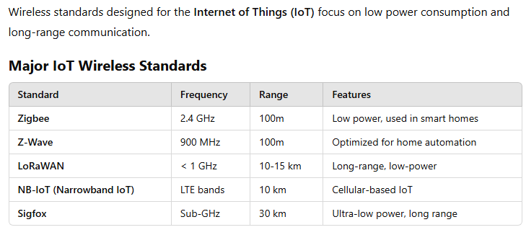
IoT Wireless Standards

Slide 115
Other Wireless Communication Standards
5.1. NFC (Near Field Communication)
Frequency: 13.56 MHz
Range: ~4 cm
Use Cases: Mobile payments (Apple Pay, Google Pay), access cards.
5.2. Infrared (IR)
Frequency: 300 GHz - 430 THz
Range: ~1m
Use Cases: TV remotes, older file transfer protocols.
5.3. Li-Fi (Light Fidelity)
Technology: Uses visible light instead of radio waves.
Speed: Up to 224 Gbps.
Use Cases: High-speed, secure wireless communication in buildings.

Slide 116
Future Trends in Wireless Communication
6.1. Wi-Fi 7 and Beyond
Uses 6 GHz spectrum for ultra-low latency.
Multi-link Operation (MLO) for better load balancing.
6.2. 6G Cellular Networks
Expected to use Terahertz (THz) frequencies.
AI-powered network optimization.
Data speeds over 100 Gbps.
6.3. Quantum Communication
Uses quantum entanglement for ultra-secure communication.

Slide 117
End of Day 2 Session
Let’s meet tomorrow for the next session

Slide 118
Welcome to the Day 3 Session
Topics to be covered:
Open System Interconnection (OSI) Model
Network & Applications Protocols

Slide 119
Open System Interconnection (OSI) Model

Slide 120

OSI Model (1 of 4)
OSI refers to a conceptual frame of work for the development of standards which makes it possible for computers and networks to inter work in a multi-vendor environment.

Slide 121
OSI Model (2 of 4)
The International Organization for Standardization developed the Open Systems Interconnection model (OSI model).
This model is called as ISO OSI reference model as it accords with connecting open systems.
System that is open for communications is known as open systems.

Slide 122
OSI Model (3 of 4)
The main aim of Open Systems Interconnection (OSI) is to permit the interconnection of computer processing systems,
From different manufacturers
Under different management
Of different ages
Of different levels of complexity

Slide 123
OSI Model (4 of 4)
Why OSI model is required?
It tells how the data communications take place in the network.
It splits the functions into seven groups called as layers. Each layer has a specified function in the OSI model.

Slide 124
Different Layers of OSI Model (1 of 4)
Application
High level applications
Application
Presentation
Syntax selection and conversion
Presentation
Session
Co-ordination of sessions
Session
Transport
End-to-end liable data transfer
Transport
Network
Network switching and routing functions
Network
Data Link
Error detection across the physical link
Data Link
Physical
Physical connection to network
Physical

Slide 125
Different Layers of OSI Model (2 of 4)
There are seven layers in OSI model. It includes:
Physical Layer (definition of hardware specifications, data transmission, and physical network design)
Data Link Layer (logical link control, media access control, data framing)
Network Layer (logical addressing, routing, error handling)
Transport Layer (middle layer)
Session Layer (TCP/IP)
Presentation Layer (translation, compression, encryption)
Application Layer (top of the stack - HTTP, FTP, SMTP, SNMP, POP3, Telnet)

Slide 126
Different Layers of OSI Model (3 of 4)
The bottom 4 layers physical, data link, network and transport are concerned with:
Physical connection between the computers.
Reliable transmission of data between the computers.
Application
Upper
layers
Presentation
Session
Transport
Network
Lower
layers
Data Link
Physical

Slide 127
Different Layers of OSI Model (4 of 4)
The top 3 layers session, presentation and application are concerned with the meaningful and cooperative exchange of information between computers.
Application
Upper
layers
Presentation
Session
Transport
Network
Lower
layers
Data Link
Physical
Refer to the notes section or the participant guide for detailed explanation
Notes:
Brief Explanation on Different layers of OSI Model:
Physical Layer
This layer manages the electrical and mechanical aspects of the physical connections that are made to the computer system.
It is concerned with transmitting raw bits over the communication channel.
It sends and receives streams of binary digits (bits i.e. 0 and 1) across a physical medium like a cable, optical fiber or a radio link.
The devices used in this layer are Repeaters, Oscilloscope, Hubs and Amplifier.
Data Link Layer
This Layer controls the error between two nodes and transfers the data through physical layer. Hubs and switches use Data link layer.
This layer ensures error-free transmission of data between two directly connected systems.
This layer breaks raw input data from physical layer into Data Frames.
This layer includes functional and procedural means to:
Transfer blocks of data.
It detects the errors in the physical transmission of the data which may have occurred.
The devices used in this layer are Switch, Bridge, ISDN Router, NIC, Intelligent Hub and Advanced Cable Tester.
Network Layer
This layer translates the logical network address and names into physical address (MAC address).
This layer provides switching and routing functions that are essential to move data.
When there is no direct communication between two systems the data is moved from the source system through intermediary nodes to the destination system.
Routes are determined based on Routing tables.
It is also responsible for segmentation of the data within a message and its reassembly at the receiving system.
The devices used in this layer are Router, ATM switch devices and Frame Relay device.
Transport Layer
It controls the end-to-end delivery of messages.
It divides the data into packets before transmission and the receiving computer re assemble the packets.
It guarantees error free data delivery.
It is essentially the link between the upper and lower parts of the OSI model.
It provides end-to-end control of a communication channel once the path has been established.
It enables a reliable and sequential exchange of data between the end systems.
The devices used in this layer are Router, Cable tester and Gateway.
Session Layer
This Layer establishes and ends the sessions across the network.
It also allows users to establish sessions on different machines.
A session may permit a user to transfer a file between two machines.
It establishes and manages a dialogue between communicating end systems.
It can allow simultaneous two-way communication or two-way alternative communications.
It provides mechanisms for recovery and re-synchronization in case a connection has been lost.
The device used in this layer is Gateway.
Presentation Layer
This Layer manages protocol conversion, data encryption and decryption, expanding graphics command and the data compression.
This layer confirms that information is transferred in such a format that can be processed by different, possibly incompatible computer systems.
It selects the appropriate syntax for data representation.
If needed, it converts data from a standardized representation used in communications to a representation that the local system can process.
The device used in this layer is Gateway Redirector.
Application Layer
Application Layer provides file transfer, electronic messaging (e-mail), virtual terminal access and network management services.
This is the highest and most complex layer of the OSI Reference Model.
It contains a variety of protocols which are commonly used.
It specifies what communication services are to be available to a computer system to allow it to co-operate with other systems in carrying out tasks.
The device used in this layer is Gateway network.

Slide 128
Different layers of OSI Model and its Functions
Layer Number | Layer | Function
7 | Application | Network process to application
6 | Presentation | Data representation, encryption and decryption
5 | Session | Interhost communication, managing sessions between applications
4 | Transport | End-to-end connections, reliability and flow control
3 | Network | Path determination, routing and logical addressing
2 | Data Link | Physical addressing and data framing
1 | Physical | Media, signal and binary transmission

Slide 129

Components of OSI Based Product (1 of 2)
OSI using computer
End User Interface
Local Processing
OSI application service interface
Application
Presentation
Session
Transport
Network
Data Link
Physical

Slide 130
Components of OSI Based Product (2 of 2)
A typical OSI based product has three major components
User interface
Local processing
OSI application service interface

Slide 131
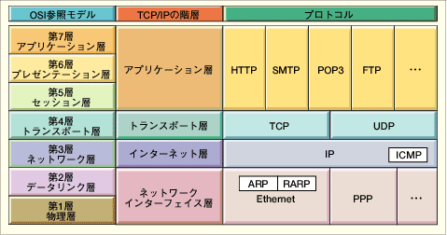
OSI and Protocol Stack
OSI: Open Systems Interconnect
OSI Model
TCP/IP Hierarchy
Protocols
7th
Application Layer
6th
Presentation Layer
Application Layer
5th
Session Layer
4th
Transport Layer
Transport Layer
3rd
Network Layer
Network Layer
2nd
Link Layer
Link Layer
1st
Physical Layer
Link Layer : includes device driver and network interface card
Network Layer : handles the movement of packets, i.e. Routing
Transport Layer : provides a reliable flow of data between two hosts
Application Layer : handles the details of the particular application

Slide 132
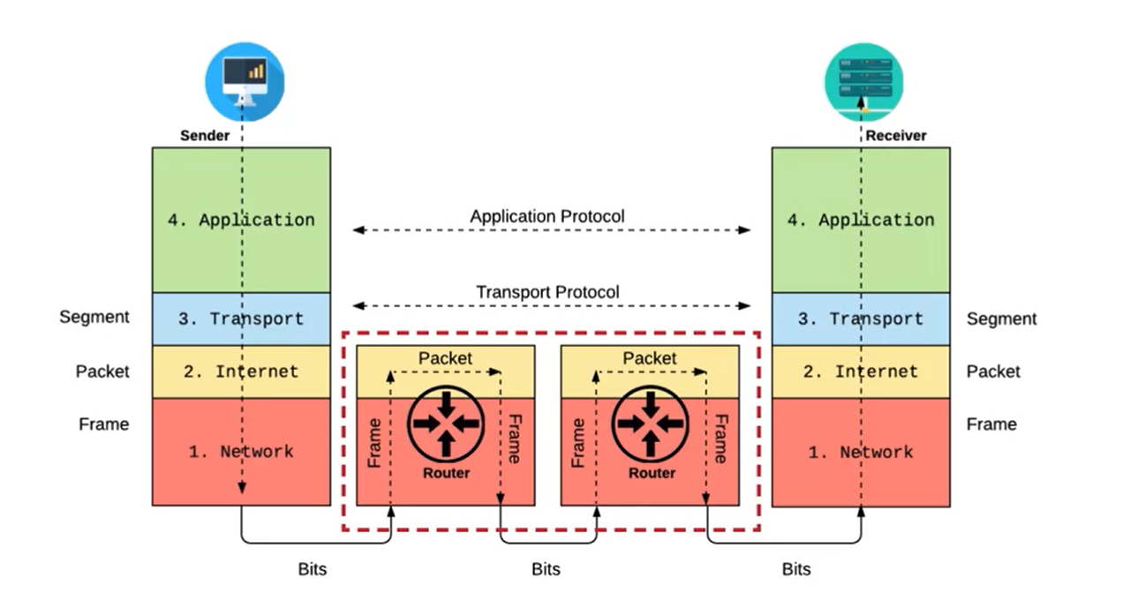
OSI and Protocol Stack
OSI: Open Systems Interconnect

Slide 133
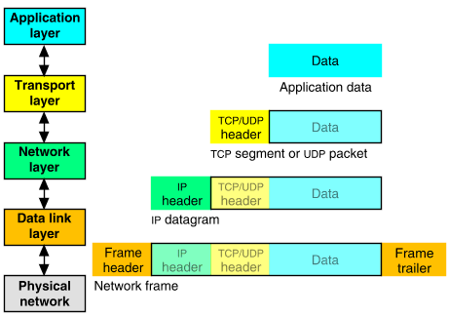
Packet Encapsulation
The data is sent down the protocol stack
Each layer adds to the data by prepending headers
22Bytes
20Bytes
20Bytes
4Bytes
64 to 1500 Bytes

Slide 134
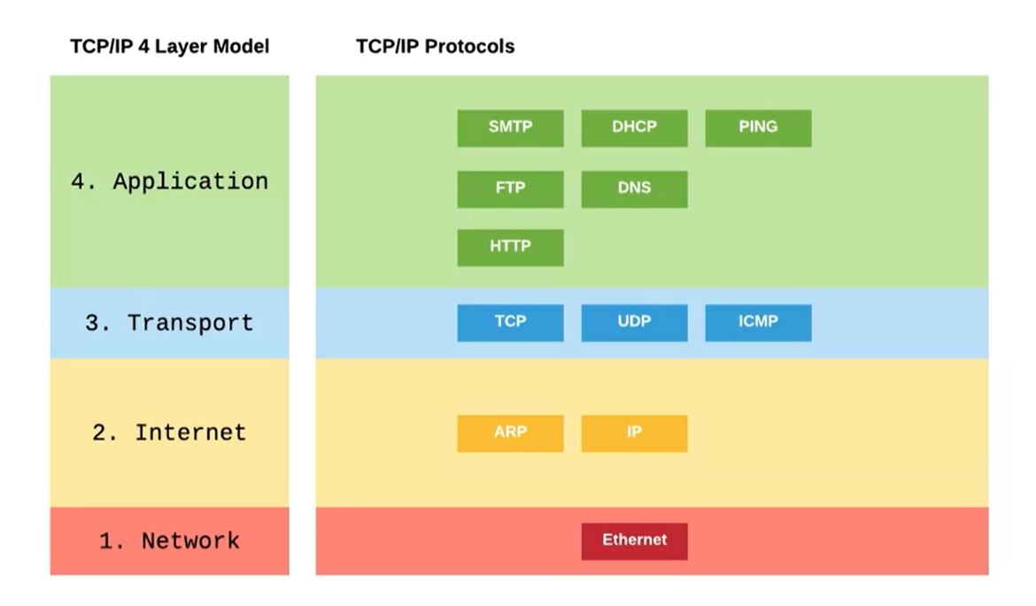
TCP/IP

Slide 135
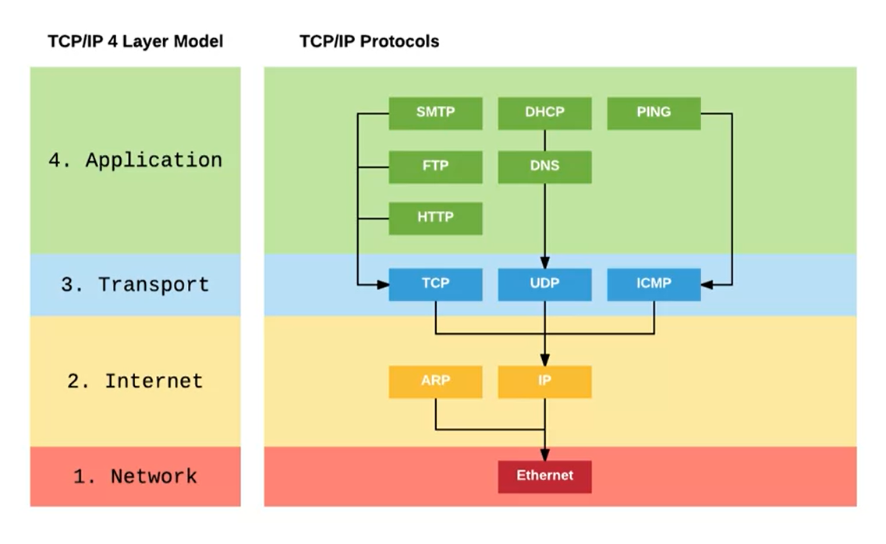
TCP/IP Protocol Stack

Slide 136
IP
Responsible for end to end transmission
Sends data in individual packets
Maximum size of packet is determined by the networks
Fragmented if too large
Unreliable
Packets might be lost, corrupted, duplicated, delivered out of order

Slide 137
IP addresses
4 bytes
e.g. 163.1.125.98
Each device normally gets one (or more)
In theory there are about 4 billion available
But…

Slide 138
Routing
How does a device know where to send a packet?
All devices need to know what IP addresses are on directly attached networks
If the destination is on a local network, send it directly there

Slide 139
Routing (cont)
If the destination address isn’t local
Most non-router devices just send everything to a single local router
Routers need to know which network corresponds to each possible IP address

Slide 140
Allocation of addresses
Controlled centrally by ICANN
Fairly strict rules on further delegation to avoid wastage
Have to demonstrate actual need for them
Organizations that got in early have bigger allocations than they really need

Slide 141
IP packets
Source and destination addresses
Protocol number
1 = ICMP, 6 = TCP, 17 = UDP
Various options
e.g. to control fragmentation
Time to live (TTL)
Prevent routing loops

Slide 142
IP Datagram
0
4
8
16
19
24
31
Vers
Len
TOS
Total Length
Identification
Flags
Fragment Offset
TTL
Protocol
Header Checksum
Source Internet Address
Destination Internet Address
Options...
Padding
Data...
Field Purpose
Vers IP version number
Len Length of IP header (4 octet units)
TOS Type of Service
T. Length Length of entire datagram (octets)
Ident. IP datagram ID (for frag/reassembly)
Flags Don’t/More fragments
Frag Off Fragment Offset
Field Purpose
TTL Time To Live - Max # of hops
Protocol Higher level protocol (1=ICMP,
6=TCP, 17=UDP)
Checksum Checksum for the IP header
Source IA Originator’s Internet Address
Dest. IA Final Destination Internet Address
Options Source route, time stamp, etc.
Data... Higher level protocol data
You just need to know the IP addresses, TTL and protocol #
Notes:
16

Slide 143
IP Routing
Source
Destination
Application
Application
Transport
Router
Transport
Network
Network
Network
Link
Link
Link
Routing Table
Destination IP address
IP address of a next-hop router
Flags
Network interface specification

Slide 144
UDP
Thin layer on top of IP
Adds packet length + checksum
Guard against corrupted packets
Also source and destination ports
Ports are used to associate a packet with a specific application at each end
Still unreliable:
Duplication, loss, out-of-orderness possible

Slide 145
UDP datagram
0
16
31
Source Port
Destination Port
Length
Checksum
Application data
Field Purpose
Source Port 16-bit port number identifying originating application
Destination Port 16-bit port number identifying destination application
Length Length of UDP datagram (UDP header + data)
Checksum Checksum of IP pseudo header, UDP header, and data
Notes:
21

Slide 146
Typical applications of UDP
Where packet loss etc is better handled by the application than the network stack
Where the overhead of setting up a connection isn’t wanted
VOIP
NFS – Network File System
Most games

Slide 147
TCP
Reliable, full-duplex, connection-oriented, stream delivery
Interface presented to the application doesn’t require data in individual packets
Data is guaranteed to arrive, and in the correct order without duplications
Or the connection will be dropped
Imposes significant overheads

Slide 148
Applications of TCP
Most things!
HTTP, FTP, …
Saves the application a lot of work, so used unless there’s a good reason not to

Slide 149
TCP implementation
Connections are established using a three-way handshake
Data is divided up into packets by the operating system
Packets are numbered, and received packets are acknowledged
Connections are explicitly closed
(or may abnormally terminate)

Slide 150
TCP Packets
Source + destination ports
Sequence number
Acknowledgement number
Checksum
Various options

Slide 151
TCP Segment
0
4
10
16
19
24
31
Source Port
Destination Port
Sequence Number
Acknowledgment Number
Len
Reserved
Flags
Window
Checksum
Urgent Pointer
Options...
Padding
Data...
Field Purpose
Source Port Identifies originating application
Destination Port Identifies destination application
Sequence Number Sequence number of first octet in the segment
Acknowledgment # Sequence number of the next expected octet (if ACK flag set)
Len Length of TCP header in 4 octet units
Flags TCP flags: SYN, FIN, RST, PSH, ACK, URG
Window Number of octets from ACK that sender will accept
Checksum Checksum of IP pseudo-header + TCP header + data
Urgent Pointer Pointer to end of “urgent data”
Options Special TCP options such as MSS and Window Scale
You just need to know port numbers, seq and ack are added
Notes:
27

Slide 152
TCP : Data transfer
Client
Host
Send Packet 1
Start Timer
Packet Lost
Timer
Packet should arrive
ACK should be sent
ACK would normally
Arrive at this time
Time Expires
Retransmit Packet1
Start Timer
Timer
Receive Packet 1
Send AXK 1
Receive ACK 1
Cancel Timer

Slide 153
Virtual Private Network (1 of 4)
Virtual Private Network (VPN) provides secure connections to private networks through the Internet.
It permits remote computers to act as local network.
Companies use VPN connection to connect geographically distributed offices.
It is used to extend intranets to disseminate information.

Slide 154
Virtual Private Network (2 of 4)
There are many VPN protocols to securely transport data over public network. The following are some of them:
Secure Sockets Layer (SSL)
Transport Layer Security (TLS)
IP security (IPSec)

Slide 155
Virtual Private Network (3 of 4)
Advantages
It is cost effective as it reduces long-distance telephone rates.
It is useful for organizations to achieve secured communications between their locations.
It avoids scalability problem.

Slide 156
Virtual Private Network (4 of 4)
Disadvantages
It requires a detailed understanding.
An organisation cannot directly control the performance of VPN.

Slide 157
Network & Applications Protocols

Slide 158
Network Protocols (1 of 5)
Network Protocol is a set of logical rules that devices must follow to
communicate. It also contains the set of Rules that will help in delivering the
messages with in the Network.
TCP / IP
Transmission Control Protocol (TCP) exchanges data between two hosts on the same network.
Internet Protocol (IP) handles addressing and routing message across one or more networks.

Slide 159
Network Protocols (2 of 5)
It provides reliable delivery of bytes from one computer to another computer.
It is the popular and widely used protocol.
There are four layers in TCP / IP. It includes:
Application Layer
Transport Layer
Internet layer
Network Access

Slide 160
Network Protocols (3 of 5)
The various protocol which operate in these layers are:
HTTP, POP3, SMTP for Application layer
TCP, UDP protocol for Transport Layer
IP for Internet layer
Ethernet for network access

Slide 161
Network Protocols (4 of 5)
IPX / SPX
IPX / SPX is a network protocol on Novell’s NetWare operating system.
It has got scalability but it is not easy to transfer data.
It did not become the Internet protocol. Now, companies are not willing to use IPX / SPX. Even NetWare started supporting TCP / IP as default protocol.

Slide 162
Network Protocols (5 of 5)
NetBIOS
NetBIOS over TCP / IP protocol allows legacy computer applications relying on the NetBIOS API to be used on TCP / IP networks.
NetBIOS was developed in the early 1980s to target small networks Now also some applications use NetBIOS.

Slide 163
Routing Protocols (1 of 2)
A routing protocol is a set of rules which are used by routers to determine the
appropriate path to forward the packets (information) towards their intended
destination.
Routing protocol defines how communication process should take place between routers.

Slide 164
Routing Protocols (2 of 2)
Routing is a process of forwarding data packets from source to destination by the routers using routing tables.
The routing process is of two types
Static routing
In static routing, routes are manually added in each router routing tables. The administrator manually enters the routes in the router's table.
Static routing does not use routing protocols.
Dynamic routing
Dynamic routing happens automatically using routing protocols.

Slide 165
Different Types of Routing Protocols (1 of 2)
BGP (Border Gateway Protocol)
It exchanges routing information between gateway hosts in a network of autonomous system.
RIP (Routing Information Protocol)
It is a dynamic routing protocol used in LAN / WAN networks.
It sends the updated routing information to the routers to keep the routers updated.

Slide 166
Different Types of Routing Protocols (2 of 2)
OSPF (Open Shortest Path First)
It selects the best routes for the destination by finding the lowest cost paths.
It is generally used in large networks.
IGRP (Interior Gateway Routing Protocol)
It is used by routers to exchange routing data in the network.

Slide 167
Knowledge Check
What is a router?
Notes:
What is a router?
A router interconnects two or more computer networks and interchanges data packets between them.

Slide 168
Knowledge Check
List any two routing protocols.
Notes:
List any two routing protocols.
BGP (Border Gateway Protocol)
RIP (Routing Information Protocol)
OSPF (Open Shortest Path First)
IGRP (Interior Gateway Routing Protocol)

Slide 169
Knowledge Check
Expand HTTP.
Notes:
Expand HTTP.
Hyper Text Transfer Protocol (HTTP).

Slide 170
End of Day 3 Session
Let’s meet tomorrow for the next session

Slide 171
Welcome to the Day 4 Session
Topics to be covered:
Application Protocols
Internet Protocol Address

Slide 172
Application Protocols

Slide 173
Application Protocols (1 of 5)
HTTP (Hyper Text Transfer Protocol)
It is the basis for World Wide Web.
You use HTTP over TCP / IP when you open a Web browser to surf the Internet.
This protocol helps to retrieve Hyper Text Markup Language (HTML) pages and other documents from web sites.

Slide 174
Application Protocols (2 of 5)
It uses port 80.
It sends all data as plain text without encryption.
HTTPS (Hyper Text Transfer Protocol with Secure Sockets Layer)
This protocol encrypts the data before transferring it over the Internet.
It uses port 443 for connection.
It encrypts all the data it sends and receives with SSL (Secure Sockets Layer).

Slide 175
Application Protocols (3 of 5)
IMAP (Internet Message Access Protocol)
This allows a user to manipulate mails in a server without retrieving them to a local computer.
SNMP (Simple Network Management Protocol)
It is an application layer protocol that facilitates the exchange of management information among network devices.
It is a simple request and response protocol.
It enables the network administrators to manage the network performance and plan for network growth.

Slide 176
Application Protocols (4 of 5)
SMTP (Simple Mail Transfer Protocol)
It is a standard protocol for sending and receiving e-mails.
POP3 (Post Office Protocol3)
It retrieves messages from a mail server to a local computer.
FTP (File Transfer Protocol)
It is a standard Internet protocol for transmitting files between computers on the Internet.

Slide 177
Application Protocols (5 of 5)
Telnet
This protocol connects you to remote computers over a TCP/IP network.
Telnet client application is used to connect to a telnet server.

Slide 178
IP Address (1 of 2)
Internet Protocol address is a unique number assigned to a Device in a network that uses the Internet Protocol for communication.
Internet Protocol Version 4 (IPv4) assigns this 32-bit IP number to computers.
The huge growth of the Internet warranted for a new addressing system called IPv6 uses 128 bits for the address.

Slide 179
IP Address (2 of 2)
The 32-bit format is written as four segments of numbers separated by periods.
Each segment can contain zero to 255. For example, 1.170.10.220 represents an IP address.
Internet Protocol refers to the way data packets are addressed and sent across the Internet.

Slide 180
How to Check an IP Address?
There are two ways to check the IP Address of the system:
IPCONFIG is a command line tool in Microsoft Windows that will display the IP Address in Windows 2000, XP, Vista or 7.
The other way to check the IP Address is to go physically to the Network Connections either in the System tray or in Network Connections under Network and Internet in Control Panel.
Refer to the notes section or the participant guide for more information
Notes:
IPConfig contains roughly around 11 commands out of which the below are main commands that can help in troubleshooting the basic network issues:
Ipconfig /all: This command will display full configuration information.
Ipconfig /release: This command will terminate any active TCP/IP connections on all network adapters and releases the IP addresses configured.
Ipconfig /renew: This command will re-establishes TCP/IP connections on all network adapters
Ipconfig /flushdns: This command will erase / Purges the DNS Resolver cache.
Ipconfig /registerdns: This command will Refreshes all DHCP leases and re-registers DNS names
To display the help on the command you should type ipconfig /? This will display the whole commands pertaining to the tool.

Slide 181
IP Addressing
32 Bits
Network
Host
8 Bits
8 Bits
8 Bits
8 Bits
Dotted
Decimal
Notation
.
.
.
172
16
122
204
Refer to the notes section or the participant guide for detailed explanation
Notes:
It follows a basic format and has specific components.
A unique 32-bit logical address is assigned to each host on a TCP/IP network.
The 32-bit logical address is divided into two parts: the host number and the network host number.
The Internet Network Information Centre (InterNIC) assigns the network number to identify a network.
An Internet Service Provider (ISP) assigns address space.
The host is identified by the host number on a network.
An IP address is a 32-bit address, which is further grouped into four octets.
The 32 bit IP address is grouped into eight bits which is separated by dots. These dots are represented in decimal format which is known as Dotted Decimal Notation.
Each bit represents a binary value in the octet. For example: 128, 64, 32, 16, 8, 4, 2, 1.
The maximum and minimum value for an octet is 255 and 0 respectively.

Slide 182
Classes of IP Address
There are five classes of IP address:
Class A - It is used for networks with large number of hosts.
Class B - It is used for medium to large networks
Class C - It is used for small local area networks
Class D - It is used for multicast and experimental purposes.
Class E - It is used for multicast and experimental purposes.

Slide 183
Different Classes of IP Address & their IP Ranges (1 of 2)
IP Address Class | Decimal Values | Theoretical IP Address range | Higher Order Bit(s)
Class A | 1 to 126 | 1.0.0.0 to 126.255.255.255 | 0
Class B | 128 to 191 | 128.0.0.0 to 191.255.255.255 | 1,0
Class C | 192 to 223 | 192.0.0.0 to 223.255.255.255 | 1,1,0
Class D | 224 to 239 | 224.0.0.0 to 239.255.255.255 | 1,1,1,0
Class E | 240 to 255 | 240.0.0.0 to 255.255.255.255 | 1,1,1,1
.

Slide 184
Different Classes of IP Address & their IP Ranges (1 of 2)
The IP address 127.0.0.1 is the loopback address of a computer, which is used to establish an IP connection to the computer used by an end user or to the same machine.
IP address formats A, B and C are available for commercial use.
The class of address can be determined by examining the first octet of the address and mapping that value to a class range. In an IP address of 172.31.1.2, for example, the first octet is 172. Because 172 falls between 128 and 191, 172.31.1.2 is a Class B address.

Slide 185
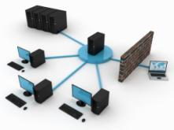
Subnetting (1 of 2)
IP networks are further divided into small networks called as sub networks or subnets.
It allows the organization to access the Internet with single shared network address.
For example: the given network address can be divided into several subnet works. For example, 172.16.1.0, 172.16.2.0, 172.16.3.0, 172.16.4.0. Now these are all subnets within network 171.16.0.0.

Slide 186

Subnetting (2 of 2)
Subnetting provides
More efficient use of network addresses
Capability to contain broadcast traffic
Extra flexibility

Slide 187

How to do Subnetting? (1 of 6)
Bits are acquired from the host address field to produce the subnet address field.

Slide 188
How to do Subnetting? (2 of 6)
Class B Address: Before Subnetting
1
0
Host
Host
1
0
Subnet
Host
Class B Address: After Subnetting

Slide 189
How to do Subnetting? (3 of 6)
A subnet address is produced by “acquiring/borrowing” bits from host field and sending them as the subnet field. The subnet mask specifies the varied number of acquired bits. The above diagram illustrates how bits are borrowed from the host address field to create the subnet address field.
Subnet masks use the same representation technique and format as IP addresses.
The subnet mask contains:
Binary 1s in all bits which specifies the network and subnet work fields.
Binary 0s in all bits which specifies the host field.

Slide 190
How to do Subnetting? (4 of 6)
Network
Network
Subnet
Host
Binary representation
11111111
11111111
11111111
00000000
Dotted Decimal representation
255
.
255
.
255
.
0

Slide 191
How to do Subnetting? (5 of 6)
The above figure consisting of binary 1s and 0sillustrates a sample subnet mask. The bits in the subnet mask should come from the left-most or high-order bits of the host field.
The subnet mask for a Class B address is 255.255.0.0 which is default and has no subnetting.
The subnet mask for a Class B address 171.16.0.0 is 255.255.255.0, which specifies eight bits of sub netting.

Slide 192
How to do Subnetting? (6 of 6)
The reason for this is that eight bits of sub netting or 2^8 – 2 (1 for the network address and 1 for the broadcast address) = 254 subnets possible, with 28 – 2 = 254 hosts per subnet.
The subnet mask for a Class C address 192.168.2.0 indicates that five bits of sub netting is 255.255.255.248. With five bits available for subnetting and the subnets possible are 2^5 – 2 = 30 with 2^3 – 2 = 6 hosts per subnet.

Slide 193
Variable Length Subnet Masking (VLSM) (1 of 5)
Subnet means the area based local area network.
The main drawback with conventional subnetting is that the subnet ID shows only one additional hierarchical level.
The solution is in the improvement of the basic subnet addressing design which is called as Variable Length Subnet Masking.
The subnet mask saves a router from handling an entire IP address.

Slide 194
Variable Length Subnet Masking (VLSM) (2 of 5)
Variable Length Subnet Masking is a technique for which subnetting is performed multiple times to permit a network to be separated into a hierarchy of subnetworks that differ in size.
The VLSM enables networks efficiently use the IP address space.
Variable length subnet mask (VLSM) is a sequence of variable length numbers to streamline packet routing within the subnets of a network.

Slide 195
Variable Length Subnet Masking (VLSM) (3 of 5)
VLSM facilitates network administrator to use a long mask on network with few hosts and a short mask on subnet with many hosts.
This allows an organization to equate the size of its subnets to the needs of its networks.

Slide 196
Variable Length Subnet Masking (VLSM) (4 of 5)
Class C (/24) network split into eight conventional subnets

Slide 197
Variable Length Subnet Masking (VLSM) (5 of 5)
62 hosts
126 hosts
Class C (/24) network split into VLSM

Slide 198
Private IP Address and Public IP Address (1 of 2)
Any computer available on the Internet is identified only by its IP address. Network Information Centre registers IP addresses to avoid any conflicts.
Private IP address is used in a private network and it is not shared on the Internet. The computer with private IP address does not have any information to share with other computers on the Internet.
Private address can be in between any of the following ranges:
192.168.0.0 - 192.168.255.255
172.16.0.0 - 172.31.255.255
10.0.0.0 - 10.255.255.255

Slide 199
Private IP Address and Public IP Address (2 of 2)
Public IP Address is open and visible to all other people on the Internet. Since it is visible to other computers, anyone can access your computer using this IP address as if they access any web server. It is also known as Static IP Address.
Public address can be in between any of the following ranges:
1.0.0.0 to 126.0.0.0
128.0.0.0 to 191.0.0.0
192.0.0.0 to 223.0.0.0
224.0.0.0 to 239.0.0.0
240.0.0.0 to 255.0.0.0

Slide 200
End of Day 4 Session
Let’s meet tomorrow for the next session

Slide 201
Welcome to the Day 5 Session
Topics to be covered:
Dynamic Host Configuration Protocol (DHCP)
Domain Naming Services (DNS)
Windows Server Administration

Slide 202
Dynamic Host Configuration Protocol (DHCP)

Slide 203
Dynamic Host Configuration Protocol (DHCP) (1 of 2)
Dynamic Host Configuration Protocol (DHCP) is a client-server based network configuration protocol.
It provides configuration information and IP address to its Internet Protocol host.
An IP address is to be assigned to a computer to facilitate it to communicate with other hosts.
It assigns IP address to individual computers in a network.

Slide 204
Dynamic Host Configuration Protocol (DHCP) (2 of 2)
It maintains a central database with network connected devices to eliminate duplicate resource assignment.
It is used for IPv4 and IPv6.
IPv6 hosts use stateless address auto configuration and IPv4 hosts use link local address to get limited local connectivity.
Apart from IP addresses, DHCP provides other configuration information like network boot servers and the IP addresses of local Domain Name Server.
Notes:
You need to have an understanding of basic TCP/IP concepts to understand DHCP.MS Windows Server 2003 includes a DHCP Server service. It is an optional networking component.

Slide 205
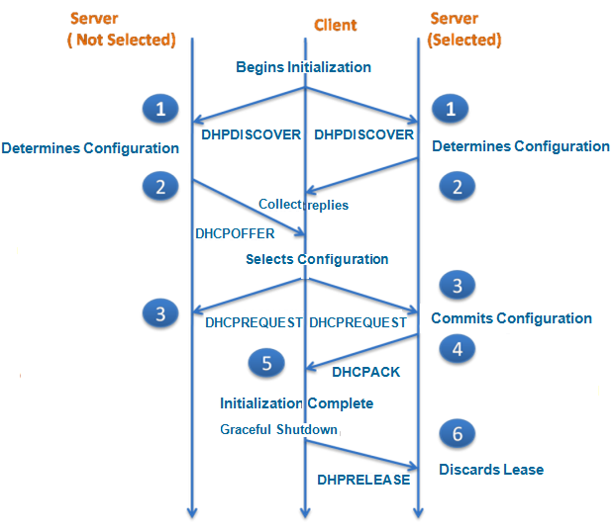
DHCP Communication

Slide 206
How to Configure DHCP?
The process of configuring the DHCP service is:
Create a scope after installing and starting the DHCP service.
Note: Ensure your DHCP server to have minimum one scope without any
overlap with any other DHCP server scope.
When you configure the DHCP service, the server is authorized at the time of you adding the server.
To authorize a DHCP server, click Start, then click Control Panel.
In the next step, click System and Security, and then click Administrative Tools.
Click System Configuration and select the Services tab.
You can enable your DHCP.

Slide 207
DHCP Communication & IP Allocation Process (1 of 2)
The client broadcasts a DHCPDISCOVER.
The server responds with a DHCPOFFER message.
The client receives DHCPOFFER message from one or more servers and decides which one to choose to request configuration parameter.
The client then broadcasts a DHCPREQUEST message to the server.
The servers not selected by DHCPREQUSET message takes the message as a declination by the client servers.

Slide 208
DHCP Communication & IP Allocation Process (2 of 2)
The client gets configured when it receives a DHCPACK message with configuration parameter.
The Client starts the configuration process, as it receives the DHCPNAK message.
If the client sends DHCPRELEASE message to the server it means that the client has chosen to may abandon the lease on a network address.
When the server receives the DHCPRELEASE message it marks the client as free.

Slide 209
IP Allocation Process (1 of 2)
DHCP servers may follow three methods to allocate the IP address:
Automatic Allocation
In automatic allocation the client is assigned a permanent free IP address within a given range.
The DHCP server keeps a record of the IP address used to correctly assign the client the same IP address which it possessed previously.

Slide 210
IP Allocation Process (2 of 2)
Dynamic Allocation
During network initialisation, DHCP is assigned a range of IP address for the client computer to request an IP address from the DHCP server.
This process uses the lease concept with a time period so that the DHCP server can reclaim, reallocate then on-renewal IP addresses.
Static Allocation
In static allocation, the DHCP server allocates the manually filled in IP address based on MAC address/ IP address pairs.

Slide 211

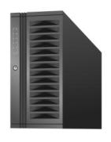
DHCP IP Allocation Process
Non-DHCP Client:
Static IP
configuration
DHCP Client2:
IP configuration from
DHCP server
Lease Renewal
Lease Generation
DHCP Server
DHCP Database
DHCP Client1:
IP Configuration from
DHCP server
IP Address1: Leased to DHCP Client1
IP Address2: Leased to DHCP Client2
IP Address3: Available to be leased

Slide 212

DHCP Reservation (1 of 2)
Reservation means the assignment of permanent IP address. A specific IP address within a scope is permanently reserved to a specific DHCP client.

Slide 213

DHCP Reservation (2 of 2)
Workstation 1
File and Print
Server
Subnet A
Subnet B
DHCP Server
Workstation 2
IP Address 1: Leased to workstation 1
IP Address 2: Leased to workstation 2
IP Address 3: Reserved for file and print server

Slide 214
Lease of DHCP IP Address
The DHCP controls a pool of information and IP addresses about client configuration parameters.
The DHCP assigns an IP address, a lease, and other IP configuration parameters to the computer.
The request and grant process uses a lease permitting the DHCP server to call back IP addresses that are not renewed.
Reservation means the assignment of permanent IP address. A specific IP address within a scope is permanently reserved to a specific DHCP client.

Slide 215
Benefits of DHCP (1 of 2)
IP address configuration
Avoids configuration errors that may appear during manual configuration.
IP address conflicts
Avoids the problem of assigning one IP address to more than one computer.

Slide 216
Benefits of DHCP (2 of 2)
It eliminates the manual intervention of network administrator and prevents any human errors.
DHCP decreases the amount of administrative work and complexity by using automatic TCP/IP configuration.
Facilitates centralised and automated configuration of TCP/IP.
Reduces the network administration related problems.

Slide 217

DHCP Scopes (1 of 2)
DHCP scope indicates a range of valid IP addresses that can be leased by the DHCP clients.

Slide 218


DHCP Scopes (2 of 2)
DHCP Server
LAN A
LAN B
Scope A
Scope B
Refer to the notes section or the participant guide for more information
Notes:
A scope must be rightly described and actuated before DHCP clients can use the DHCP server for automatic TCP/IP configuration.
A DHCP scope is an authoritative set of IP addresses and TCP/IP configuration parameters
These are valid for lease to DHCP clients of a meticulous subnet.
The network administrator develops a scope for every subnet.
Each DHCP scope has a single constant series of IP addresses. To employ various address ranges in a single scope, first describe the complete address range for the scope, and then fix exclusion ranges.

Slide 219
Scope Properties
Following are the scope properties
Network ID
Subnet mask
Network IP address range
Lease duration
Router
Scope name
Exclusion range
Refer to the notes section or the participant guide for more information
Notes:
Following are the scope properties in detail:
When the scope is created, a scope name is assigned.
A range of accessible IP addresses from which to exclude or include IP addresses applied in DHCP lease offers.
An individual subnet mask, which completes the network ID for an IP address in the scope.
Lease duration values.

Slide 220
Domain Name System (DNS)

Slide 221
Introduction to Domain Name System (DNS)
(“.” Root)
Other top level
domains
Parent Domain
Com
Contoso
Edu
Org
Root Domain
printserver
pay roll
accounts
Child Domain

Slide 222
Domain Name System (DNS)
Domain names are the names organised in a tree, which are then split into zones, each one of them delivered by a name server.
The DNS (Domain Name System) is a standard technology for managing the names of websites and other Internet domains.
A DNS server is a computer registered to join the Domain Name System.

Slide 223
Domain Name Space
The domain name space includes a tree of domain names.
Every leaf or node in the tree has zero or additional resource records
The additional resource records contain data or information connected with the domain name.
At the beginning of the root zone, the tree is sub-divided into zones.
A DNS zone includes a collection of linked nodes authoritatively served by an authoritative name server.

Slide 224
Parts of Domain Name Space (1 of 2)
The various parts of a domain name space
A domain name generally includes two or more parts (technically labels).
The domain name is written (example.com) separated by dots.
The rightmost label gives information about the top-level domain (.com).
The label to the left indicates a subdivision, or subdomain of the domain above it (example).
The subdivision can go down 127 levels.

Slide 225
Parts of Domain Name Space (2 of 2)
Each label can have up to 63 octets.
The total length of the domain name should not exceed 253 octets.
A hostname refers to a domain name that has one or more associated IP addresses.
For example: ‘example.com’ and ‘www.example.com’ domains are both hostnames, but still the ‘com’ domain is not.

Slide 226
Benefits of DNS
DNS offers many benefits. Some of them are as follows:
Security
Provides high security to data and prohibits unauthorized people to access data.
Errors detection
It is capable of automatically detecting errors. It checks for the possible error when
there is an update and reports it. This prevents the failure of DNS.
Easy to use
It is very easy to use this and maintain.

Slide 227
How to Configure DNS? (1 of 2)
Steps to configure the primary DNS suffix of the client computer:
Click the Performance and Maintenance in Control Panel.
Open System in Control panel.
Click the Computer Name tab. The tab Computer Name displays the domain or workgroup, the computer name and a brief description of the computer it belongs to.
Click Change, then click More.

Slide 228
How to Configure DNS? (2 of 2)
Steps to configure the primary DNS suffix of a DNS Suffix and NetBIOS
Computer Name:
Specify the DNS suffix which is to be tagged to the name of the computer while completing its fully qualified domain name (FQDN).
After the changes have been applied, restart the computer to initialize the new DNS domain name.
If the DNS server has been configured and installed in a system make sure that the zone authority records are updated.
The zone authority records include start of authority (SOA) and name server (NS) resource records.

Slide 229
DNS Zones and Forward Zones
The DNS zones are used to map practical, name based domains to numerically identified Internet resources. DNS problems can prevent you from visiting Web sites. If you face connection problems, ensure that DNS is not creating that problem by pinging the site that you are not able to connect.
Forward zone refers to a specific configuration of caching name servers. The domain name resolution is forwarded to another authoritative name server.

Slide 230
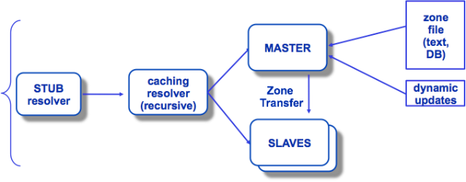
DNS Data Flow

Slide 231
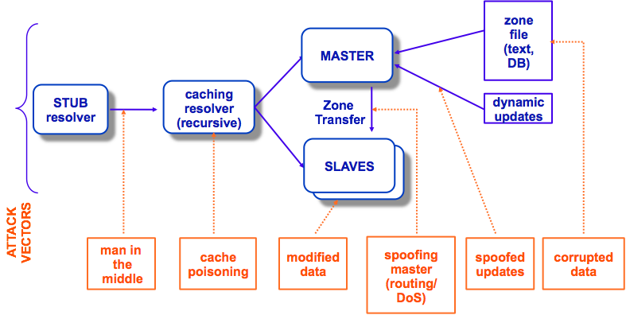
DNS Vulnerabilities

Slide 232
DNS Vulnerabilities
Cache-poisoning
DNS interception
Confidentiality
Reliability
Integrity
Reflection attacks
Which of these does DNSSEC address?

Slide 233
DNS Packet Format
DNS (Domain Name System) uses a specific packet format for communication between clients (resolvers) and servers. The DNS packet is divided into two main types:
DNS Query: Sent by a client to request information.
DNS Response: Sent by a DNS server with the requested information.

Slide 234
DNS Packet Structure
The DNS packet consists of the following fields:
Header (12 bytes)
Question Section
Answer Section
Authority Section
Additional Section

Slide 235
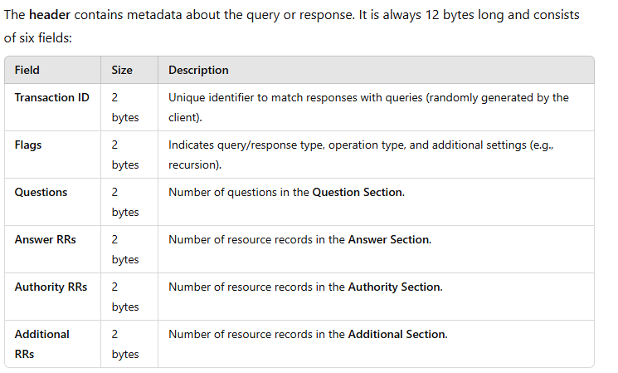
Header (12 bytes)

Slide 236
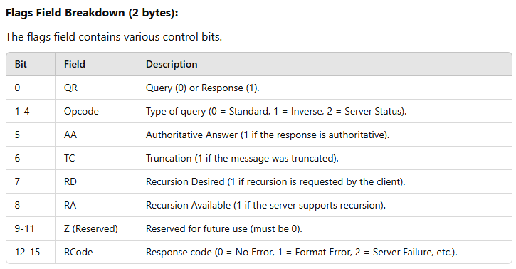
Header (12 bytes)

Slide 237
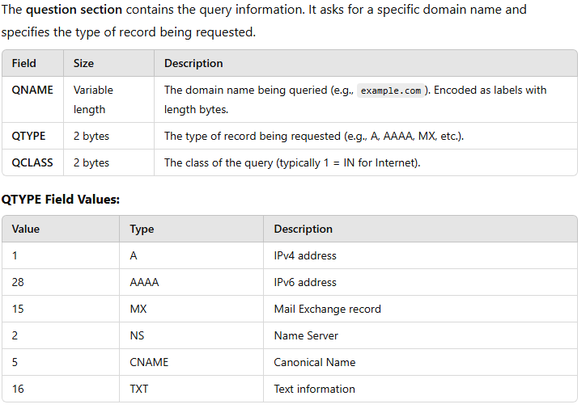
Question Section

Slide 238
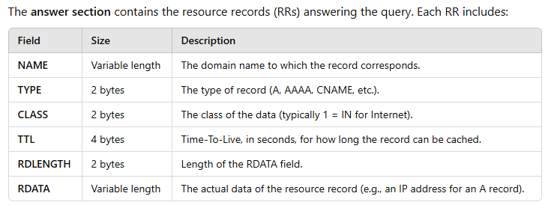
Answer Section

Slide 239
Authority Section
This section contains resource records pointing to authoritative name servers for the queried domain. It is structured the same as the Answer Section, including:
NAME
TYPE
CLASS
TTL
RDLENGTH
RDATA

Slide 240

DNS Packet Example

Slide 241
DNS Hierarchy
The Domain Name System (DNS) is a hierarchical and decentralized naming system used to resolve human-readable domain names (like example.com) into IP addresses (like 192.0.2.1).
The hierarchy ensures efficient name resolution by organizing domain names into levels.

Slide 242

Structure of DNS Hierarchy

Slide 243

Structure of DNS Hierarchy

Slide 244

Structure of DNS Hierarchy

Slide 245

Structure of DNS Hierarchy

Slide 246

Structure of DNS Hierarchy

Slide 247

Structure of DNS Hierarchy

Slide 248

Structure of DNS Hierarchy

Slide 249

Structure of DNS Hierarchy

Slide 250
Structure of DNS Hierarchy
Advantages of DNS Hierarchy
Scalability:
Distributed system allows billions of domain names to coexist.
Efficiency:
Caching at various levels (resolver, local, TLD) reduces query time.
Fault Tolerance:
Anycast and distributed root servers provide high availability.
Flexibility:
Subdomains enable easy organization of web services.

Slide 251
DS Record (Delegation Signer Record)
A Delegation Signer (DS) record is a type of DNS record used in DNSSEC (Domain Name System Security Extensions).
It establishes a chain of trust between a parent domain (like a top-level domain, TLD) and a child domain by securely linking the child's DNSKEY record with the parent zone.

Slide 252
Purpose of DS Record
Chain of Trust: DS records create a secure link between the parent zone and the child zone, forming a chain of trust.
DNSSEC Validation: Facilitates the validation of DNSSEC-signed records by providing a cryptographic hash of the child zone's DNSKEY.
Prevents Spoofing: Ensures that the DNS records have not been tampered with and originate from an authoritative source.

Slide 253

Structure of a DS Record

Slide 254

How DS Records Work

Slide 255
DNSSEC (Domain Name System Security Extensions)
DNSSEC (Domain Name System Security Extensions) is a set of security protocols that adds authentication and data integrity to the DNS system.
It prevents attacks such as DNS spoofing and cache poisoning by ensuring that DNS responses are authentic and have not been tampered with during transit.

Slide 256
Purpose of DNSSEC
Authenticate DNS Data: Ensures that DNS responses come from the correct and authoritative source.
Data Integrity: Guarantees that the data received matches what was originally published by the domain owner.
Prevent Attacks: Protects against DNS spoofing and cache poisoning, where attackers attempt to redirect users to malicious sites by providing false DNS data.

Slide 257
How DNSSEC Works
Key Components of DNSSEC
Digital Signatures:
DNSSEC digitally signs DNS records using private keys.
Public keys are distributed through DNS records, allowing resolvers to verify the signatures.
Public-Key Cryptography:
The domain owner generates a key pair:
Private Key: Used to sign DNS records.
Public Key: Published in the DNS as a DNSKEY record.
Chain of Trust:
DNSSEC creates a hierarchy of trust starting from the root zone.
Each zone (root, TLD, domain) authenticates the next level by signing its public key.

Slide 258
How does DNSSEC Protect Internet Users?
DNSSEC (Domain Name System Security Extensions) enhances the security of the Domain Name System (DNS) by preventing attacks such as DNS spoofing, cache poisoning, and man-in-the-middle attacks.
It ensures that users are directed to legitimate websites and not to malicious imposters.

Slide 259

What Threats Does DNSSEC Prevent?

Slide 260

DNSSEC Records

Slide 261

DNSSEC Records

Slide 262

DNSSEC Records

Slide 263

Chain of Trust in DNSSEC

Slide 264
Advantages of DNSSEC
Data Authenticity:
Ensures DNS responses are genuine.
Data Integrity:
Prevents tampering with DNS records.
Protection Against Attacks:
Mitigates DNS spoofing and cache poisoning.
Trust in the Internet:
Strengthens overall internet security infrastructure.

Slide 265
Limitations of DNSSEC
Deployment Complexity:
Requires correct key management and signing processes.
Does Not Provide Encryption:
DNSSEC ensures authenticity but does not encrypt DNS traffic (use DNS-over-HTTPS or DNS-over-TLS for encryption).
Increased Packet Size:
Adds overhead to DNS packets due to signatures.
Partial Adoption:
Not all domains and resolvers support DNSSEC.

Slide 266

Step-by-Step Guide to Manage DNSSEC for a Domain Name

Slide 267

Step-by-Step Guide to Manage DNSSEC for a Domain Name

Slide 268

Step-by-Step Guide to Manage DNSSEC for a Domain Name

Slide 269

Step-by-Step Guide to Manage DNSSEC for a Domain Name

Slide 270

Step-by-Step Guide to Manage DNSSEC for a Domain Name

Slide 271

Step-by-Step Guide to Manage DNSSEC for a Domain Name

Slide 272

Test DNSSEC Configuration

Slide 273

Maintain DNSSEC

Slide 274

Maintain DNSSEC

Slide 275
Handle DNSSEC Errors
DNSSEC misconfiguration can break DNS resolution. Common issues include:
Missing or Incorrect DS Records:
Ensure the DS record at the parent zone matches the hash of your KSK.
Signature Expiry:
Regularly resign the zone to prevent expired RRSIG records.
Broken Chain of Trust:
Ensure all DNSKEY records are signed correctly and linked to the parent zone.

Slide 276

DNSSEC Implementation Flow

Slide 277
Key Operations of DNSSEC
The operation of DNSSEC involves the following steps:
Key Generation & Signing
Zone Signing Process
Chain of Trust
DNS Query with DNSSEC Validation
Resolver Verification
Error Handling & Failure Scenarios
Each of these steps ensures that DNSSEC functions correctly and prevents DNS attacks.

Slide 278

Hypertext Transfer Protocol (HTTP)

Slide 279
What is an enterprise application?
Software that performs business functions such as accounting, customer information management, sales and so on
Aims to improve the organization's performance
Software application for the enterprises of today…and tomorrow…
Need for rapid scalability (both in terms of volume and geographical spread)
Need to accommodate multiple types of device access
Need to integrate with diverse software applications
Need to be very change-friendly
High degree of security reliability and performance

Slide 280
Enterprise application n-tier architecture
Browser
firewall
Application Client
Services
Presentation logic
Business Logic
XML
documents
DB

Slide 281
What is a web application?
Client accesses applications using a browser.
Client typically requests for a static or dynamic resource/page from a server connected to the internet. This server is a web server.
The client typically gets back HTML page as response that can view in the browser. Further interaction with the server can happen using the HTML page.

Slide 282
Static and Dynamic resource/page
Static pages/resources are the files that are pre-created in a particular path in the web server.
Dynamic pages are created by the application on the fly.

Slide 283
Web server
Request for a static resources is met by the web server.
The web server understands HTTP protocol.
Example: Apache web server.
Notes:
Sometimes people refer to an application server as web server which is acceptable now a days.

Slide 284
Application server
Application server is an environment where applications can reside and run.
The definition extended to support web applications as well.
A web server which can run web application is an application server. In other words, web server is embedded in application server. For instance , Apache web server is embedded in most of the popular application server’s of today like Tomcat, Jboss.
JEE (Java Platform, Enterprise Edition ) application servers support Java based applications and provides API and supporting services.
Request for a dynamic resource is met by application server.
Notes:
Sometimes people refer to an application server as web server which is acceptable now a days.

Slide 285
JEE Application server
Apache Tomcat Web Server
Jboss Application server
Websphere Application Server from IBM
Oracle WebLogic Server.
We will be using Apache Tomcat Web Server 7.0 for our sessions.

Slide 286
HTTP Protocol
HTTP is an application level protocol ( generally implemented over TCP/IP) used to transfer information between the web clients and web applications.
It provides a set of rules that computers use to communicate over the internet.
Communication is done by sending packets.
The packet structure should be is defined by the protocol.
Packets are request and response packet.
HTTP 1.1 is stateless implies that after one cycle of request-response the connection between the client and the web server is lost.

Slide 287


HTTP and Statelessness
opening connection to the requested URL
Request
Response
Client
closing connection to the requested URL
Web Server

Slide 288
HTTP Methods
GET
POST
OPTIONS
HEAD
PUT
DELETE
TRACE
CONNECT
Our focus!

Slide 289
The GET request method
Used for accessing static resources such as HTML pages or images.
Example: requesting for a page www.yahoo.com
Can also be used to retrieve information that is formed dynamically ( example: page generated by the application in a response to a specific user query).
Form tag assumes GET method when method attribute is not specified.
Example: www.mySite.com/index.do?city=Bangalore
The convention has been established that the GET (and HEAD methods) SHOULD NOT have the significance of taking an action other than retrieval. These methods ought to be considered "safe".

Slide 290
A sample GET Packet
GET /mywebdir/index.do?city=Bangalore HTTP/1.1
Host:www.mySite.com
User-Agent:Mozilla/5.0…
Accept: text/xml,application/xml, text/html, image/gif
Accept-Language: en-us
Accept-Encoding: gzip, deflate
Keep-Alive: 300
Connection: keep-alive
Request Header
Request Body

Slide 291

A sample GET Packet
<html>
<head>
<title>Book list</title>
</head>
<body>
<h1>Locate Books</h1>
<form name=“findBook" method=“get" action="FindBook">
Title:
<input name="title" type="text"><br><br>
<input type="submit" name="Submit" value="Submit">
</form>
</body>
</html>
optional
Query String
Request goes to the application as:
http://myWeb/FindBook?title=“Mastering%20EJB”
URL: Uniform Resource Locator

Slide 292
The POST Request
This method is used to send large amount of data to the server.
It is commonly used for accessing dynamic resources.
Data is sent within the body of the request.
If data such as password is transmitted, the post method is preferred.
According to W3C, POST is designed to allow a uniform method to cover the following functions:
-Annotation of existing resources; -
Posting a message to a bulletin board, newsgroup, mailing list, or similar group of articles; -
Providing a block of data, such as the result of submitting a form, to a data-handling process; -
Extending a database through an append operation.

Slide 293
A sample POST Packet
POST /mywebdir/index.do HTTP/1.1
Host:www.mySite.com
User-Agent:Mozilla/5.0…
Accept: text/xml,application/xml, text/html, image/gif
Accept-Language: en-us
Accept-Encoding: gzip, deflate
Keep-Alive: 300
Connection: keep-alive
Request Header
city=Bangalore&state=Karnataka
Request Body

Slide 294
A sample response packet
Status code which indicates successful request acceptance
HTTP/1.1 200 OK
Set-Cookie:JSESSIONID=7277272818;Path=/xyz
Content-Type: text/html
Content-Length:230
Date: Sun, 1 Apr 2007 13:45:30 GMT
Server: Apache Server/1.1
Connection:close
Response Header
<html>
…
</html>
Response Body

Slide 295
Status codes
Status Code | Type | Description
1XX | Information | Request received, continuing to process
2XX | Success | The was successfully received and accepted
3XX | Redirection | Further action must be in order to complete the request
4XX | Client Error | Request cannot be fulfilled because of error in client side
5XX | Server Error | Request cannot be fulfilled because of error in server side

Slide 296
Status 2xx
GET Request for a resource
Response packet
HTTP/1.1 200 OK
…
<html>
…</html
header
Client
Server
body
HTTP status code 2xx indicating the requested resource is available.

Slide 297
Status 3xx
Status 3xx
HTTP status code 3xx indicating the redirect
Server
Request for a resource
Response packet
HTTP/1.1 307 Temporary Redirect
…
Client
Request for a resource
PondServer

Slide 298
Status 4xx
Status 4xx
GET Request for a resource
Response packet
HTTP/1.1 404 NOT FOUND
…
header
Client
Server
body
HTTP status code 4xx indicating the requested resource is not available.

Slide 299
Status 5xx
Status 5xx
Http Method not defined!
POST Request for a resource
Response packet
HTTP/1.1 500 Internal Server Error
…
Client
Server
HTTP status code 5xx server error. In this case the request is made for the method not defined in the servlet.

Slide 300

HTTP Status Codes

Slide 301
Secure HTTP
HTTPS (Hypertext Transfer Protocol Secure) is the secure version of HTTP that encrypts communication between a client (browser) and a web server using SSL/TLS (Secure Sockets Layer/Transport Layer Security).
This encryption prevents eavesdropping, tampering, and man-in-the-middle attacks (MITM).
Protocol Type:
Application Layer (Runs over TCP/IP)
Default Port: 443
Encryption: Uses SSL/TLS
Authentication: Uses digital certificates (e.g., SSL/TLS certificates)

Slide 302

How HTTPS Works

Slide 303

Differences Between HTTP and HTTPS

Slide 304
Why web services?
Interoperability
Allows heterogeneous applications to work together as if they are one.
For instance, .NET and JEE application can work together by exposing services via web service interface
Reuse existing application
Already existing components of applications can be reused by making them as services available over net that can be called upon by any other application.
For instance Microsoft has made web services available in SharePoint Online that can be used by the developer.

Slide 305
SOA (Service oriented architecture)
W3C definition
Set of components which can be invoked and whose interface descriptions can be published and discovered.
Service Broker
Service Provider
Service Requester
internet
2. Find service
1. Register service
3. invoke
4. Run

Slide 306
Other SOA and their problems
RMI: Requires Java
CORBA: Requires compatible ORBs
DCOM: Requires Windows
Advantage of web service
Apart from platform-independence, web services provide richer specification and also provide more complete set of protocols for security, transaction etc.

Slide 307
UDDI
Universal Descriptor, Discovery and Integration
Provides facilities to publish and find Web Services.
A directory for storing information about web services. It acts like a service broker, enabling service requester to find a suitable service provider.
UDDI communicates via SOAP

Slide 308
SOAP(Simple Object Access Protocol)
It is a communication protocol used by the applications describing the format for sending messages.
It is platform independent since it uses XML, simple and extensible.
Built on top of HTTP and others. SOAP over HTTP most common
The SOAP specification defines the envelope structure, encoding rules, and conventions for representing remote procedure calls and responses.
SOAP Engines embedded in J2EE Application Servers. For example the Apache Axis is a soap engine embedded in application severs like Tomcat, Jboss, IBM Websphere has its own SOAP engine.
SOAP 1.1 and 1.2 versions

Slide 309
SOAP message structure
soap:Envelope
soap:Header
soap:Body
soap:Fault
SOAP Envelope is the root element of a SOAP message
Optional SOAP Header contains application-specific information like authentication etc. Attributes defined in the SOAP Header defines how a recipient should process the SOAP message.
The required SOAP Body element contains the actual SOAP message intended for the ultimate endpoint of the message.
The optional SOAP Fault element is used to indicate error messages.

Slide 310
A sample SOAP Request Packet
POST /ws1/index.jsp HTTP/1.1
Host: www.xyz.com
Content-Type: text/xml; charset="utf-8"
Content-Length: xxx
SOAPAction: ""
<soap:Envelope xmlns:soap="http://www.w3.org/2003/05/soap-envelope">
<soap:Header>
</soap:Header>
<soap:Body>
<m:SayHello xmlns:m="http://www.hello.org">
<m:Name>Sam</m:Name>
</m:GetStockPrice>
</soap:Body>
</soap:Envelope>
message name
parameter name
parameter value

Slide 311
URN
A unified resource name (URN) uniquely identifies the service to clients. It must be unique among all services deployed in a single SOAP server, which is
identified by a certain network address. A URN is encoded as a universal resource identifier (URI). We commonly use the format urn:UniqueServiceID.
In the previous example the URN for the urn:Hello

Slide 312
A sample SOAP Response Packet
HTTP/1.1 200 OK
Content-Type: text/xml; charset="utf-8"
Content-Length: xxx
<soap:Envelope xmlns:soap="http://www.w3.org/2001/12/soap-envelope" soap:encodingStyle="http://www.w3.org/2001/12/soap-encoding"> <soap:Body xmlns:m=" http://www.hello.org"> <m:SayHelloResponse> <m:Message>Hello Sam</m:Message> </m:SayHelloResponse> </soap:Body> </soap:Envelope>
return value

Slide 313
WSDL
Web Services Description Language
It is XML based.
Enables application to communicate with each other in an automated way.
WSDL describes the network services offered by the provider (an endpoint).
Used to describe the interface of the Web Service and where an implementation is running
Used to locate web services

Slide 314
Roles
The Web Services provider creates the Web Service and installs it on an application server.
The Web Services requestor writes the client application that invokes the Web Service.
The Web Services broker runs a UDDI Registry where providers publish their Web Services and requestors find the Web Services.
SOAP is the protocol to invoke a Web Services, and it is also a protocol that can be used to publish and locate Web Services in the UDDI Registry. The registry can also be accessed from a Web browser.

Slide 315
Components
Service Broker
Service Requester
Service Provider
UDDI
Publish web service using WSDL
JAXR API
Locate web service using WSDL
JAXR API
SOAP Browser
Web services
Client Application
Invoke
JAX-RPC API
SOAP

Slide 316
Axis 2
Apache Axis2™ is a Web Services / SOAP / WSDL engine, the successor to the widely used Apache Axis SOAP stack.
In other words, it is an engine for working with Web services. It provides the capability to add Web services interfaces to Web applications.
It is available in Java and C.
It can also be used as a standalone server application.
Apache Axis2 not only supports SOAP 1.1 and SOAP 1.2, but it also has integrated support for the widely popular REST style of Web services.

Slide 317
Important Features
Speed
Axis2 uses its own object model and StAX (Streaming API for XML) thereby making parsing is faster and efficient.
Low memory foot print
Designed to use less memory and use of StAX overall results in low memory footprint.
AXIOM -
Axis2 light-weight object model, AXIOM, for message processing which is extensible, highly performance and is developer convenient.

Slide 318
Hot Deployment -
Axis2 is equipped with the capability of deploying Web services and handlers while the system is up and running.
Asynchronous Web services
Axis2 now supports asynchronous Web services and asynchronous Web services invocation using non-blocking clients and transports.
Flexibility and Stability
Easier to extend AXIS thereby making it flexible and has a set of published interfaces which makes the whole thing more stable
WSDL support
WSDL 1.1 and 2.0 allows to build stubs to access remote services

Slide 319
SSH
The SSH protocol (also referred to as Secure Shell) is a method for secure remote login from one computer to another.
It provides several alternative options for strong authentication, and it protects communications security and integrity with strong encryption.
It is a secure alternative to the non-protected login protocols (such as telnet, rlogin) and insecure file transfer methods (such as FTP).

Slide 320

SSH

Slide 321

SSH

Slide 322
Typical SSH Usage
The protocol is used in corporate networks for:
providing secure access for users and automated processes
interactive and automated file transfers
issuing remote commands
managing network infrastructure and other mission-critical system components.

Slide 323
File Transfer Protocol
How FTP Works
FTP operates on a client-server model, where:
A client requests a connection to an FTP server.
The server authenticates the client (using a username & password or anonymous login).
Once connected, the client can upload, download, rename, or delete files on the server.
📌 FTP operates on two modes:
Active Mode: Server initiates the data connection to the client.
Passive Mode: Client initiates the data connection to the server (used when firewalls block incoming connections).

Slide 324
File Transfer Protocol
FTP Ports
Port 21 → Used for command/control communication between client and server.
Port 20 → Used for data transfer (in active mode).
Passive Mode Ports → Dynamic ports are assigned for data transfer.

Slide 325
File Transfer Protocol
Key Features of FTP
✅ File Upload & Download – Transfer files between computers. ✅ Authentication – Supports username & password login. ✅ Directory Navigation – List, create, and manage folders on the server. ✅ Multiple Transfer Modes – Supports binary (for files) and ASCII (for text files) transfers. ✅ Resumable Transfers – Can resume interrupted downloads (if supported by the server). ✅ Anonymous FTP – Allows public access without requiring credentials.

Slide 326

FTP Commands

Slide 327


FTP Commands

Slide 328
Advantages & Disadvantages of FTP
✅ Advantages
Fast and efficient for large file transfers.
Supports resuming interrupted downloads.
Directory and file management capabilities.
Can be automated using scripts.
❌ Disadvantages
Not secure (sends data in plain text).
Firewall issues (requires extra configuration).
No encryption (use SFTP/FTPS for security).

Slide 329
Secure File Transfer Protocol (SFTP)
Key Features of SFTP
✅ Encryption: Uses SSH (Secure Shell) to secure file transfers. ✅ Authentication: Supports password-based, public key, and multi-factor authentication (MFA). ✅ File Management: Supports file uploads, downloads, deletions, renaming, and directory navigation. ✅ No Need for Additional Ports: Unlike FTP, SFTP works over a single port (default: 22). ✅ Resumable Transfers: Allows interrupted downloads/uploads to resume. ✅ Cross-Platform Support: Works on Linux, macOS, and Windows.

Slide 330

Secure File Transfer Protocol (SFTP)

Slide 331
How SFTP Works
The client initiates a connection to the SFTP server (via SSH, port 22).
Authentication occurs using:
Password-based authentication.
SSH key authentication (preferred for security).
Once authenticated, the client can transfer files securely.
All commands and data are encrypted over the SSH tunnel.

Slide 332
Trivial File Transfer Protocol (TFTP)
Trivial File Transfer Protocol (TFTP) is a lightweight, simple file transfer protocol that is designed for transferring small files across a network.
Unlike FTP, it does not require authentication and is often used in embedded systems, network booting, and firmware upgrades.

Slide 333

Key Characteristics of TFTP

Slide 334
Use Cases of TFTP
Network Booting: Used in PXE (Preboot Execution Environment) to boot computers without a hard drive.
Firmware Upgrades: Commonly used to transfer firmware to network devices (routers, switches).
Embedded Systems: Lightweight nature makes it suitable for IoT devices and small embedded devices.
Backup Configurations: Used for saving and restoring configuration files on network devices.

Slide 335
SMTP
SMTP (Simple Mail Transfer Protocol) is a communication protocol used for sending emails across networks.
It works primarily between mail servers but can also be used by end users to send email messages from an email client (such as Outlook or Gmail) to an outgoing mail server.

Slide 336
How SMTP Works
Sender Email Client: The email client (or application) sends the email to the SMTP server (e.g., smtp.gmail.com).
SMTP Server: This server processes and forwards the message.
Message Routing: SMTP servers route the message to the recipient’s email server (e.g., via DNS using the recipient’s domain).
Recipient’s Server: The recipient’s server (often using IMAP or POP3 for retrieval) stores the message until it’s retrieved.

Slide 337

Common SMTP Ports

Slide 338
SMTP Commands
HELO/EHLO: Identifies the sender to the SMTP server.
MAIL FROM: Specifies the sender’s email address.
RCPT TO: Specifies the recipient’s email address.
DATA: Begins the transfer of the email content.
QUIT: Terminates the connection.

Slide 339
SMTP Authentication
To prevent unauthorized access and spam, SMTP servers typically require authentication:
AUTH LOGIN: Base64-encoded username and password.
AUTH PLAIN: Plain text credentials (less secure).
STARTTLS: Encrypts the session using TLS.

Slide 340
Common Issues
Authentication errors: Ensure you’re using app-specific passwords if two-factor authentication (2FA) is enabled (especially with Gmail).
Blocked ports: Port 25 is often blocked by ISPs.
Firewall: Firewalls or network restrictions could block SMTP connections.

Slide 341
S/MIME (Secure/Multipurpose Internet Mail Extensions)
S/MIME is a protocol that provides end-to-end encryption and digital signing of emails.
It ensures the confidentiality, integrity, and authenticity of email communication.

Slide 342
🔐 Key Features of S/MIME
Encryption: Emails are encrypted using public-key cryptography, ensuring that only the intended recipient can read the message.
Digital Signatures: Verifies the identity of the sender and ensures that the message has not been altered.
Authentication: Uses X.509 certificates to prove the sender’s identity.
Data Integrity: Ensures that the email’s content is not tampered with during transit.

Slide 343
📬 How S/MIME Works
Sender:
The sender’s email client uses their private key to digitally sign the message.
The email is encrypted using the recipient’s public key.
Recipient:
The recipient’s email client decrypts the email using their private key.
The digital signature is verified using the sender’s public key.

Slide 344
🔑 Requirements for S/MIME
Certificates: Both sender and recipient must have an X.509 certificate. These can be issued by trusted Certificate Authorities (CAs) or self-signed for private use.
Email Client Support: Common clients like Microsoft Outlook, Apple Mail, and Thunderbird support S/MIME.

Slide 345
🔧 Setting Up S/MIME
Obtain a Certificate:
Get a certificate from a trusted CA like DigiCert, GlobalSign, or Sectigo.
The certificate will include your public key, and the private key will be securely stored on your device.
Install the Certificate:
Import the certificate into your email client.
In most cases, the email client will automatically associate the certificate with your email address.
Enable S/MIME:
Enable encryption and/or digital signing in the email client’s settings.
Select the installed certificate when prompted.

Slide 346
🔒 Security Considerations
Certificate Management: Ensure proper handling of public and private keys to prevent unauthorized access.
Revocation: Regularly check for revoked or expired certificates.
Email Client Compatibility: Not all email clients fully support S/MIME encryption.

Slide 347
PGP
PGP is a widely used encryption program that provides end-to-end encryption and digital signing for email and other forms of communication.
Unlike S/MIME, which uses a centralized Certificate Authority (CA) for trust, PGP uses a web of trust model where users manually validate one another's public keys.

Slide 348
🌐 How PGP Works
Public/Private Key Pair:
Each user generates a pair of keys:
Public Key: Used to encrypt messages.
Private Key: Used to decrypt messages and create digital signatures.
Encryption:
The sender encrypts the message using the recipient’s public key.
Decryption:
The recipient decrypts the message using their private key.
Digital Signature:
The sender signs the message using their private key, and the recipient verifies the signature using the sender’s public key.

Slide 349
🛡️ Key Benefits of PGP
End-to-End Encryption: Only the recipient can decrypt the message.
Authentication: Digital signatures ensure that the message is from the intended sender.
Integrity: Any tampering with the message is detected during verification.

Slide 350
📜 PGP Key Management
Key Generation: Tools like GPG (GnuPG) are commonly used to create PGP keys.
Public Key Sharing: Public keys are often shared through key servers or directly between users.
Key Revocation: If a private key is compromised, users can revoke it using a revocation certificate.

Slide 351

PGP vs S/MIME

Slide 352
Telnet
Telnet (TELecommunication NETwork) is a network protocol used to provide remote access to another computer over a network.
It allows users to control and manage devices like servers, routers, and network hardware by issuing commands through a command-line interface (CLI).

Slide 353
🔑 Key Features of Telnet
Remote Access: Enables users to remotely access another machine and execute commands.
Command-Based Interface: It provides text-based communication where you issue commands and receive responses.
Port Usage: By default, Telnet uses port 23.
No Encryption: Telnet sends data (including usernames and passwords) in plain text, making it insecure over public networks.

Slide 354

Basic Telnet Commands

Slide 355

Installing Telnet

Slide 356

How Telnet Works

Slide 357

When to Use Telnet vs. SSH

Slide 358
SNMP
If an organization has 1000 devices, then to check all devices, one by one every day, are working properly or not is a hectic task.
To ease these up, Simple Network Management Protocol (SNMP) is used.
Simple Network Management Protocol (SNMP) –
SNMP is an application layer protocol that uses UDP port number 161/162.SNMP is used to monitor the network, detect network faults, and sometimes even used to configure remote devices.

Slide 359
SNMP Components
There are 3 components of SNMP:
SNMP Manager –
It is a centralized system used to monitor network. It is also known as Network Management Station (NMS)
SNMP agent –
It is a software management software module installed on a managed device. Managed devices can be network devices like PC, routers, switches, servers, etc.
Management Information Base –
MIB consists of information on resources that are to be managed. This information is organized hierarchically. It consists of objects instances which are essentially variables.

Slide 360
SNMP Messages
GetRequest –
SNMP manager sends this message to request data from the SNMP agent. It is simply used to retrieve data from SNMP agents. In response to this, the SNMP agent responds with the requested value through a response message.
GetNextRequest –
This message can be sent to discover what data is available on an SNMP agent. The SNMP manager can request data continuously until no more data is left. In this way, the SNMP manager can take knowledge of all the available data on SNMP agents.

Slide 361
SNMP Messages
GetBulkRequest –
This message is used to retrieve large data at once by the SNMP manager from the SNMP agent. It is introduced in SNMPv2c.
SetRequest –
It is used by the SNMP manager to set the value of an object instance on the SNMP agent.
Response –
It is a message sent from the agent upon a request from the manager. When sent in response to Get messages, it will contain the data requested. When sent in response to the Set message, it will contain the newly set value as confirmation that the value has been set.

Slide 362
SNMP Messages
Trap –
These are the message sent by the agent without being requested by the manager. It is sent when a fault has occurred.
InformRequest –
It was introduced in SNMPv2c, used to identify if the trap message has been received by the manager or not. The agents can be configured to send trap message continuously until it receives an Inform message. It is the same as a trap but adds an acknowledgement that the trap doesn’t provide.

Slide 363
SNMP Security Levels
noAuthNoPriv –
This (no authentication, no privacy) security level uses a community string for authentication and no encryption for privacy.
authNopriv – This security level (authentication, no privacy) uses HMAC with Md5 for authentication and no encryption is used for privacy.
authPriv – This security level (authentication, privacy) uses HMAC with Md5 or SHA for authentication and encryption uses the DES-56 algorithm.

Slide 364
SNMP Versions
SNMPv1 –
It uses community strings for authentication and uses UDP only.
SNMPv2c –
It uses community strings for authentication. It uses UDP but can be configured to use TCP.
SNMPv3 –
It uses Hash-based MAC with MD5 or SHA for authentication and DES-56 for privacy. This version uses TCP. Therefore, the conclusion is the higher the version of SNMP, the more secure it will be.

Slide 365
NTP (Network Time Protocol)
Network Time Protocol (NTP) is an application layer protocol used for clock synchronization between hosts on a TCP/IP network.
The goal of NTP is to ensure that all computers on a network agree on the time, since even a small difference can create problems.
For example, if there is more than 5 minutes difference on your host and the Active Directory domain controller, you will not be able to login into your AD domain.

Slide 366
Why NTP (Network Time Protocol)
Time usually just advances. If you have communicating programs running on different computers, time still should even advance if you switch from one computer to another.
Obviously if one system is ahead of the others, the others are behind that one.
From the perspective of an external observer, switching between these systems would cause time to jump forward and back, a non-desirable effect.
As a consequence, isolated networks may run their own wrong time, but as soon as you connect to the Internet, effects will be visible.
Just imagine some EMail message arrived five minutes before it was sent, and there even was a reply two minutes before the message was sent.
Even on a single computer some applications have trouble when the time jumps backwards.
For example, database systems using transactions and crash recovery like to know the time of the last good state.[1]
Therefore, air traffic control was one of the first applications for NTP..

Slide 367

RPC

Slide 368

RPC

Slide 369

RPC

Slide 370

How RPC Works

Slide 371
SMB
SMB (Server Message Block) is a client/server protocol that governs access to files and whole directories, as well as other network resources like printers, routers or interfaces open to the network.
Information exchange between the different processes of a system (also known as inter-process communication) can be handled based on the SMB protocol.
Developed by the IT group IBM in 1983, various versions and implementations of the protocol have been released over the past decades.
SMB first became available for the public as part of the OS/2 network operating system LAN Manager and its successor LAN Server.
The main application of the protocol has since been the Windows operating system series because its network services are backwards-compatible with SMB.

Slide 372

SMB

Slide 373

SMB

Slide 374
Session Initiation Protocol (SIP)
Session Initiation Protocol (SIP) is used to signal and control interactive communication sessions.
The uses for such sessions include voice, video, chat and instant messaging, as well as interactive games and virtual reality.
The SIP protocol is increasingly being used to provide Voice over IP, Presence and Instant Messaging in Next Generation Networks, and being mandated for many new applications, including 3G telephony.
SIP is a protocol developed primarily by the SIPCORE working group of the IETF (see the SIPCORE Charter) and is an alternative to the ITU Recommendation H.323, but is a more lightweight and general-purpose, text-based protocol based on HTTP.
SIP can be used to control Internet multimedia conferences, Internet telephone calls and multimedia distribution, in both the core and the periphery of the communications network.

Slide 375

Session Initiation Protocol (SIP)

Slide 376
Session Initiation Protocol (SIP)
SIP invitations are used to create sessions and carry session descriptions that allow participants to agree on a set of compatible media types. In this way, SIP is not restricted to any particular media type, and can therefore handle the expanding range of media technologies.
SIP enables user mobility through a mechanism that allows requests to be proxied or redirected to the user's current location. Users can register their current location with their home server.
SIP supports end-to-end and hop-by-hop authentication, as well as end-to-end encryption using S/MIME.
Members in a SIP session can communicate using multicast or unicast relations, or a combination of these. In addition, SIP is independent of the lower-layer transport protocol, which allows it to take advantage of new transport protocols.
Software implementing the basic SIP protocol can be extended with additional capabilities and is actively being exploited for many media applications.

Slide 377
RADIUS (Remote Authentication Dial-In User Service)
Remote Authentication Dial-In User Service (RADIUS) is a networking protocol that provides centralized authentication, authorization, and accounting (AAA) management for users who connect and use a network service.
RADIUS was developed by Livingston Enterprises in 1991 as an access server authentication and accounting protocol.
It was later brought into IEEE 802 and IETF standards.
RADIUS is a client/server protocol that runs in the application layer and can use either TCP or UDP. Network access servers, which control access to a network, usually contain a RADIUS client component that communicates with the RADIUS server.
RADIUS is often the back-end of choice for 802.1X authentication.
A RADIUS server is usually a background process running on UNIX or Microsoft Windows.

Slide 378

RADIUS (Remote Authentication Dial-In User Service)

Slide 379

TACACS+ (Terminal Access Controller Access Control System)
Terminal Access Controller Access Control System or called as TACACS is authentication protocol and is commonly used within the UNIX based networks that allows a remote access server to forward a user's logon password to an authentication server to determine whether access can be allowed to a given system.

Slide 380
TACACS+ (Terminal Access Controller Access Control System)
TACACS and TACACS+ Security as a e security protocol for Terminal Access Controller Access Control System (TACACS) or TACACS+ to authenticate the following kinds of access to the device:
Telnet access
SSH access
Console access
Web management access
Access to the Privileged EXEC level and CONFIG levels of the CLI

Slide 381

TACACS+ (Terminal Access Controller Access Control System)

Slide 382
RIP
RIP stands for Routing Information Protocol. RIP is an intra-domain routing protocol used within an autonomous system.
Here, intra-domain means routing the packets in a defined domain, for example, web browsing within an institutional area.
To understand the RIP protocol, our focus is to know the structure of the packet, how many fields it contains, and how these fields determine the routing table.

Slide 383
RIP
RIP is based on the distance vector-based strategy, so we consider the entire structure as a graph where nodes are the routers, and the links are the networks.
In a routing table, the first column is the destination, or we can say that it is a network address.
The cost metric is the number of hops to reach the destination. The number of hops available in a network would be the cost. The hop count is the number of networks required to reach the destination.
In RIP, infinity is defined as 16, which means that the RIP is useful for smaller networks or small autonomous systems. The maximum number of hops that RIP can contain is 15 hops, i.e., it should not have more than 15 hops as 16 is infinity.
The next column contains the address of the router to which the packet is to be sent to reach the destination.

Slide 384

RIP

Slide 385

RIP

Slide 386

RIP How it Works

Slide 387
RIP How it Works
z
w
x
y
A
D
B
C
Destination Network Next Router Num. of hops to dest.
w A 2
y B 2
z B 7
x -- 1
…. …. ....
Routing table in D

Slide 388
RIP: Example
Dest Next hops
w - 1
x - 1
z C 4
…. … ...
Advertisement
from A to D
z
w
x
y
A
D
B
C
Destination Network Next Router Num. of hops to dest.
w A 2
y B 2
z B A 7 5
x -- 1
…. …. ....
Routing table in D

Slide 389
RIP: Link Failure and Recovery
If no advertisement heard after 180 sec --> neighbor/link declared dead
routes via neighbor invalidated
new advertisements sent to neighbors
neighbors in turn send out new advertisements (if tables changed)
link failure info quickly (?) propagates to entire net
poison reverse used to prevent ping-pong loops (infinite distance = 16 hops)

Slide 390
RIP Table processing
RIP routing tables managed by application-level process called route-d (daemon)
advertisements sent in UDP packets, periodically repeated
routed
routed
Transprt
(UDP)
Transprt
(UDP)
network forwarding
(IP) table
network
(IP)
forwarding
table
link
link
physical
physical

Slide 391
TCP
TCP is one of the main protocols of the Internet Protocol Suite. It is a connection-oriented protocol, meaning it establishes a reliable connection between the sender and receiver before data is transmitted.
TCP is widely used for reliable communication over the internet and in local networks.

Slide 392
🔑 Key Features of TCP
Connection-Oriented: A connection must be established before data transfer.
Reliable Data Delivery: TCP ensures that all data sent is received accurately and in the correct order.
Error Detection and Correction: Uses checksums and acknowledgment packets (ACK) to verify successful data transmission.
Flow Control: Manages the rate of data transmission to prevent overloading the receiver.
Congestion Control: Adjusts the sending rate based on network conditions.

Slide 393

How TCP Works

Slide 394

Common TCP Ports

Slide 395
TCP Socket Programming in Java
Steps for TCP Communication:
Server: Create a server socket to listen for incoming connections.
Client: Connect to the server using the server’s IP address and port.
Exchange Data: Use input and output streams to send and receive messages.
Close Connection: Both client and server close their sockets when done.

Slide 396

TCP vs. UDP

Slide 397
Common Use Cases of TCP
Web Browsing: HTTP and HTTPS rely on TCP for reliable communication.
Email: Protocols like SMTP, POP3, and IMAP use TCP.
File Transfers: FTP and SFTP depend on TCP to ensure files are correctly transferred.
Database Communication: TCP is used for communication between applications and databases like MySQL and PostgreSQL.

Slide 398

TCP Troubleshooting Commands

Slide 399
🔐 Security Considerations
Man-in-the-Middle Attacks: Since TCP does not provide encryption by itself, consider securing communications with protocols like TLS or SSL.
Firewalls: Make sure necessary TCP ports are open for applications to communicate.
DDoS Protection: TCP services may be vulnerable to denial-of-service (DoS) and distributed denial-of-service (DDoS) attacks.

Slide 400

TCP Header

Slide 401

Structure of the TCP Header (Basic Format)

Slide 402
TCP Header Field Details
Source Port (16 bits)
Identifies the port on the sending host.
Destination Port (16 bits)
Identifies the port on the receiving host.
Sequence Number (32 bits)
Keeps track of the order of data sent.
The first segment has a randomly chosen sequence number.
Ensures that segments are received and reassembled in the correct order.
Acknowledgment Number (32 bits)
Contains the next expected sequence number from the sender.
Used to acknowledge receipt of segments.
Data Offset (4 bits)
Specifies the length of the TCP header in 32-bit words.
Minimum value is 5 (20 bytes), and the maximum value is 15 (60 bytes if options are present).
Reserved (3 bits)
Reserved for future use. Set to 0.

Slide 403

TCP Header Field Details
Flags (9 bits) Also called control bits, these flags control connection setup, termination, and data flow:

Slide 404
TCP Header Field Details
Window Size (16 bits)
Specifies how much data (in bytes) the receiver is willing to accept.
Helps control the flow of data and prevent buffer overflows.
Checksum (16 bits)
Ensures the integrity of the header and data.
Calculated using a pseudo-header, which includes parts of the IP header.
Urgent Pointer (16 bits)
Used only if the URG flag is set.
Points to the position of urgent data within the segment.
Options (Variable length)
Optional field that can be used for features like:
Maximum Segment Size (MSS): The largest segment that can be sent.
Window Scaling: Used for large windows in high-speed networks.
Selective Acknowledgment (SACK):
Allows the receiver to acknowledge out-of-order segments.
Padding (Variable)
Ensures that the header is a multiple of 32 bits.

Slide 405

TCP Header Example

Slide 406
UDP
UDP is a lightweight, connectionless transport layer protocol that is often used for time-sensitive transmissions or applications where speed is more important than reliability.
Unlike TCP, UDP does not establish a connection, and it does not guarantee the delivery, order, or integrity of packets.

Slide 407
🌟 Key Features of UDP
Connectionless: No need to establish a connection before sending data.
Low Overhead: Minimal control mechanisms, making it faster than TCP.
No Error Correction: UDP does not guarantee that packets are delivered or delivered in order.
Unreliable: No retransmission of lost packets.
Useful for Broadcasts/Multicasts: Supports sending data to multiple devices simultaneously.

Slide 408

🌐 Common Applications of UDP

Slide 409

🌐 UDP Header Format

Slide 410
🔑 Detailed Explanation of UDP Header Fields
Source Port (16 bits)
The port number on the sending device.
Optional in some applications (can be set to 0 if not needed).
Destination Port (16 bits)
The port number on the receiving device.
Determines which service or application should process the incoming data (e.g., port 53 for DNS).
Length (16 bits)
The total length of the UDP header and data, in bytes.
Minimum value is 8 bytes (header-only).
Checksum (16 bits)
Detects errors in the header and data.
Optional in IPv4 but mandatory in IPv6.
If no checksum is computed, this field can be set to 0 (for IPv4).

Slide 411

TCP vs UDP

Slide 412
🔒 TLS (Transport Layer Security)
TLS is a cryptographic protocol designed to provide secure communication over a network.
It ensures the confidentiality, integrity, and authentication of data transferred between applications, typically in web browsers, email clients, and other applications that need secure communication.
It is the successor to SSL (Secure Sockets Layer) and is widely used in protocols like HTTPS, SMTP, IMAP, and FTPS.

Slide 413
🔑 Key Features of TLS
Encryption: Encrypts data to prevent unauthorized access during transmission.
Authentication: Verifies the identity of the parties involved in the communication.
Integrity: Ensures that data is not altered during transmission.
Forward Secrecy: Protects past communications even if long-term keys are compromised.

Slide 414
📜 TLS Handshake Process (Simplified)
The TLS handshake is a process used to establish a secure connection between a client and a server.
Client Hello:
The client sends a "Hello" message to the server, which includes supported cryptographic algorithms (cipher suites), the TLS version, and a randomly generated value.
Server Hello:
The server responds with its own "Hello" message, selecting a compatible cipher suite and returning its digital certificate containing its public key.
Certificate Exchange:
The server sends its SSL/TLS certificate to the client for authentication.
The client verifies the server's certificate using trusted Certificate Authorities (CAs).
Key Exchange:
The client and server exchange cryptographic keys using algorithms like Diffie-Hellman or RSA to securely establish a shared session key.
Session Key Established:
Both parties use the session key to encrypt and decrypt data.
Finished:
Both client and server send a finished message encrypted with the session key, completing the handshake.

Slide 415

🔐 TLS Versions

Slide 416

Key Concepts of TLS

Slide 417

TLS in Common Protocols

Slide 418
🔒 TLS Security Considerations
TLS Certificates: Ensure that certificates are issued by a trusted Certificate Authority (CA).
Cipher Suite Configuration: Use strong encryption algorithms (e.g., AES, ChaCha20).
TLS Version: Disable outdated versions (e.g., TLS 1.0, 1.1) and use TLS 1.2 or TLS 1.3.
Forward Secrecy: Enable cipher suites that support perfect forward secrecy.

Slide 419

🔧 TLS Troubleshooting Tools

Slide 420
🌐 Overview of Internet Protocols
Internet protocols are a set of rules that govern how data is transmitted, routed, and received across networks, including the internet.
These protocols work together to ensure the reliable delivery of data across interconnected systems.

Slide 421
📄 1. IP (Internet Protocol)
Purpose: Defines addressing and routing for data packets between devices.
Versions: IPv4 (32-bit address space) and IPv6 (128-bit address space).
Functionality: Each device on a network is assigned an IP address for identification.
IPv4 Address Example: 192.168.1.1
IPv6 Address Example: 2001:0db8:85a3:0000:0000:8a2e:0370:7334
Key Functions:
Packet Routing: Routes data to the correct destination using IP addresses.
Fragmentation: Splits large packets into smaller fragments to fit the network’s MTU (Maximum Transmission Unit).

Slide 422
📄 1. IP (Internet Protocol)
Purpose: Defines addressing and routing for data packets between devices.
Versions: IPv4 (32-bit address space) and IPv6 (128-bit address space).
Functionality: Each device on a network is assigned an IP address for identification.
IPv4 Address Example: 192.168.1.1
IPv6 Address Example: 2001:0db8:85a3:0000:0000:8a2e:0370:7334
Key Functions:
Packet Routing: Routes data to the correct destination using IP addresses.
Fragmentation: Splits large packets into smaller fragments to fit the network’s MTU (Maximum Transmission Unit).

Slide 423
📜 IP Header (IPv4 Header Format)
The IP header is part of every IP packet and contains vital information that helps routers and hosts process and deliver data across networks. The IPv4 header typically has a minimum size of 20 bytes but can be extended with optional fields up to 60 bytes.

Slide 424

IPv4 Header Format

Slide 425

IPv4 Header Breakdown

Slide 426

IPv4 Header Breakdown

Slide 427

IPv4 Header Breakdown

Slide 428
IP Header Fields: Word 1
Version: 4 for IPv4
Header Length: Number of 32-bit words (usually 5)
Type of Service: Priority information (unused)
Datagram Length: Length of header + data in bytes
0
4
8
12
16
19
24
31
Version
HLen
DSCP/ECN
Datagram Length
Identifier
Flags
Offset
TTL
Protocol
Checksum
Limits packets to 65,535 bytes
Source IP Address
Destination IP Address
Options (if any, usually not)
Data

Slide 429
IP Header Fields: Word 3
Time to Live: decremented by each router
Used to kill looping packets
Protocol: ID of encapsulated protocol
6 = TCP, 17 = UDP
Checksum
0
4
8
12
16
19
24
31
Version
HLen
DSCP/ECN
Datagram Length
Identifier
Flags
Offset
TTL
Protocol
Checksum
Source IP Address
Used to implement trace route
Destination IP Address
Options (if any, usually not)
Data

Slide 430
IP Header Fields: Word 4 and 5
Source and destination address
In theory, must be globally unique
In practice, this is often violated
0
4
8
12
16
19
24
31
Version
HLen
DSCP/ECN
Datagram Length
Identifier
Flags
Offset
TTL
Protocol
Checksum
Source IP Address
Destination IP Address
Options (if any, usually not)
Data

Slide 431


Problem: Fragmentation
MTU = 4000
MTU = 2000
MTU = 1500
Datagram
Dgram1
Dgram2
1
2
3
4
Problem: each network has its own MTU
DARPA principles: networks allowed to be heterogeneous
Minimum MTU may not be known for a given path
IP Solution: fragmentation
Split datagrams into pieces when MTU is reduced
Reassemble original datagram at the receiver

Slide 432
IP Header Fields: Word 2
Identifier: a unique number for the original datagram
Flags: M flag, i.e. this is the last fragment
Offset: byte position of the first byte in the fragment
Divided by 8
0
4
8
12
16
19
24
31
Version
HLen
TOS
Datagram Length
Identifier
Flags
Offset
TTL
Protocol
Checksum
Source IP Address
Destination IP Address
Options (if any, usually not)
Data

Slide 433
Fragmentation Example
MTU = 4000
MTU = 2000
MTU = 1500
Length = 2000, M = 1
Offset = 0
IP
Data
Length = 3820, M = 0
20
1980
IP Hdr
Data
3800
1980
+ 1820
= 3800
20
Length = 1840, M = 0
Offset = 1980
IP
Data
20
1820

Slide 434
Fragmentation Example
MTU = 2000
MTU = 1500
Length = 2000, M = 1
Offset = 0
Length = 1500, M = 1
Offset = 0
IP
Data
IP
Data
Length = 1500, M = 1
Offset = 1980
20
1980
20
1480
IP
Data
Length = 520, M = 1
Offset = 1480
1480
+ 500
= 1980
20
1480
Length = 1840, M = 0
Offset = 1980
IP
Data
Length = 360, M = 0
Offset = 3460
IP
Data
20
500
IP
Data
20
1820
20
340

Slide 435
IP Fragment Reassembly
Length = 1500, M = 1, Offset = 0
Performed at destination
M = 0 fragment gives us total data size
360 – 20 + 3460 = 3800
Challenges:
Out-of-order fragments
Duplicate fragments
Missing fragments
Basically, memory management nightmare
IP
Data
20
1480
Length = 520, M = 1, Offset = 1480
IP
Data
20
500
Length = 1500, M = 1, Offset = 1980
IP
Data
20
1480
Length = 360, M = 0, Offset = 3460
IP
Data
20
340

Slide 436
Fragmentation Concepts
Highlights many key Internet characteristics
Decentralized and heterogeneous
Each network may choose its own MTU
Connectionless datagram protocol
Each fragment contains full routing information
Fragments can travel independently, on different paths
Best effort network
Routers/receiver may silently drop fragments
No requirement to alert the sender
Most work is done at the endpoints
i.e. reassembly

Slide 437
Fragmentation in Reality
Fragmentation is expensive
Memory and CPU overhead for datagram reconstruction
Want to avoid fragmentation if possible
MTU discovery protocol
Send a packet with “don’t fragment” bit set
Keep decreasing message length until one arrives
May get “can’t fragment” error from a router, which will explicitly state the supported MTU
Router handling of fragments
Fast, specialized hardware handles the common case
Dedicated, general purpose CPU just for handling fragments

Slide 438
The IPv4 Address Space Crisis
Problem: the IPv4 address space is too small
2³² = 4,294,967,296 possible addresses
Less than one IP per person
Parts of the world have already run out of addresses
IANA assigned the last /8 block of addresses in 2011
Region | Regional Internet Registry (RIR) | Exhaustion Date
Asia/Pacific | APNIC | April 19, 2011
Europe/Middle East | RIPE | September 14, 2012
North America | ARIN | 13 Jan 2015 (Projected)
South America | LACNIC | 13 Jan 2015 (Projected)
Africa | AFRINIC | 17 Jan 2022(Projected)

Slide 439
IPv6
IPv6, first introduced in 1998(!)
128-bit addresses
4.8 * 10²⁸ addresses per person
Address format
8 groups of 16-bit values, separated by ‘:’
Leading zeroes in each group may be omitted
Groups of zeroes can be omitted using ‘::’
2001:0db8:0000:0000:0000:ff00:0042:8329
2001:0db8:0:0:0:ff00:42:8329
2001:0db8::ff00:42:8329

Slide 440
IPv6 Trivia
Who knows the IP for localhost?
127.0.0.1
What is localhost in IPv6?
::1

Slide 441
IPv6 Header
Double the size of IPv4 (320 bits vs. 160 bits)
0
4
8
12
16
19
24
31
Version
DSCP/ECN
Flow Label
Datagram Length
Next Header
Hop Limit
Version = 6
Same as IPv4
Groups packets into flows, used for QoS
Source IP Address
Same as IPv4
Same as Protocol in IPv4
Same as TTL in IPv4
Destination IP Address

Slide 442
Differences from IPv4 Header
Several header fields are missing in IPv6
Header length – rolled into Next Header field
Checksum – was useless, so why keep it
Identifier, Flags, Offset
IPv6 routers do not support fragmentation
Hosts are expected to use path MTU discovery
Reflects changing Internet priorities
Today’s networks are more homogeneous
Instead, routing cost and complexity dominate

Slide 443
PPP
The PPP stands for Point-to-Point protocol. It is the most commonly used protocol for point-to-point access.
Suppose the user wants to access the internet from the home, the PPP protocol will be used.
It is a data link layer protocol that resides in the layer 2 of the OSI model.
It is used to encapsulate the layer 3 protocols and all the information available in the payload in order to be transmitted across the serial links.
The PPP protocol can be used on synchronous link like ISDN as well as asynchronous link like dial-up.
It is mainly used for the communication between the two devices.

Slide 444
PPP
It can be used over many types of physical networks such as serial cable, phone line, trunk line, cellular telephone, fiber optic links such as SONET.
As the data link layer protocol is used to identify from where the transmission starts and ends, so ISP (Internet Service Provider) use the PPP protocol to provide the dial-up access to the internet.

Slide 445
PPP Services
It defines the format of frames through which the transmission occurs.
It defines the link establishment process. If user establishes a link with a server, then "how this link establishes" is done by the PPP protocol.
It defines data exchange process, i.e., how data will be exchanged, the rate of the exchange.
The main feature of the PPP protocol is the encapsulation. It defines how network layer data and information in the payload are encapsulated in the data link frame.
It defines the authentication process between the two devices. The authentication between the two devices, handshaking and how the password will be exchanged between two devices are decided by the PPP protocol.

Slide 446

PPP Frame

Slide 447

PPP Frame

Slide 448
IANA
The global coordination of the DNS Root, IP addressing, and other Internet protocol resources is performed as the Internet Assigned Numbers Authority (IANA) functions.
IANA is responsible for coordinating some of the key elements that keep the Internet running smoothly.
The Internet is renowned for being a worldwide network free from central coordination.
But there is a technical need for key parts of the Internet to be globally coordinated. IANA undertakes this coordination role.

Slide 449
IANA
IANA activities can be broadly grouped into three categories:
Domain Names
Management of the DNS Root, the .int and .arpa domains, and an IDN practices resources
Number Resources
Coordination of the global pool of IP and AS numbers, primarily providing them to Regional Internet Registries.
Protocol Assignments
Internet protocols’ numbering systems are managed in conjunction with standards bodies.

Slide 450

Unreachable Networks

Slide 451
Unreachable Networks
Network is unreachable
Symptom
User receives a "network is unreachable" message on sending a ping request.
Cause
The ping packet did not get sent, because the switch cannot find an interface with a route that leads to the destination for one of the following reasons:
A configuration error, such as an interface having an incorrect IP address or subnet defined.
DHCP having failed to assign an address at all.
The user meant to ping out the management vrf, but forgot to add vrf mgmt to the ping command.
Action
Adjust the switch configuration to ensure that a route to the destination network exists.

Slide 452


Destination Unreachable Messages

Slide 453

ICMP - ECHO / ECHO REPLY (PING) MESSAGE

Slide 454

ICMP - ECHO / ECHO REPLY (PING) MESSAGE

Slide 455

ICMP - ECHO / ECHO REPLY (PING) MESSAGE

Slide 456
Time Exceeded Error Messages
This error message is used when an IP datagram’s Time-to-Live value has reached zero, but the datagram has not yet been delivered to its destination.
Since the Time-to-Live field indicates the maximum number of hops that a datagram can take, the router cannot forward a datagram with a Time-to-Live value of zero and must destroy it instead.
Since most systems use Time-to-Live values of 30 or more, the presence of this message generally indicates that a routing loop is preventing the datagram from being delivered.

Slide 457
IP Parameter Problem
The Parameter Problem error message generally means that something is wrong with the IP datagram itself, and that the datagram is being discarded.
Parameter Problem errors almost always result from an incorrect usage of an IP option.
For example, a device may have sent an IP datagram with a malformed Source Route option in the IP header.
This datagram would fail to be delivered due to this error and would get discarded by the recipient (or an intermediary gateway) once the error was detected.
Although it might seem that a Destination Unreachable: Source Route Failed error message would be sent in this case, that would not be true since the problem was a malformed option, rather than an undeliverable address.

Slide 458

IP Parameter Problem

Slide 459
ICMP
The ICMP stands for Internet Control Message Protocol. It is a network layer protocol.
It is used for error handling in the network layer, and it is primarily used on network devices such as routers.
As different types of errors can exist in the network layer, so ICMP can be used to report these errors and to debug those errors.
For example, some sender wants to send the message to some destination, but the router couldn't send the message to the destination.
In this case, the router sends the message to the sender that I could not send the message to that destination.
The IP protocol does not have any error-reporting or error-correcting mechanism, so it uses a message to convey the information.
For example, if someone sends the message to the destination, the message is somehow stolen between the sender and the destination.
If no one reports the error, then the sender might think that the message has reached the destination.
If someone in-between reports the error, then the sender will resend the message very quickly.

Slide 460



ICMP

Slide 461


ICMP Error Reporting

Slide 462
Network Troubleshooting
Cable Problem: The cable which is used to connect two devices can get faulty, shortened or can be physically damaged.
Connectivity Problem: The port or interface on which the device is connected or configured can be physically down or faulty due to which the source host will not be able to communicate with the destination host.
Configuration Issue: Due to a wrong configuration, looping the IP, routing problem and other configuration issues, network fault may arise and the services will get affected.
Software Issue: Owing to software compatibility issues and version mismatch, the transmission of IP data packets between the source and destination is interrupted.
Traffic overload: If the link is over utilized then the capacity or traffic on a device is more than the carrying capacity of it and due to overload condition the device will start behaving abnormally.
Network IP issue: Due to improper configuration of IP addresses and subnet mask and routing IP to the next hop, the source will not be able to reach the destination IP through the network.

Slide 463

Network Troubleshooting

Slide 464
Troubleshooting IP Problems
In the TCP/IP protocol suite, if we are not able to reach at the destination IP address and not able to find the route to reach the next hop at any point in the network, then we will use PING and TRACEROUTE tools for troubleshooting the cause and location of the issue.

Slide 465
Troubleshooting IP Problems
Firstly locate the pair of devices between the source and the destination host between which the connectivity issue has occurred.
Once you locate the devices using the tools, the fault can be due to a physical connectivity issue. Thus check the physical connections all over the path.
There can be a fault in the LAN connectivity as well if you are working in a LAN network. So check the LAN connections. The local port can be faulty or down due to which the source cannot be able to reach the destination IP.
One of the reasons of the fault can be the router connectivity issue while traveling through various paths to reach the destination. Hence check that if the router is defined properly at each of the intermediate hops.
Check the configuration settings.

Slide 466
Troubleshooting Local Connectivity Issues
If the destination and the source are of the identical subnet mask, then try to ping the destination IP.
Else, if the destination is of some other subnet mask then try to ping the gateway IP address of the router.
Now, if both the ping fails, then first check that in the configuration settings, if both the subnet mask and route to be followed to reach the destination are defined properly in the routing table or not?
Once you are done with the configuration part and found everything OK, then check if your source host is able to ping some another hop in the LAN network other than the destination host or route to that?
If you are not able to ping to another device then there can be many reasons for this. It may even be a configuration issue, a physical connectivity issue, and repetitive IP address entry issue.

Slide 467
Correcting Repetitive IP problems
For rectifying the duplicate entry of an IP issue, disconnect the doubtful device from the LAN and also make the interface on which the device was connected shut down.
Now ping the device from some another device of the same subnet or LAN network.
If the ping is OK, then it indicates that the IP is being used by some other device as well on the network.
From the ARP table of the device, find out its MAC address and modify the IP address according to planning.
But if the problem persists still, then there will be a physical connectivity or configuration issue in it..

Slide 468
Troubleshooting Physical Connectivity Issues
The list of faults that come under this category are:
Improper connection of cables
Router, switch or hub port is faulty or down.
Traffic overload on the link or particular interface.
Configuration issue at layer-1.

Slide 469
Troubleshooting Physical Connectivity Issues
#1) Checking Cable connectivity Issue: The cables are used for connections, based on the type of connectivity.
Like, for connectivity between a router and a computer the crossover pair of the cable is used.
Thus, make sure that the suggested and suitable cable is used to make a physical connection between any two devices.
If connections are found ok, then maybe the cable is faulty, so check the connectivity by replacing the existing cable with a newer one. Still, if the problem persists, then check the port or interface on which the link is terminated. There is a possibility for the port to be faulty.

Slide 470
Troubleshooting Physical Connectivity Issues
#2) Port Faulty Scenario: Check that the port or interface on which the link is established is not shut down.
Verify the duplex mode and speed as well. If the port is up and still the problem persists, then there are indicator lights that are present on each of the device to show the running status of the port.
From the indicator lights, check if the port is physically radiating or down. If the port is physically malfunctioning then it will appear by light status. In this situation, configure the link on some other free port or interface.

Slide 471
Troubleshooting Physical Connectivity Issues
#3) Traffic overload: If there is more traffic than the carrying capacity at a link or interface then at some point it will start behaving abnormally. Thus verify these criteria to ensure smooth running.
#4) Configuration Issue: Check the router configuration on the interface by show ip interface and show running-config commands.

Slide 472
Troubleshooting Routing Problems
The kind of fault that occurs between the source and destination hosts while floating data packets in a network are listed below:
The route is not defined in the router between the source and destination.
A wrong Routing protocol is used to find out the route to the next hop or destination.
Software related fault at the router.
Any filter or firewall may be barring the entry of data packets to the destination node.
There may be configuration faults that arise at the source router end.

Slide 473
Troubleshooting Routing Problems
To find out the resolution, the first step is to locate the hop between the source and the destination where the problem has occurred.
The process verifies the IP connectivity and routing protocols connectivity at each hop starting from the source host towards the destination one.
We can also use the traceroute tool to locate the hop where the problem has arised. But this is not helpful in all the cases. Hence, it is better if we proceed with the first one.
Once we locate the problematic hop, then login to that router via telnet and then try to ping the source and destination host.
If the ping is not successful, then verify the routing table for routes between the source and destination. If routes are not defined then configure the IP routes with the subnet mask and default route in the router.

Slide 474
Troubleshooting Routing Problems
In condition, if the ping responses with only a few percentages of success, then there may be multiple paths that are defined to reach the destination.
But out of multiple paths, one is failing to reach the destination. The cause for this is that a routing loop can occur in the path. To rectify this, trace the looping hop, and correct the configuration.
After rectification of the above steps, if still, the problem persists, then check the routing protocol used, and change the protocol in accordance with the network.

Slide 475
Troubleshooting Upper-layer Faults
After checking the physical connectivity, Local connectivity, IP connectivity, and Routing issues, if you are still not finding a resolution for the fault, then there is a possibility for the fault to be the in transport and application layer protocol.
A fault can arise due to the following reasons:
The data connection is down.
A packet filter or firewall is blocking the incoming or outgoing traffic.
Particular service on the server is down.
There can be an authentication and access issue between the client and the server host.
Software incompatibility or version mismatch issues between the source and the destination host.

Slide 476
Troubleshooting Upper-layer Faults
Depending upon the category of fault, we take the rectification steps.
In the condition of firewall barring the traffic to flow through the network, we look out for a way to move the source host in the network in such a way in which the firewalls can be avoided or bypassed.
For service down issues, take measures to make it up, or align another server to deliver the service.
For the authentication process issue, we can deploy checks with the help of the software where the authentication is failing, and then based on the results you can rectify the issue.
For version mismatch and compatibility issue, upgrade your system so that both will be compatible with each other.

Slide 477

Troubleshooting Wireless Network Connection Issue
#1) Whenever you connect your Tablet, mobile phone or Laptop with the WI-FI device, and if you are not able to connect then check all the LAN or WAN cable connections.

Slide 478
Troubleshooting Wireless Network Connection Issue
#2) After verification of all of the above points, if the connection is still not through, then verify the WI-FI network adaptor settings.
For windows laptop or PC, go to control panel, select the network connections option and check what is the status on the wireless network adaptor? It should be enabled. If it is not enabled, then click on the enable key and mark the status as enabled.
Also, check if the airplane mode on a laptop or PC is disabled. If it is enabled, then it will not allow connecting with a wireless network.

Slide 479

Troubleshooting Wireless Network Connection Issue

Slide 480

Troubleshooting Wireless Network Connection Issue
After checking all the above settings, if the status is still not connected then check the wireless access point and SSID settings.
After correction of the desired settings, the status will change from not connected to acquiring network address to connected.
At this point, the client also allocates the IP address to the requesting device.

Slide 481
Troubleshooting Wireless Network Connection Issue
#4) If still, the problem persists, then click on the diagnose option from the wireless network connection status menu to find out the cause.
#5) After performing all the above troubleshooting steps, if you are not able to connect to the network still, then there may be other reasons like some firewall or packet filter is barring you for using the network, and there could be a problem with the authentication protocol used etc.
#6) To resolve these issues, reconfigure all the network settings and verify the IP reachability by using PING.

Slide 482
OSPF (Open Shortest Path First)
“open”: publicly available
uses Link State algorithm
LS packet dissemination
topology map at each node
route computation using Dijkstra’s algorithm
OSPF advertisement carries one entry per neighbor router
advertisements disseminated to entire AS (via flooding)
carried in OSPF messages directly over IP (rather than TCP or UDP

Slide 483
OSPF “advanced” features (not in RIP)
security: all OSPF messages authenticated (to prevent malicious intrusion)
multiple same-cost paths allowed (only one path in RIP)
For each link, multiple cost metrics for different TOS (e.g., satellite link cost set “low” for best effort; high for real time)
integrated uni- and multicast support:
Multicast OSPF (MOSPF) uses same topology data base as OSPF
hierarchical OSPF in large domains.

Slide 484

Hierarchical OSPF

Slide 485
Hierarchical OSPF
two-level hierarchy: local area, backbone.
Link-state advertisements only in area
each nodes has detailed area topology; only know direction (shortest path) to nets in other areas.
area border routers: “summarize” distances to nets in own area, advertise to other Area Border routers.
backbone routers: run OSPF routing limited to backbone.
boundary routers: connect to other AS’s.

Slide 486
Internet inter-AS routing: BGP
BGP (Border Gateway Protocol): the de facto standard
BGP provides each AS a means to:
Obtain subnet reachability information from neighboring ASs.
Propagate reachability information to all AS-internal routers.
Determine “good” routes to subnets based on reachability information and policy.
allows subnet to advertise its existence to rest of Internet: “I am here”

Slide 487
BGP basics
pairs of routers (BGP peers) exchange routing info over semi-permanent TCP connections: BGP sessions
BGP sessions need not correspond to physical links.
when AS2 advertises prefix to AS1:
AS2 promises it will forward any addresses datagrams towards that prefix.
AS2 can aggregate prefixes in its advertisement
eBGP session
3c
iBGP session
2c
3a
3b
2a
AS3
2b
1c
AS2
1a
1b
AS1
1d

Slide 488
Distributing reachability info
using eBGP session between 3a and 1c, AS3 sends prefix reachability info to AS1.
1c can then use iBGP do distribute new prefix info to all routers in AS1
1b can then re-advertise new reachability info to AS2 over 1b-to-2a eBGP session
when router learns of new prefix, creates entry for prefix in its forwarding table.
eBGP session
3c
iBGP session
2c
3a
3b
2a
AS3
2b
1c
AS2
1a
1b
AS1
1d

Slide 489
Path attributes & BGP routes
advertised prefix includes BGP attributes.
prefix + attributes = “route”
two important attributes:
AS-PATH: contains ASs through which prefix advertisement has passed: e.g, AS 67, AS 17
NEXT-HOP: indicates specific internal-AS router to next-hop AS. (may be multiple links from current AS to next-hop-AS)
when gateway router receives route advertisement, uses import policy to accept/decline.

Slide 490
BGP route selection
router may learn about more than 1 route to some prefix. Router must select route.
elimination rules:
local preference value attribute: policy decision
shortest AS-PATH
closest NEXT-HOP router: hot potato routing
additional criteria

Slide 491
BGP messages
BGP messages exchanged using TCP.
BGP messages:
OPEN: opens TCP connection to peer and authenticates sender
UPDATE: advertises new path (or withdraws old)
KEEPALIVE keeps connection alive in absence of UPDATES; also ACKs OPEN request
NOTIFICATION: reports errors in previous msg; also used to close connection

Slide 492
BGP routing policy
legend:
provider
B
network
X
W
A
customer
C
network:
Y
A,B,C are provider networks
X,W,Y are customer (of provider networks)
X is dual-homed: attached to two networks
X does not want to route from B via X to C
.. so X will not advertise to B a route to C

Slide 493
BGP routing policy (2)
legend:
provider
B
network
X
W
A
customer
C
network:
Y
A advertises path AW to B
B advertises path BAW to X
Should B advertise path BAW to C?
No way! B gets no “revenue” for routing CBAW since neither W nor C are B’s customers
B wants to force C to route to w via A
B wants to route only to/from its customers!

Slide 494
ARP
ARP stands for (Address Resolution Protocol). It is responsible to find the hardware address of a host from a known IP address. There are three basic ARP terms.
The important terms associated with ARP are:
(i) Reverse ARP
(ii) Proxy ARP
(iii) Inverse ARP

Slide 495

ARP
ARP stands for Address Resolution Protocol, which is used to find the MAC address of the device from its known IP address.
This means, the source device already knows the IP address but not the MAC address of the destination device.
The MAC address of the device is required because you cannot communicate with a device in a local area network (Ethernet) without knowing its MAC address.
So, the Address Resolution Protocol helps to obtain the MAC address of the destination device.

Slide 496
ARP
Scenario 1: When the data packet is lost or erroneous.
The purpose of ARP is to convert the 32-bit logical address (IPv4 address) to the 48-bit physical address (MAC address).
This protocol works between layer 2 and layer 3 of the OSI model.
The MAC address resides at layer 2, which is also known as the data link layer and IP address resides at layer 3, this layer is also known as the network layer.

Slide 497
Types of Mapping in ARP
There are two different ways to map the IP address into the MAC address, which are given below:
Static Mapping
Dynamic Mapping

Slide 498
Static Mapping
In the static mapping, a table consists of a logical address and corresponding physical address of the destination device.
In this, the IP and MAC address of the device is entered manually in an ARP table.
The source device must access the table first if a source wants to communicate with the destination device.

Slide 499
Dynamic Mapping
In the dynamic mapping, if a device knows the logical address of the other device, then by using the Address Resolution protocol, this device will also find the physical address of the device.
The dynamic entries are created automatically when the source device sends an ARP broadcast request. These entries are not permanent and cleared periodically.

Slide 500

Address Resolution Protocol (ARP) and its types
Address Resolution Protocol (ARP) is a communication protocol used to find the MAC (Media Access Control) address of a device from its IP address.
This protocol is used when a device wants to communicate with another device on a Local Area Network or Ethernet.

Slide 501
Address Resolution Protocol (ARP) and its types
Proxy ARP - Proxy ARP is a method through which a Layer 3 devices may respond to ARP requests for a target that is in a different network from the sender.
The Proxy ARP configured router responds to the ARP and map the MAC address of the router with the target IP address and fool the sender that it is reached at its destination.
At the backend, the proxy router sends its packets to the appropriate destination because the packets contain the necessary information.

Slide 502
Address Resolution Protocol (ARP) and its types
Gratuitous ARP - Gratuitous ARP is an ARP request of the host that helps to identify the duplicate IP address.
It is a broadcast request for the IP address of the router.
If an ARP request is sent by a switch or router to get its IP address and no ARP responses are received, so all other nodes cannot use the IP address allocated to that switch or router.
Yet if a router or switch sends an ARP request for its IP address and receives an ARP response, another node uses the IP address allocated to the switch or router.

Slide 503
Address Resolution Protocol (ARP) and its types
Reverse ARP (RARP) - It is a networking protocol used by the client system in a local area network (LAN) to request its IPv4 address from the ARP gateway router table.
A table is created by the network administrator in the gateway-router that is used to find out the MAC address to the corresponding IP address..

Slide 504
Address Resolution Protocol (ARP) and its types
Inverse ARP (In ARP) - Inverse ARP is inverse of the ARP, and it is used to find the IP addresses of the nodes from the data link layer addresses.
These are mainly used for the frame relays, and ATM networks, where Layer 2 virtual circuit addressing are often acquired from Layer 2 signaling.
When using these virtual circuits, the relevant Layer 3 addresses are available.

Slide 505
IGRP
Interior Gateway Routing Protocol (IGRP) is a proprietary distance vector routing protocol used to communicate routing information within a host network.
It was invented by Cisco.
IGRP manages the flow of routing information within connected routers in the host network or autonomous system.
The protocol ensures that every router has routing tables updated with the best available path.
IGRP also avoids routing loops by updating itself with the changes occurring over the network and by error management

Slide 506
IGRP
Cisco created Interior Gateway Routing Protocol (IGRP) in response to the limitations in Routing Information Protocol (RIP), which handles a maximum hop count of 15.
IGRP supports a maximum hop count of up to 255. The primary two purposes of IGRP are to:
Communicate routing information to all connected routers within its boundary or autonomous system
Continue updating whenever there is a topological, network or path change that occurs

Slide 507
EIGRP
EIGRP is an abbreviation for "Enhanced Interior Gateway Routing Protocol".
It is a distance vector protocol that is based on Cisco that runs on DUAL (Diffusing Update Algorithm).
It is mainly utilized to share data from one router to neighboring routers in the same region.
However, EIGRP is a complicated protocol, and it is easy to configure and operate in both small and large networks.
It was designed to resolve the problems of traditional distance vector routing protocols like RIP (Routing Information Protocol) and IGRP, which were complex to scale to meet the needs of the network.

Slide 508
EIGRP
EIGRP is a hybrid protocol as it combines aspects of the distance vector routing protocol and the link-state routing protocol.
EIGRP gets its updates from its neighbours, like the distance vector routing system.
Similarly, the EIGRP protocol maintains a topology table of the announced routes and employs the Diffusing Update Algorithm (DUAL) as the link-state protocol to select a loop-free path.

Slide 509
Advantages of EIGRP
EIGRP configuration was developed to be simple to use.
Manual route summarization is a more advanced capability of EIGRP. It increases stability while decreasing routing table size.
It may route several layer protocols with protocol-dependent modules.
It will converge in 200 milliseconds.
If the destination has more than one connection, it will determine the difference between them.
It is the protocol that performs unequal cost load balancing.

Slide 510
Disadvantages of EIGRP
It is a distance vector routing system that depends on neighbour-provided routes.
It may only be accessed with CISCO network devices.
It doesn't support future applications because it is not extensible.

Slide 511
OSPF
OSPF is an abbreviation for "Open Shortest Path first".
It is an open standard routing protocol similar to the EIGRP protocol, and it is an open IETF standard that may be utilized in many networks.
The OSPF's development focused on developing a link-state protocol that may offer more scalability and efficiency than the Routing Information Protocol.
It runs on protocol number 89, uses the AD value 110, and has a dependable transportation mechanism.
OSPF is a low-class routing protocol that also helps with variable-length subnet masking (VLSM) and discontinuous networks.
It utilizes multicast addresses 224.0.0.5 and 224.0.0.6 to send Hello and updates.
There is also a provision of authentication in the OSPF protocol, which comes in two flavours: basic test and message-digest algorithm 5.

Slide 512
OSPF
The OSPF employs the Dijkstra algorithm to compute routes by creating the shortest path tree (SPT).
In link-state ads, each router displays itself and its links to its neighbors straightforwardly and understandably, allowing OSPF to lay out the network topology using information from the shortest-path tree.

Slide 513
OSPF
Advantages
OSPF is based on an open standard routing protocol. It is compatible with most routers.
It utilizes both incremental updates and trigger updates to offer quick convergence.
It supports both IP protocol versions. OSPFv2 and OSPFv3 both support IPv4 and IPv6.
It provides a loop-free topology by utilizing the SPF algorithm.

Slide 514
OSPF
Disadvantages
It requires a large amount of data to determine the best route for each location. OSPF uses more RAM than other routing systems to store the data.
It is a more difficult protocol to comprehend and learn than other Internet Protocols.
It uses the SPF algorithm that needs additional CPU processing to determine the optimum path.

Slide 515

EIGRP vs OSPF

Slide 516

EIGRP vs OSPF

Slide 517
HSRP
Hot Standby Router Protocol (HSRP) is a CISCO proprietary protocol, which provides redundancy for a local subnet.
In HSRP, two or more routers gives an illusion of a virtual router.
HSRP allows you to configure two or more routers as standby routers and only a single router as an active router at a time.
All the routers in a single HSRP group shares a single MAC address and IP address, which acts as a default gateway to the local network.
The Active router is responsible for forwarding the traffic.
If it fails, the Standby router takes up all the responsibilities of the active router and forwards the traffic.

Slide 518
HSRP
Hot Standby Router Protocol provides this by using a Virtual IP address and a MAC address as a Gateway of multiple path alternatives.
The traffic is always going to the Virtual IP address, Virtual Gateway.
So, the traffic flow is independent from a device. This avoids single point of failure on the networks.
Hot Standby Router Protocol works with HSRP Groups. For each group, there are different routers that has different roles. These roles are:
Active Router
Standby Router
Listening Routers

Slide 519
HSRP
The Active Router is the router that the traffic flow goes through. It is the router that provides active traffic flow.
The Standby Router is the backup of Active Router. When the active router fails then this router becomes Active, and the traffic goes through this router.
Lastly the Listening Routers are the other routers that are participating in the HSRP group.

Slide 520
HSRP
These HSRP states are mentioned below respectively:
Init: Starting state, the protocol is not running yet. Interfaces are available.
Learn: Router doesn’t know anything yet. Waits for hellos, to learn Virtual IP.
Listen: Router knows Virtual IP, not elected as standby or active.
Speak: Router is actively participating in Active/Standby election by sending hellos.
Standby: Acting as backup. Monitors and send hellos.
Active: Accepting and forwarding user traffic.

Slide 521

HSRP

Slide 522
Virtual Router Redundancy Protocol (VRRP)
VRRP is an open standard protocol, which is used to provide redundancy in a network.
It is a network layer protocol (protocol number-112).
The number of routers (group members) in a group acts as a virtual logical router which will be the default gateway of all the local hosts.
If one router goes down, one of the other group members can take place for responsibility for forwarding the traffic.

Slide 523
Virtual Router Redundancy Protocol (VRRP)
virtual IP address: An IP address is assigned as a virtual IP address from the local subnet which is configured as a default gateway for all the local hosts.
Virtual MAC address: A virtual MAC address is automatically generated by taking the last 8 bytes as the VRRP group number in hexadecimal. In VRRP, Mac address used is 0000.5e00.01xx. Here, xx is the VRRP group number in hexadecimal.
Master router: One of the VRRP group member is elected as master router which takes up the responsibility of forwarding the local traffic.
The router is elected based on priority.
If some group member of VRRP group has higher priority than others, then it will be elected as master router.
If the priority is same(by default 100) then the router having the highest IP address will become the master router.
Backup routers: Only one of the VRRP group member will become the master router while others will be back up routers.
In case the master router fails then one of the backup routers will become master router.

Slide 524
Virtual Router Redundancy Protocol (VRRP)
Master advertisement timer: The master router multicast the keep-alive messages at 224.0.0.18 in every 1 second.
Master dead timer: The time in which the backup router will take up the responsibilities of Master router if the master advertisement message is not received. It is, by default, 3.69 seconds.
Preempt: It is a state in which one of the backup routers becomes the master router (when the master router goes down). Also, when the master router comes up again, it will become the master router as its priority is still higher.
Object tracking: The VRRP object tracking provides a way in which the best router will become the master router.
The current master router continuously polls the tracked object state (such as line protocol is up or down). Suppose if the master router line protocol is down then the priority of backup router will be increased dynamically i.e it will become the master router.
Authentication: VRRP supports 3 types of authentication – 1. No authentication 2. Plain text authentication 3. MD5 authentication

Slide 525
BGP
Border Gateway Protocol (BGP) is the postal service of the Internet.
When someone drops a letter into a mailbox, the Postal Service processes that piece of mail and chooses a fast, efficient route to deliver that letter to its recipient.
Similarly, when someone submits data via the Internet, BGP is responsible for looking at all the available paths that data could travel and picking the best route, which usually means hopping between autonomous systems.
BGP is the protocol that makes the Internet work by enabling data routing.
When a user in Singapore loads a website with origin servers in Argentina, BGP is the protocol that enables that communication to happen quickly and efficiently.

Slide 526
BGP
BGP version 1: This version was released in 1989 and is defined in RFC 1105.
BGP version 2: It was defined in RFC 1163.
BGP version 3: It was defined in RFC 1267.
BGP version 4: It is the current version of BGP defined in RFC 1771.

Slide 527

BGP

Slide 528
BGP
An autonomous system is a collection of networks that comes under the single common administrative domain.
Or we can say that it is a collection of routers under the single administrative domain.
For example, an organization can contain multiple routers having different locations, but the single autonomous number system will recognize them.
Within the same autonomous system or same organization, we generally use IGP (Interior Gateway Protocol) protocols like RIP, IGRP, EIGRP, OSPF.
Suppose we want to communicate between two autonomous systems. In that case, we use EGP (Exterior Gateway Protocols).
The protocol that is running on the internet or used to communicate between two different autonomous number systems is known as BGP (Border Gateway Protocol).
The BGP is the only protocol that is running on the internet backbone or used to exchange the routes between two different autonomous number systems. Internet service providers use the BGP protocol to control all the routing information.

Slide 529
Data Link Layer Protocols
In the OSI model, the data link layer is a 4th layer from the top and 2nd layer from the bottom.
The communication channel that connects the adjacent nodes is known as links, and in order to move the datagram from source to the destination, the datagram must be moved across an individual link.
The main responsibility of the Data Link Layer is to transfer the datagram across an individual link.
The Data link layer protocol defines the format of the packet exchanged across the nodes as well as the actions such as Error detection, retransmission, flow control, and random access.
The Data Link Layer protocols are Ethernet, token ring, FDDI and PPP.
An important characteristic of a Data Link Layer is that datagram can be handled by different link layer protocols on different links in a path.
For example, the datagram is handled by Ethernet on the first link, PPP on the second link.

Slide 530
Data Link Layer Protocols
In the OSI model, the data link layer is a 4th layer from the top and 2nd layer from the bottom.
The communication channel that connects the adjacent nodes is known as links, and in order to move the datagram from source to the destination, the datagram must be moved across an individual link.
The main responsibility of the Data Link Layer is to transfer the datagram across an individual link.
The Data link layer protocol defines the format of the packet exchanged across the nodes as well as the actions such as Error detection, retransmission, flow control, and random access.
The Data Link Layer protocols are Ethernet, token ring, FDDI and PPP.
An important characteristic of a Data Link Layer is that datagram can be handled by different link layer protocols on different links in a path.
For example, the datagram is handled by Ethernet on the first link, PPP on the second link.

Slide 531

Data Link Layer Protocols

Slide 532
Data Link Layer Protocols
SDLC is basically a communication protocol of computer. It usually supports multipoint links even error recovery or error correction also.
It is usually used to carry SNA (Systems Network Architecture) traffic and is present precursor to HDLC.
It is also designed and developed by IBM in 1975.
It is also used to connect all of the remote devices to mainframe computers at central locations may be in point-to-point (one-to-one) or point-to-multipoint (one-to-many) connections.
It is also used to make sure that the data units should arrive correctly and with right flow from one network point to next network point.

Slide 533
Data Link Layer Protocols
HDLC is basically a protocol that is now assumed to be an umbrella under which many Wide Area protocols sit.
It is also adopted as a part of X.25 network. It was originally created and developed by ISO in 1979.
This protocol is generally based on SDLC. It also provides best-effort unreliable service and also reliable service.
HDLC is a bit-oriented protocol that is applicable for point-to-point and multipoint communications both.

Slide 534
Data Link Layer Protocols
SLIP is generally an older protocol that is just used to add a framing byte at end of IP packet.
It is basically a data link control facility that is required for transferring IP packets usually among Internet Service Providers (ISP) and a home user over a dial-up link.
It is an encapsulation of the TCP/IP especially designed to work with over serial ports and several router connections simply for communication.
It is some limitations like it does not provide mechanisms such as error correction or error detection.

Slide 535
Data Link Layer Protocols
SLIP is generally an older protocol that is just used to add a framing byte at end of IP packet.
It is basically a data link control facility that is required for transferring IP packets usually among Internet Service Providers (ISP) and a home user over a dial-up link.
It is an encapsulation of the TCP/IP especially designed to work with over serial ports and several router connections simply for communication.
It is some limitations like it does not provide mechanisms such as error correction or error detection.

Slide 536
Data Link Layer Protocols
Link Control Protocol (LCP) –
It was originally developed and created by IEEE 802.2.
It is also used to provide HDLC style services on LAN (Local Area Network). LCP is basically a PPP protocol that is used for establishing, configuring, testing, maintenance, and ending or terminating links for transmission of data frames.

Slide 537
Data Link Layer Protocols
Link Access Procedure (LAP) –
LAP protocols are basically a data link layer protocols that are required for framing and transferring data across point-to-point links.
It also includes some reliability service features.
There are basically three types of LAP i.e. LAPB (Link Access Procedure Balanced), LAPD (Link Access Procedure D-Channel), and LAPF (Link Access Procedure Frame-Mode Bearer Services).
It is actually originated from IBM SDLC, which is being submitted by IBM to the ISP simply for standardization.

Slide 538
Data Link Layer Protocols
Network Control Protocol (NCP) –
NCP was also an older protocol that was implemented by ARPANET.
It basically allows users to have access to use computers and some of the devices at remote locations and also to transfer files among two or more computers.
It is generally a set of protocols that is forming a part of PPP.
NCP is always available for each and every higher-layer protocol that is supported by PPP.
NCP was replaced by TCP/IP in the 1980s.

Slide 539
Fiber Distributed Data Interface (FDDI)
FDDI stands for Fiber Distributed Data Interface.
It is a set of ANSI and ISO guidelines for information transmission on fiber-optic lines in Local Area Network (LAN) that can expand in run upto 200 km (124 miles).
The FDDI convention is based on the token ring protocol.
In expansion to being expansive geographically, an FDDI neighborhood region arranges can support thousands of clients.
FDDI is habitually utilized on the spine for a Wide Area Network(WAN).

Slide 540
Fiber Distributed Data Interface (FDDI)
An FDDI network contains two token rings, one for possible backup in case the essential ring falls flat.
The primary ring offers up to 100 Mbps capacity.
In case the secondary ring isn’t required for backup, it can also carry information, amplifying capacity to 200 Mbps.
The single ring can amplify the most extreme remove; a double ring can expand 100 km (62 miles).

Slide 541
Fiber Distributed Data Interface (FDDI)
Characteristics of FDDI
FDDI gives 100 Mbps of information throughput.
FDDI incorporates two interfaces.
It is utilized to associate the equipment to the ring over long distances.
FDDI could be a LAN with Station Management.
Allows all stations to have broken even with the sum of time to transmit information.
FDDI defines two classes of traffic viz. synchronous and asynchronous.

Slide 542
Fiber Distributed Data Interface (FDDI)
Advantages of FDDI
Fiber optic cables transmit signals over more noteworthy separations of approximately 200 km.
It is conceivable to supply the need to the work stations associated within the chain. Consequently, based on the prerequisite a few stations are bypassed to supply speedier benefit to the rest.
FDDI employments different tokens to make strides organize speed.
It offers a higher transmission capacity (up to 250 Gbps). Thus, it can handle information rates up to 100 Mbps.
It offers tall security because it is troublesome to spy on the fiber-optic link.
Fiber optic cable does not break as effectively as other sorts of cables.

Slide 543
Fiber Distributed Data Interface (FDDI)
Disadvantages of FDDI
FDDI is complex. Thus, establishment and support require an incredible bargain of expertise.
FDDI is expensive. Typically, since fiber optic cable, connectors and concentrators are exceptionally costly.

Slide 544
Token Ring
Token ring (IEEE 802.5) is a communication protocol in a local area network (LAN) where all stations are connected in a ring topology and pass one or more tokens for channel acquisition.
A token is a special frame of 3 bytes that circulates along the ring of stations.
A station can send data frames only if it holds a token.
The tokens are released on successful receipt of the data frame.

Slide 545

Token Ring
If a station has a frame to transmit when it receives a token, it sends the frame and then passes the token to the next station; otherwise it simply passes the token to the next station.
Passing the token means receiving the token from the preceding station and transmitting to the successor station.
The data flow is unidirectional in the direction of the token passing. In order that tokens are not circulated infinitely, they are removed from the network once their purpose is completed.

Slide 546
Token Ring
If a station has a frame to transmit when it receives a token, it sends the frame and then passes the token to the next station; otherwise it simply passes the token to the next station.
Passing the token means receiving the token from the preceding station and transmitting to the successor station.
The data flow is unidirectional in the direction of the token passing. In order that tokens are not circulated infinitely, they are removed from the network once their purpose is completed.

Slide 547
What is Cisco Discovery Protocol (CDP)?
Cisco Discovery Protocol (CDP) is a Cisco proprietary protocol designed to facilitate the network management of Cisco devices by discovering hardware and protocol information about neighboring devices.
By using CDP, Network Engineers can gather information about neighboring network devices, determining the type of hardware or equipment, software version, active interfaces the device is using (whether physical or VLAN), how they are configured, and other useful information.
That is quite a bit of information, and this is useful for troubleshooting and documenting the network.

Slide 548
What is Cisco Discovery Protocol (CDP)?
Cisco Discovery Protocol performs functions like several other proprietary network protocols such as Foundry Discovery Protocol (FDP), Nortel Discovery Protocol (NDP), Link Layer Topology Discovery (LLTD), and the vendor-neutral Link Layer Discovery Protocol (LLDP). The CDP is a very useful protocol for Cisco Network Engineers.

Slide 549
VLAN
Virtual LAN (VLAN) is a concept in which we can divide the devices logically on layer 2 (data link layer).
Generally, layer 3 devices divide broadcast domain but broadcast domain can be divided by switches using the concept of VLAN.
A broadcast domain is a network segment in which if a device broadcast a packet then all the devices in the same broadcast domain will receive it.
The devices in the same broadcast domain will receive all the broadcast packets but it is limited to switches only as routers don’t forward out the broadcast packet.
To forward out the packets to different VLAN (from one VLAN to another) or broadcast domain, inter Vlan routing is needed.

Slide 550
VLAN
Through VLAN, different small-size sub-networks are created which are comparatively easy to handle.
VLAN ranges –
VLAN 0, 4095: These are reserved VLAN which cannot be seen or used.
VLAN 1: It is the default VLAN of switches. By default, all switch ports are in VLAN. This VLAN can’t be deleted or edit but can be used.
VLAN 2-1001: This is a normal VLAN range. We can create, edit and delete these VLAN.
VLAN 1002-1005: These are CISCO defaults for fddi and token rings. These VLAN can’t be deleted.
Vlan 1006-4094: This is the extended range of Vlan.

Slide 551
VLAN Trunking Protocol
VTP is CISCO proprietary protocol used to maintain consistency throughout the network or user can say that synchronizing the VLAN information in same VTP domain.
VTP allows you to add, delete and rename VLANs which is then propagated to other switches in the VTP domain.
VTP advertisements can be sent over 802.1Q, and ISL trunks.
There are some requirements for VTP to communicate VLAN information between switches. These are:
The VTP version must be same on the switches user wants to configure
VTP domain name must be same on the switches
One of the switches must be a server
Authentication should match if applied

Slide 552

VLAN Trunking Protocol

Slide 553
VLAN Trunking Protocol
We have one VTP server. This is the switch where you create/modify or delete VLANs.
The other switches are VTP clients.
The VTP configuration has a revision number that increases every time you make a change.
Every time you make a change on the VTP server, this will be synchronized to the VTP clients.
We can have multiple VTP servers since it also functions as a VTP client, so you can make changes on multiple switches in your network.
To make VTP work, you need to set up a VTP domain name, which you can just make up if you configure it to be the same on all your switches.

Slide 554
VLAN Trunking Protocol Advantages
Helps you to separate the network into smaller network VLAN management.
It allows you to track and monitoring of VLANs accurately.
Plug-and-play configuration when adding new VLANs.
VLAN configuration consistency across the network.
Accurate tracking and monitoring of VLANs.
Provide dynamic reporting of added VLANs across a network.
Offers simplify the management of the VLAN database across multiple switches.
VLAN management on switches like adding, deleting, and renaming VLANs.
Configurations are consistent and have fewer errors
Reduce VLAN management.

Slide 555
Spanning Tree protocol
The spanning tree protocol is also known as STP. It is a protocol that monitors the overall performance of the network.
The main task of the spanning tree protocol is to remove the redundant link.
This protocol uses the Spanning tree algorithm (STA), which is used to detect the redundant link.
The STA maintains the topology database that is used to find the redundant links.
If the redundant link is found, then the link gets disabled.
Once the redundant links are removed, then only those links will remain active which are chosen by the STA. If a new link is added or some existing link is removed, then the STA will be re-executed to adjust the changes.

Slide 556
Spanning Tree protocol
The spanning tree protocol is a layer 2 protocol that tends to solve the problems when the computers use the shared telecommunications paths on a local area network.
When they share the common path, if all the computers send the data simultaneously, it affects the overall network performance and brings all the network traffic near a halt.
The spanning tree protocol (STP) overcomes this situation by using the concept of bridge looping.
Bridge looping is used when there are multiple connections between the two endpoints, and messages are sent continuously, which leads to the flooding of the network.
To remove the looping, STP divides the LAN network into two or more segments with the help of a device known as bridges.
The bridge is used to connect the two segments so when the message is sent, the message is passed through the bridge to reach the intended destination.
The bridge determines whether the message is for the same segment or a different segment, and it works accordingly.
This network segmentation greatly reduces the chances of a network coming to a halt.

Slide 557
Spanning Tree protocol
This protocol selects one switch as a root bridge where the root bridge is a central point as when the message is sent; then it always passes through the bridge.
It selects the shortest path from a switch to the root bridge.
It blocks the links that cause the looping on a network, and all the blocked links are maintained as backups.
It can also activate the blocked links whenever the active link fails. Therefore, we can say that it also provides fault tolerance on a network.

Slide 558
Spanning Tree protocol
There are five ports used in STP:
Root port: The root port is a port that has the lowest cost path to the root bridge.
Designated port: The designated port is a port that forwards the traffic away from the root bridge.
Blocking port: The blocking port is a port that receives the frames, but it neither forwards nor sends the frames. It simply drops the received frames.
Backup port: The backup port is a port that provides the backup path in a spanning
tree if a designated port fails. This port gets active immediately when the designated port fails.
Alternate port: The alternate port is a port that provides the alternate path to the root bridge if the root bridge fails.

Slide 559
Windows Server Administration

Slide 560
Windows Server 2019: Important new features and improvements
Microsoft Windows Server 2019 is the operating System bridging on-premises and cloud that will help you to grow your business locally and extend operations to the cloud from a position of strength.
It maximizes your existing investments and builds on Windows Server security, app innovation, and Hyper-Converged Infrastructure capabilities to help you extend and enrich on-premises investments to include cloud services

Slide 561
Windows Server 2019: Important new features and improvements
Storage Replica (now limited support also included in Windows Server 2019 Standard)
• Storage Migration Service for easy and automated, wizard-driven migration of legacy Windows file servers
• 24TB RAM support
• 1024 Logical Processor support
• Windows Defender Advanced Threat Protection – ATP (Azure subscription required) unified endpoint protection
• Security enhancements:
o System Guard Runtime Monitor
o Virtual Secure Mode (VSM) Enclaves
o Shielded Linux VMs
o Shielded VM Single Host Binding
• Windows Admin Center (browser-based, out-of-band management tool: free download from Microsoft)
• Azure integration(Azure subscription required):
o Azure File Sync
o Azure Backup
o Azure Advanced Threat Analytics(ATA)

Slide 562
Windows Server 2019: Important new features and improvements
• Hyper-V:
o Virtual Persistent Memory (vPMEM)
o Nested virtualization
o Fallback Host Guardian Service (HGS)
o Shielded VM Offline Mode
• Updated WSSD Program for validated Storage Spaces Direct(S2D) solutions
• System Insights local predictive analytics
• Common PMEM architecture for all NV-DIMM devices
• PMEM enhancements within Clustering, Virtualization, S2D and ReFS to enable DAX with certain Apps (SQL)
• S2D Networking performance enhancements - Guest RDMA
• Telemetry enhancements – include HW configuration, System ROM version, OS version, Server roles/Features/Apps,
Geographic location, device/driver reliability
• RDS Next Gen enhancements

Slide 563
Windows Server 2019: Important new features and improvements
Container services:
Support for Kubernetes (stable; v1.14)
Support for Tigera Calico for Windows
Linux containers on Windows
Storage:
Storage Spaces Direct
Storage Migration Service
Storage Replica
System Insights
Security:
Shielded Virtual Machines
Improved Windows Defender Advanced Threat Protection (ATP)
Administration:
Windows Admin Center
SetupDiag
OpenSSH included

Slide 564

Software Information

Slide 565

Overview of AD DS
Protocol
What is Authentication?
What is Authorization?
Why Deploy AD DS?
Centralized Network Management
Requirements for Installing AD DS
Overview of AD DS and DNS
Overview of AD DS Components

Slide 566
Protocol
Lightweight Directory Access Protocol (LDAP)
X.500 Standard
Based on TCP/IP
A method for accessing, searching, and modifying a directory service
A client-server model

Slide 567




What is Authentication?
Authentication is the process of verifying a user’s identity on a network
Authentication includes two components:
Interactive logon: grants access to the local computer
Network authentication: grants access to network resources
Notes:
A passport is a good analogy for authentication. It is a means by which a user can verify they are who they say they are.
The most common way for users to authenticate is by providing a user name and password. However, some computer systems also support authentication based on smart cards, one-time passwords, or biometric information, such as fingerprint scans.

Slide 568








What is Authorization?
Authorization is a process of verifying that an authenticated user has permission to perform an action
Security principals are issued security identifiers (SIDs) when the account is created
User accounts are issued security tokens during authentication that include the user’s SID and all related group SIDs
Shared resources on a network include access control lists (ACL) that define who can access the resource
The security token is compared against the Discretionary Access Control List (DACL) on the resource and access is granted or denied
Notes:
Some of the types of attributes that might be contained in the security token are user group, ownership, and admin privileges.
The security identifier (SID) attribute is unique for each user or security group, and is the primary means by which the security principal is identified when trying to access network resources.
Authorization happens frequently and unobtrusively whenever users request services, like opening their home folder, reading/writing files, or when requesting access to an AD DS aware application. The user only sees the result of the authorization--they are granted or denied access.
An access control list (ACL) is a list of access control entries (ACE). Each ACE in an ACL identifies a security principal and the access rights allowed, denied, or audited for that principal. The security descriptor for a securable object can contain two types of ACLs: a DACL and a SACL.
A discretionary access control list (DACL) identifies the security principals that are allowed or denied access to an object. When a person or process tries to access an object, the system checks the ACEs in the object's DACL to determine whether to grant access to it. If the object does not have a DACL, the system grants full access to everyone. If the object's DACL has no ACEs, the system denies all attempts to access the object because the DACL does not allow any access rights.
A system access control list (SACL) enables administrators to log attempts to access a secured object. Each ACE specifies the types of access attempts by a specified principal that cause the system to generate a record in the security event log. An ACE in a SACL can generate audit records when an access attempt fails, when it succeeds, or both.

Slide 569
Why Deploy AD DS?
AD DS provides a centralized system for managing users, computers, and other resources on a network
AD DS features include:
Centralized directory
Single sign-on access
Integrated security
Scalability
Common management interface

Slide 570
Centralized Network Management
AD DS centralizes network management by providing:
Single location and set of tools for managing user and group accounts
Single location for assigning access to shared network resources
Directory service for AD DS enabled applications
Options for configuring security policies that apply to all users and computers
Group policies to manage user desktops and security settings

Slide 571
Requirements for Installing AD DS
Object | Description
TCP/IP | Configure appropriate TCP/IP and DNS server addresses.
Credentials | To install a new AD DS forest, you need to be local Administrator on the server. To install an additional domain controller in an existing domain, you need to be a member of the Domain Admins group.
Domain Name System )DNS) Infrastructure | Verify that a DNS infrastructure is in place. When you install AD DS, you can include DNS server installation, if it is needed. When you create a new domain, a DNS delegation is created automatically during the installation process. Creating a DNS delegation requires credentials that have permissions to update the parent DNS zones.

Slide 572






Overview of AD DS and DNS
AD DS requires a DNS infrastructure
AD DS domain names must be DNS domain names
DNS Domain Name
DNS
AD DS domain controller records must be registered in DNS to enable other domain controllers and client computers to locate the domain controllers
DNS zones can be stored in AD DS as Active Directory integrated zones
DNS Zone

Slide 573

Component Overview
AD DS is composed of both physical and logical components
Physical Components | Logical Components
Data store Domain controllers Global catalog server Read-Only Domain Controller (RODC) | Partitions Schema Domains Domain trees Forests Sites Organizational units (OUs)
Notes:
Physical components
Data store: Stores the AD DS information. This is a file on each domain controller.
Domain Controller Server and read-only domain controller (RODC): Contains a copy of AD DS database.
Global catalog servers: Host the global catalog, which is a partial, read-only copy of all the domain naming contexts in the forest. A global catalog speeds up searches for objects that might be attached to other domain controllers in the forest.
Logical components
Partitions: Various partitions exist in AD DS: domain directory, configuration directory, schema directory, global catalog, application directory.
Schema: Defines the list of attributes which all objects in the AD DS can have.
Domains: logical, administrative boundary for users and computers
Domain Trees: Collection of domain controllers that share a common root domain.
Forests: Collections of domains that share a common AD DS.
Sites: Collections of users, groups, computers as defined by their physical locations. Useful in planning administrative tasks such as replication of the AD DS.
OUs: Organizes the elements found at a give site or domain for the purposes of securing them more selectively.

Slide 574
Overview of AD DS Physical Components
Domain Controllers
Global Catalog Servers
Data Store
Replication
Sites

Slide 575



Domain Controllers
A domain controller is a server with the AD DS server role installed that has specifically been promoted to a domain controller
Domain controllers:
Host a copy of the AD DS directory store
Provide authentication and authorization services
Replicate updates to other domain controllers in the domain and forest
Allow administrative access to manage user accounts and network resources
Windows Server 2008 and later supports RODCs
Notes:
Each domain controller holds a copy of the directory store, and updates can be made to the AD DS data on all domain controllers except for RODCs.
Have multiple domain controllers in each domain. This provides load balancing, but more importantly, it also provides recoverability if a server failure occurs.
All domain controllers engage in authentication and authorization, thus making it a redundant system with fewer fail-points.

Slide 576


Global Catalog Servers
Global catalog servers are domain controllers that also store a copy of the global catalog
The global catalog:
Contains a copy of all AD DS objects in a forest that includes only some of the attributes for each object in the forest
Improves efficiency of object searches by avoiding unnecessary referrals to domain controllers
Required for users to log on to a domain
Notes:
The global catalog partition is like other partitions in AD DS, but unlike other partitions, administrators cannot enter information directly into this partition. The global catalog builds and updates its content based on values of a schema attribute (isMemberOfPartialAttributeSet), thus deciding when to replicate that attribute of an AD DS object in the global catalog.
Note that the alternative to having a searchable global catalog would be much more traffic over the entire organization’s network.

Slide 577
What is the AD DS Data Store?
The AD DS data store contains the database files and processes that store and manage directory information for users, services, and applications
The AD DS data store:
Consists of the Ntds.dit file
Is stored by default in the %SystemRoot%\NTDS folder on all domain controllers
Is accessible only through the domain controller processes and protocols
Notes:
The NTDS.DIT file is a database with usually 3 or more tables. The name and purpose of the important tables are the following:
1. datatable - used to store the objects accessible in Active Directory
2. link_table - used to provide references to objects (introduced with Server 2003)
3. sd_table - used to store the security descriptors
The database engine for NTDS.DIT is the Extensible Storage Engine (ESE or JET Blue) and is a proprietary Microsoft database engine. This engine is also used in Microsoft Exchange, however, the pagesizes are different between the two databases. It is 8192 bytes in the NTDS.DIT database and 4096 bytes in Exchange.
The AD DS database cannot be directly accessed by any applications. All access to the database is managed by the domain controller.
64-bit hardware can provide a significant performance boost for domain controllers because of the increase in addressable memory space.

Slide 578
What is AD DS Replication?
AD DS replication copies all updates of the AD DS database to all other domain controllers in a domain or forest
AD DS replication:
Ensures that all domain controllers have the same information
Uses a multimaster replication model
Can be managed by creating AD DS sites
The AD DS replication topology is created automatically as new domain controllers are added to the domain
Notes:
If directory information did not replicate regularly:
logons would fail at domains other than where the user account was created
locations and names of domain controllers might not be current, causing services contained on them to become unavailable
Advantages of multi-master replication include:
the elimination of single point of failure
faster replication as each domain controller can be involved with replicating data
Domain controllers in the same site replicate their data, typically within 15 seconds after a change, completing replication with all members in a properly configured tree in about 45 seconds.
When you create multiple sites, you can configure a replication schedule between the sites.

Slide 579
What are Sites?
An AD DS site is used to represent a network segment where all domain controllers are connected by a fast and reliable network connection
Sites are:
Associated with IP subnets
Used to manage replication traffic
Used to manage client logon traffic
Used by site aware applications such as Distributed File Systems (DFS) or Exchange Server
Used to assign group policy objects to all users and computers in a company location
Notes:
Sites are often defined after an analysis of network bandwidth capacity.
The primary reason for creating sites is to control network traffic across wide area network (WAN) links. By creating sites, you can minimize replication traffic across the WAN link because you can schedule the replication. You also control client logon traffic and provide a better client logon experience because client computers will always connect to a domain controller in their own site first.

Slide 580

Domains
Units of Replication
Maintained by Domain Controllers
Millions of Objects
Notes:
All of the domain controllers in a particular domain can receive changes and replicate those changes to all other domain controllers in the domain. Each domain in Active Directory is identified by a Domain Name System (DNS) domain name and requires one or more domain controllers.

Slide 581

Trees

Slide 582
Overview of AD DS Logical Components
AD DS Schema
The Basics
Trusts
AD DS Objects
Demo: Installation and Management

Slide 583
What is the AD DS Schema?
The AD DS Schema:
Defines every type of object that can be stored in the directory
Enforces rules regarding object creation and configuration
Object Types | Function | Examples
Class Object | What objects can be created in the directory | User Computer
Attribute Object | Information that can be attached to an object | Display name
Notes:
One of the easiest ways to describe the schema is to say that it is a set of rules that define what you can do in AD DS.
ADSIEdit and the Schema Management Console are tools you can use to manage the schema. You must register the Schema snap-in by using the regsvr32 schmmgmt.dll command before creating the custom MMC.

Slide 584

The Basics: Domains
Domains are used to group and manage objects in an organization
Contoso.com
Domains:
An administrative boundary for applying policies to groups of objects
A replication boundary for replicating data between domain controllers
An authentication and authorization boundary that provides a way to limit the scope of access to resources

Slide 585

The Basics: Trees
A domain tree is a hierarchy of domains in AD DS
contoso.com
emea.contoso.com
na.contoso.com
All domains in the tree:
Share a contiguous namespace with the parent domain
Can have additional child domains
By default create a two-way transitive trust with other domains

Slide 586


The Basics: Forests
A forest is a collection of one or more domain trees
Forests:
Share a common schema
Share a common configuration partition
Share a common global catalog to enable searching
Enable trusts between all domains in the forest
Share the Enterprise Admins and Schema Admins groups

Slide 587

The Basics: Organizational Units (OUs)
OUs are Active Directory containers that can contain users, groups, computers, and other OUs
OUs are used to:
Represent your organization hierarchically and logically
Manage a collection of objects in a consistent way
Delegate permissions to administer groups of objects
Apply policies
Notes:
OUs can be used to create both a hierarchical and logical representation of a company. OUs can also be used to delegate certain administrative rights. For example, a junior network administrator may be given permission to administer user accounts in an OU that contains all accounts for a branch office location.

Slide 588


Trusts
Trusts provide a mechanism for users to gain access to resources in another domain
Types of Trusts | Description | Diagram
Directional | The trust direction flows from trusting domain to the trusted domain
Transitive | The trust relationship is extended beyond a two-domain trust to include other trusted domains
Access
TRUST
Trust & Access
All domains in a forest trust all other domains in the forest
Trusts can extend outside the forest
Notes:
The trusted domain as the domain where the accounts are, and the trusting domain as where the shared resources are.
Domains can allow access to shared resources outside of their boundaries by using a trust. You can use a one-way trust to optimize performance between domains. Mention that forest trusts allow users to access resources in any domain in the other forest, as well as logon to any domain in the forest using a same VPN.
Realm trusts enable trusts between Windows Server 2003 and Windows Server 2008 domains and directory-service implementations on other platforms by their shared use of open standard security system Kerberos version 5 protocol.

Slide 589
AD DS Objects
Object | Description
User | Enables network resource access for a user
InetOrgPerson | Similar to a user account Used for compatibility with other directory services
Contacts | Used primarily to assign e-mail addresses to external users Does not enable network access
Groups | Used to simplify the administration of access control
Computers | Enables authentication and auditing of computer access to resources
Printers | Used to simplify the process of locating and connecting to printers
Shared folders | Enables users to search for shared folders based on properties

Slide 590
Active Directory Setup
https://msftwebcast.com/2019/03/step-by-step-guide-how-to-setup-active.html

Slide 591
Disk Partitioning and File System Creation (1 of 2)
The Disk Management tool helps you to partition the disk drive.
1. Click start and type diskmgmt.msc at elevated command prompt to open the Disk Management console.
2. In Disk Management’s console, you need to right-click unallocated area and click New Simple Volume. This starts the New Simple Volume Wizard.

Slide 592
Disk Partitioning and File System Creation (2 of 2)
3. You can read the Welcome page and click Next.
4. The Specify Volume Size page defines volume size then click Next.
5. Specify a drive letter or path On the Assign Drive Letter or Path then click Next.
6. Use the Format Partition page to decide if the volume needs to be formatted.
7. Click Next to confirm then click Finish.

Slide 593
Hardware Drivers
Hardware driver means a set of codes packaged in a file to instruct a computer how to use a hardware.
All computer components like printer, DVD player, hard disk or graphics card require a hardware driver to function.
Updating a hardware driver adds new functionality to the component.

Slide 594
Configuration of Hardware Drivers
The following are the steps to install a printer driver in Windows 7:
1. Click start button to open Devices and Printers.
2. Click Devices and Printers.
3. Right click the printer you want to update then click Printer properties.
4. Click the Advanced tab.
5. Click the New Driver then follow the instructions in the Add Printer Driver wizard.

Slide 595
Patches
A patch is a fix to a bug available in the software.
Patches are available as downloads over the Internet.
Installation of patch files help software to overcome its existing problems.
Windows 7 Service Pack 1 includes previously released security, performance and stability updates for Windows 7.
Service Pack 1 helps to keep the Windows 7 up to date.

Slide 596
Steps to Install Windows Updates (1 of 2)
Steps to install windows updates are:
1. Click start button and type Windows Update at search programs and files box.
2. Select Windows Update.
3. Click Check for updates from left pane.

Slide 597
Steps to Install Windows Updates (2 of 2)
4. You will see the details about the updates available for your computer.
i. xx important updates are available
ii. xx optional updates are available
5. You can select the updates for installation.
6. Click Install Updates.

Slide 598
Service Available for Windows Server (1 of 2)
Services available for Windows server like Windows 2003/2008 are:
Windows Server 2008 updates are available in service packs. It helps Windows Server 2008 to be latest.
It extends and updates the computer's functionality.
It includes updates, system administration tools, drivers and other components.
A new service pack contains all the previous service pack contents along with the new fixes.

Slide 599
Service Available for Windows Server (2 of 2)
You can download service pack 2 for Windows Server 2008 from the Windows Update site or from the Microsoft Download Centre.
The following versions of Windows Server 2008 SP2 are available.
32-bit version
64-bit version
Itanium-based version
The site for Windows Server 2008 SP2 is http://update.microsoft.com.

Slide 600
Knowledge Check
What is an IP address?
Notes:
What is an IP address?
Internet Protocol (IP) address is a unique number assigned to computers in a network that uses the Internet Protocol for communication.

Slide 601
Knowledge Check
List the various classes of IP address.
Notes:
List the various classes of IP address.
There are five classes of IP address:
Class A
Class B
Class C
Class D
Class E

Slide 602
Knowledge Check
Expand DHCP.
Notes:
Expand DHCP.
Dynamic Host Configuration Protocol (DHCP).

Slide 603
Knowledge Check
What is DHCP scope?
Notes:
What is DHCP scope?
A scope is a range of IP addresses that are available to be leased.

Slide 604
Knowledge Check
List two benefits of DHCP.
Notes:
List two benefits of DHCP.
It avoids configuration errors that may appear during manual configuration.
It avoids the problem of assigning one IP address to more than one computer
It eliminates the manual intervention of network administrator and prevents any human errors.
It decreases the amount of administrative work and complexity by using automatic TCP/IP configuration.
It facilitates centralised and automated configuration of TCP/IP.
It reduces the network administration related problems.

Slide 605
Knowledge Check
Expand DNS.
Notes:
Expand DNS.
Domain Name System (DNS)

Slide 606
Knowledge Check
What is DNS?
Notes:
What is DNS?
The DNS (Domain Name System) is a standard technology for managing the names of websites and other Internet domains.

Slide 607
Knowledge Check
List any two benefits of DNS.
Notes:
List any two benefits of DNS.
It provides high security to data and prohibits unauthorised people to access data.
It is very easy to use this and maintain.
It is capable of automatically detecting errors.
It checks for the possible error when there is an update and reports it. This prevents the failure of DNS.

Slide 608
End of Day 5 Session
Let’s meet tomorrow for the next session

Slide 609
Welcome to the Day 6 Session
Topics to be covered:
RAID Systems
Active Directory
Remote Administration

Slide 610
Raid Systems

Slide 611
Redundant Array of Independent Disks (RAID) (1 of 2)
RAID (Redundant Array of Independent Disks) is a data storage mechanism that employs more than two disk drives to form a logical unit.
This is for the purpose of fault tolerance and performance.
It is used on servers and not for personal computers.
It allows storing of the same data redundantly.

Slide 612
Redundant Array of Independent Disks (RAID) (2 of 2)
This process involves linking of many low cost hard drives together to form a single large capacity storage device.
This provides a good performance, storage capacity and reliability.
Every company want to reduce the costs. This RAID system reduces the cost of investment on high quality hard disks. It provides good storage capacity compared to using individual high capacity hard drives.

Slide 613
Different Types of RAID (1 of 3)
The following are the different types of RAID:
RAID 0 Striping
It splits data evenly across two or more disks without redundancy.
It provides best performance but there is no fault tolerance.
RAID 1 Mirroring
It creates an exact copy of a set of data on two disks.
It provides best performance and fault tolerance.

Slide 614
Different Types of RAID (2 of 3)
RAID 2
It uses striping across disks with some disks storing Error Checking and Correcting (ECC) information.
RAID 3 Parity Disk
It uses striping and dedicates one drive for storing parity information.
Performance is not good when there are more requests.

Slide 615
Different Types of RAID (3 of 3)
RAID 4
It uses large stripes meant to read records from any single drive.
Input / Output overlapping is not possible.
RAID 5 Striping with Parity
All read and write operations can be overlapped.
It stores parity information but not redundant data.
It is the commonly used type.

Slide 616
Advantages of RAID Systems
It is good for server and it increases the performance of server.
it ensures that there is no system crash.
It employs the disk stripping techniques. Disk stripping increases the performance.
Mirroring keeps a duplicate copy of your disks. You can recover the data from one system if another is lost.

Slide 617

Disadvantage of RAID Systems
It is difficult to configure the RAID system.

Slide 618
Active Directory

Slide 619


Active Directory (AD) (1 of 4)
System Management Server
Windows Server
Windows Rights Management Services
EPS
Operations Manager
Microsoft Identity Integration Server
Active directory
Windows Server System
Group Policy
Active directory
Application Model (AD/AM)
Notes:
Active Directory is an authentication directory to provide contact information of users.
This provides centralized administration and authentication in Windows 2000/2003 domain.
This acts as the central authority for network security.
This lets the operating system readily verify a user’s identity and control access to network resources.
This acts as an integration point for bringing systems together and consolidating management tasks.
The domain controller refers to a server computer that runs Active Directory.
All the network administration and security work is done at Active Directory.
This uses Lightweight Directory Access Protocol (LDAP) and DNS.
This assigns and enforces security policies and authenticates and authorizes all users and computers.
Microsoft provides the service of active directory which is an implementation of LDAP for use in windows environments.
Microsoft created this directory service for Windows domain networks.
This includes Windows Server operating systems.
In an Active directory domain at least one server is known as Domain Controller which is installed with Active Directory Service. The security principle accounts for the domain are stored on domain controller which also provides authentication for the domain users.
Active Directory is an essential and inseparable part of the Windows 2000network architecture that improves on the domain architecture of the Windows NT® 4.0 operating system to provide a directory service designed for distributed networking environments.
Active Directory clients must communicate with domain controllers when logging on to the network and when searching for shared resources. Access to domain controllers and global catlogs is performed using the Lightweight Directory Access Protocol (LDAP).

Slide 620
Active Directory (AD) (2 of 4)
Active Directory is an authentication directory to provide contact information of users.
Provides centralised administration and authentication in Windows 2000/2003 domain.
This acts as the central authority for network security.
This lets the operating system readily verify a user’s identity and control access to network resources.

Slide 621
Active Directory (AD) (3 of 4)
Active Directory acts as an integration point for bringing systems together and consolidating management tasks.
Microsoft provides the service of active directory which is an implementation of Lightweight Directory Access Protocol (LDAP) for use in windows environments.
Microsoft created this directory service for Windows domain networks.
It includes Windows Server operating systems.

Slide 622
Active Directory (AD) (4 of 4)
The domain controller refers to a server computer that runs Active Directory.
All the network administration and security work is done at Active Directory.
It uses Lightweight Directory Access Protocol (LDAP) and DNS.
It assigns and enforces security policies and authenticates and authorises all users and computers.

Slide 623


Directory Database v/s Flat File Database (1 of 3)
Restricted Account Database Size
Security accounts in classic NT are stored in the Security Account Manager database, called the SAM.
The SAM is a flat-file database consisting of a set of groups and a set of users.
SAM Database Structure
The contents of SAM database cannot be viewed as registry. It permits access only to the system account access by the system account.

Slide 624

Directory Database v/s Flat File Database (2 of 3)
Single Point of Failure
The Primary Domain Controller (PDC) is the only server that has read / write access to the SAM in a classic NT domain.
Poor Operational Performance
The single PDC in a classic NT domain imposes practical limits on daily operations.

Slide 625

Directory Database v/s Flat File Database (3 of 3)
Nontransitive Trust Relationships
Domain controllers in trusted domains perform pass-through authentications to check the credentials of users from trusted domains.
Classic trust relationships can only operate in one direction.
Classic domains are linked by trust relationships. These trust relationships are based on entries in the NT Security database called Local Security Authority (LSA) Secrets.

Slide 626
Logical Structure of Active Directory
The logical structure of Active directory includes:
Object
Domain
Organisational Unit
Domain Tree
Forest
Global Catalog

Slide 627

Object
An object is an instance of storage of a class.
It represents the physical entities that build a network.

Slide 628

Domain (1 of 3)
Domain is a group of networked computers and resources that provide centralised authentication and administration by sharing a common directory database known as active directory database.
The domain is the most basic building block in the Active Directory model.
Each domain has at least one domain controller; optimally it will have two or more.

Slide 629

Domain (2 of 3)
The first domain in the enterprise is known as the forest root domain.
It is commonly referred to as either the root domain or the forest domain.
It is the starting point for an Active Directory namespace.
This first domain can either be a dedicated or a nondedicated root domain.

Slide 630

Domain (3 of 3)
A dedicated root, also known as an empty root, is one that is used as an empty placeholder to start Active Directory.
A non-dedicated root domain is one in which actual user and group accounts are created.

Slide 631

Domain Tree
Domain tree is a logical group of domains that share a common DNS name space in the same forest.
A domain tree results when an organisation creates a domain subsequent to the forest root domain and does not want to use an existing namespace.
The creation of additional domain trees is purely an organisational and naming decision, not one that affects functionality.

Slide 632

Organisational Unit
A domain can be further divided into logical units called Organisational Unit (OU).
OU can be used to delegates administrative control to a group of objects.
To implement security policies called group policies.
To delegate administrative rights.

Slide 633

Forest and Global Catalog
Forest
Forest is a group of domains and domain trees that are implemented with implicit transitive trust relationship.
The forest is the ultimate security boundary for the enterprise.
All domains and domain trees exist within one or more Active Directory forests.
Global Catalog
A global catalog is a domain controller that stores a
copy of all Active Directory objects in a forest.

Slide 634
Benefits of Active Directory
Security
Provides improved data security by allowing only authorised people to access data.
Provides single sign on facility.
Distinct user name and password – Network ID (NetID).
Password synchronized between LDAP and AD Directory Services.
Decrease overhead via standardization.
Revise services via centralized management capabilities.
Revise workstation security
Central storage added for departments
Backup and restoration services for central storage

Slide 635
Management of Various Objects in AD (1 of 2)
The objects available within Active Directory
User
It includes user logon name, first name, last name, display name and telephone number.
Computer
It includes information relating to a computer within a domain.

Slide 636
Management of Various Objects in AD (2 of 2)
Group
It includes user accounts, other groups and computers.
Organisational Unit
It contains user accounts, groups, computers, shared resources and other organisational units.

Slide 637
DNS Configuration Usage in AD
Active Directory depends on DNS to function.
It requires the DNS service available on Windows Server or equivalents.
Early Microsoft DNS version is not supporting Active Directory.
Active Directory cannot function without Service Resource Records, Dynamic DNS and Incremental Zone Transfers features of DNS.
Active Directory domain deployment is possible only with DNS configuration.

Slide 638
Roles of Active Directory (1 of 3)
The following Flexible Single Master Operations (FSMO) roles are assigned to
active directory:
Schema Master
It maintains and modifies the Active Directory schema.
Domain Naming Master
It adds and deletes domains in a forest.
Infrastructure Master
It updates the group to user reference.

Slide 639
Roles of Active Directory (2 of 3)
Relative ID (RID) Master
It ensures every object created to have a unique identification number.
Primary Domain Controller (PDC)
Primary Domain Controller is a server computer in Windows domain.
A domain refers to a group of computers. In other words, it is called forest.

Slide 640
Roles of Active Directory (3 of 3)
PDC controls the access to various computer resources, different account types exist in a domain.
They are guest or anonymous login accounts.
The PDC has an administration account that controls all the domain resources.

Slide 641
Remote Administration

Slide 642
Remote Administration (1 of 2)
Remote administration means the process of controlling a computer from a remote location.
Remote administration tool can be used in LAN / WAN environment to support end-user.
Remote administration software is used when it is difficult to access a computer in person.

Slide 643
Remote Administration (2 of 2)
Remote administration is available on wireless devices like BlackBerry, Palm devices and mobile phones.
This does not provide the full remote access. But, it allows administrators to perform tasks like rebooting computers, resetting passwords and viewing system event logs.

Slide 644
Advantages of Remote Administration (1 of 2)
Convenient working hours.
It happens that you need to work beyond office working hours. You can work from your own at your convenience.
The administrator can help others remotely.
The administrator can monitor the computer and Internet usage.
The administrator can install required applications on other computers from a remote location.

Slide 645
Advantages of Remote Administration (2 of 2)
The administrator can shut down or reboot networked computers.
Physical presence
Your physical presence is not required at the problem site. You can attend the problem from your workplace. It saves lot of time and energy.
Remote administration tools provide the option of task automation.
It saves time and energy of administrators.

Slide 646
List of Remote Administration Tools Available
Principal Vendors Tools (IBM Blade / HP Blade)
MSTSC
DAMWARE
VNC
KVM (Keyboard / Video / Mouse)
Team Viewer
Refer to the notes section or the participant guide for more information
Notes:
Principal Vendors Tools (IBM Blade / HP Blade ….)
IBM Blade addresses the issues of manageability, scalability, capacity, performance, cooling, power and space constraints.
They reduce the infrastructure costs.
The HP Blade is the brain of the new infrastructure.
It is designed for both local and remote administration of HP Blade System c-Class.
It provides:
simple, fast setup and configuration
secure access to the HP Blade System infrastructure
automated power and cooling of the HP Blade System infrastructure
MSTSC
It connects you to remote computers or Remote Desktop Session Host servers to edit an existing Remote Desktop Connection configuration file and migrate legacy connection files.
DAMEWARE
It is a remote administration utility program.
It allows an administrator to remotely access another computer. The administrator can easily connect to the user's desktop and understand the problem and resolve it.
VNC (Virtual Network Computing)
It is a graphical remote administration tool to share computers.
VNC is a platform independent open source.
It provides remote technical support and help accessing files from a remote computer.
KVM (Keyboard / Video / Mouse)
KVM stands for Keyboard, Video and Mouse.
It is also known as PC switch or Electronic switch.
KVM switch controls, switches and manages many computers through a single keyboard, monitor and mouse.
Multiple computer management requires many set of keyboard, mouse and monitor.
It is not an effective way of management as it costs more and occupies more space.
The KVM switch solves the problem of space, cost and increases the productivity.
Team Viewer
It is a remote access free tool for non-commercial use.
It includes instant remote support, remote maintenance, remote access, online meetings, presentations and training sessions.
It connects to any computer or server within a few seconds.

Slide 647
Knowledge Check
Expand RAID.
Notes:
Expand RAID.
Redundant Array of Independent Disks (RAID).

Slide 648
Knowledge Check
List any two advantages of RAID systems.
Notes:
List any two advantages of RAID systems.
It is good for server and it increases the performance of server
It ensures that there is no system crash.
It employs the disk stripping techniques. Disk stripping increases the performance.
Mirroring keeps a duplicate copy of your disks. You can recover the data from one system if another is lost.

Slide 649
Knowledge Check
What is Active Directory?
Notes:
What is Active Directory?
Active Directory is an authentication directory to provide contact information of users.

Slide 650
Knowledge Check
List any two benefits of Active Directory?
Notes:
List any two benefits of Active Directory?
It provides improved data security by allowing only authorised people to access data.
It provides single sign on facility.
Distinct user name and password – Network ID (NetID).
Password synchronized between LDAP and AD Directory Services.

Slide 651
Knowledge Check
What is Remote Administration?
Notes:
What is Remote Administration?
Remote administration means the process of controlling a computer from a remote location.

Slide 652
Knowledge Check
List any two Remote Administration tool.
Notes:
List any two remote administration tool.
Principal Vendors Tools (IBM Blade / HP Blade)
MSTSC
DAMWARE
VNC
KVM (Keyboard / Video / Mouse)
Team Viewer

Slide 653

Course Summary (1 of 2)
You have completed the course.
You will now be able to:
Describe the basics of a network
Explain the benefits of networking
Describe the hardware requirement of the network devices
Differentiate the kinds network cables
Describe network and application protocols

Slide 654
Course Summary (2 of 2)
Define an IP address
Define the DHCP and DNS
Describe the windows server administration
Describe Active Directory

Slide 655
End of Day 6 Session

Slide 656
Thank You

